Slide 1
Year 1- NUMBERS TO 100
Session 1 – Counting numbers to 100.

Slide 2
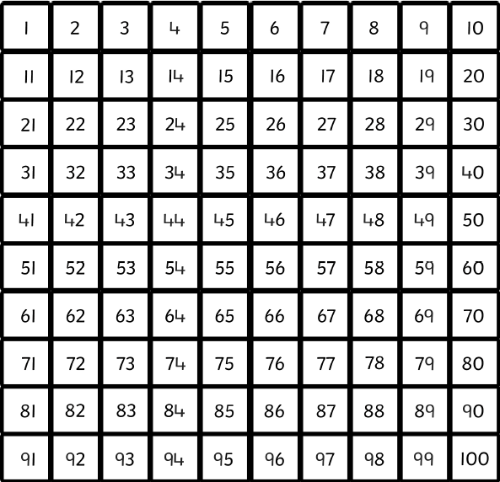
Let’s practice counting in multiples of 10!
10
20
30
40
50
60
70
80
90
100

Slide 3
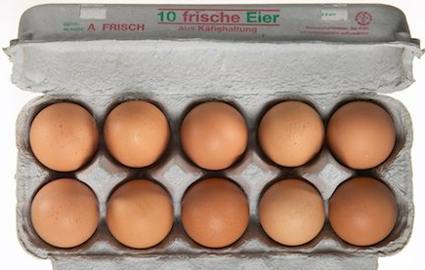
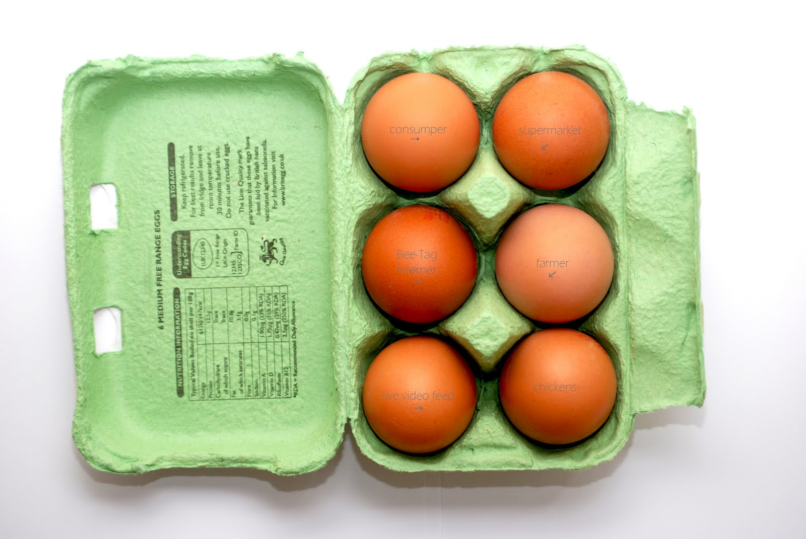
We are going to practice counting objects up to 100.
How many eggs altogether?
First, count the big groups of 10.
Put this number in your head.
Then, count on the ones.
10
20
30
40
50
51 52 53 54 55

Slide 4
How many eggs altogether?
First, count the big groups of 10.
Put this number in your head.
Then, count on the ones.
10
20
30
40
50
60
70
80
81 82

Slide 5


How many spots altogether?
Use the hundred square to help you count on.
First, count the big groups of 10.
Then, count on the ones.
Put this number in your head.
10
20
30
40
50
60
61 62 63 64

Slide 6

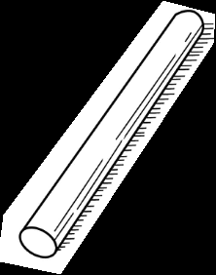
How many sticks altogether?
Use the hundred square to help you count on.
First, count the big groups of 10.
Then, count on the ones.
Put this number in your head.
10
20
30
40
50
60
61 62 63

Slide 7
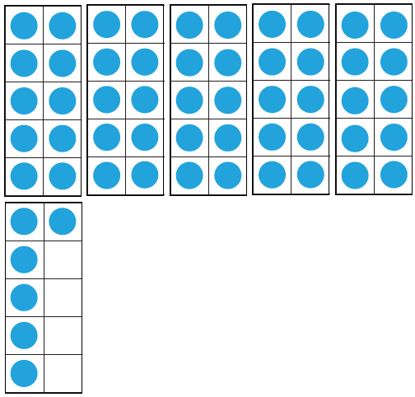
How many counters altogether on the ten frames?
Remember a full ten frame is 10! We don’t have to count every one!
20
40
10
30
50
First, count the big groups of 10.
Then, count on the ones.
Put this number in your head.
51 52 53 54 55 56

