Slide 1
Year 1- FRACTIONS
Session 4 – Exploring the idea of quarters

Slide 2
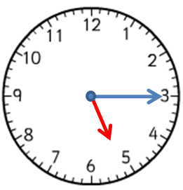
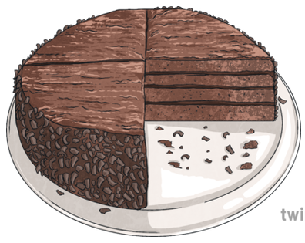
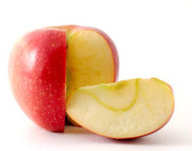
Where have you heard the word quarter?
Can you think of your own ideas as well?

Slide 3
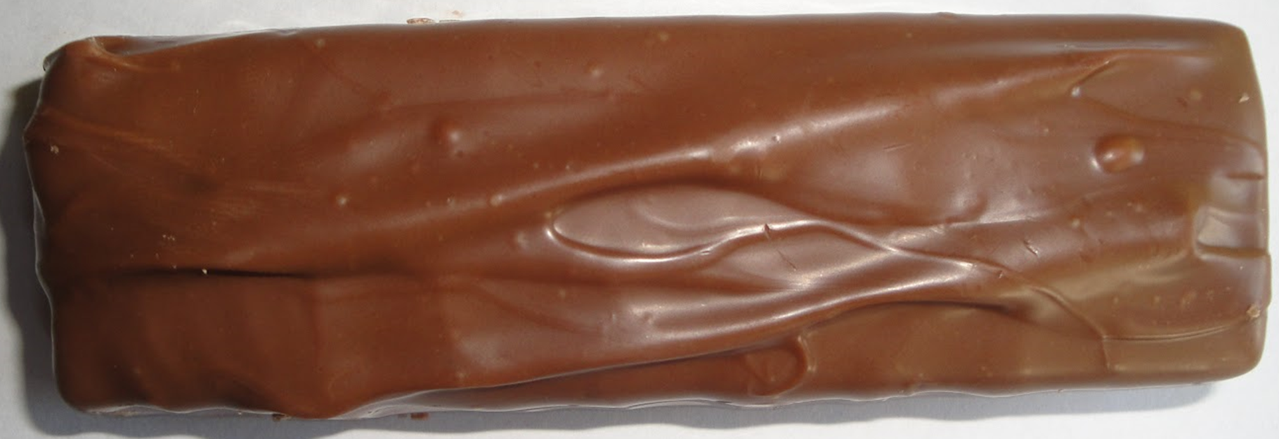
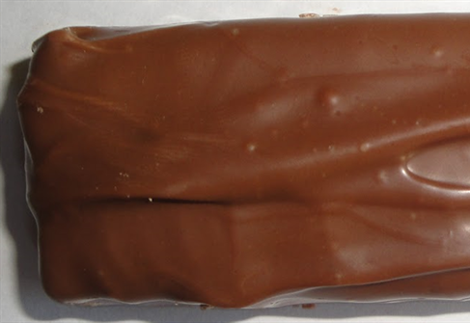
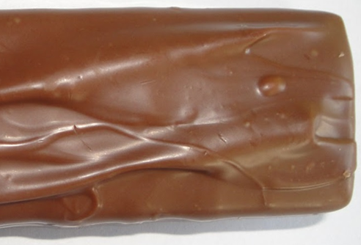
I have a whole chocolate bar.
I want to share it fairly between my 4 teddy bears.
Whole means all of the object.
Half means 2 parts that are exactly the same.
Quarters means 4 parts that are exactly the same.

Slide 4
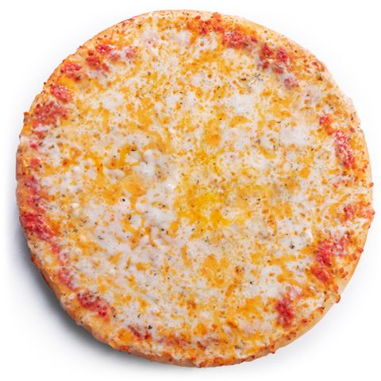
I have a whole pizza.
I want to share it fairly between me, Mum, Dad and my brother.
I need to cut it into quarters.
One quarter for me.
One quarter for Dad.
One quarter for my brother.
One quarter for Mum.
Whole means all of the object.
Quarters means 4 parts that are exactly the same.
We can also draw lines to show quarters.

Slide 5
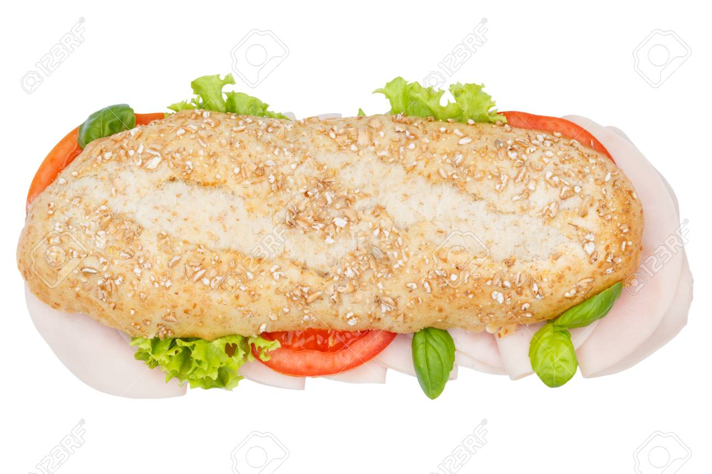
I have a whole baguette.
I want to share it fairly between me and my 3 friends.
I need to cut it into quarters because I need 4 pieces.
One quarter for me.
One quarter for my friend.
One quarter for my friend.
One quarter for my friend.
Whole means all of the object.
Quarters means 4 parts that are exactly the same.
We can also draw lines to show quarters.

Slide 6
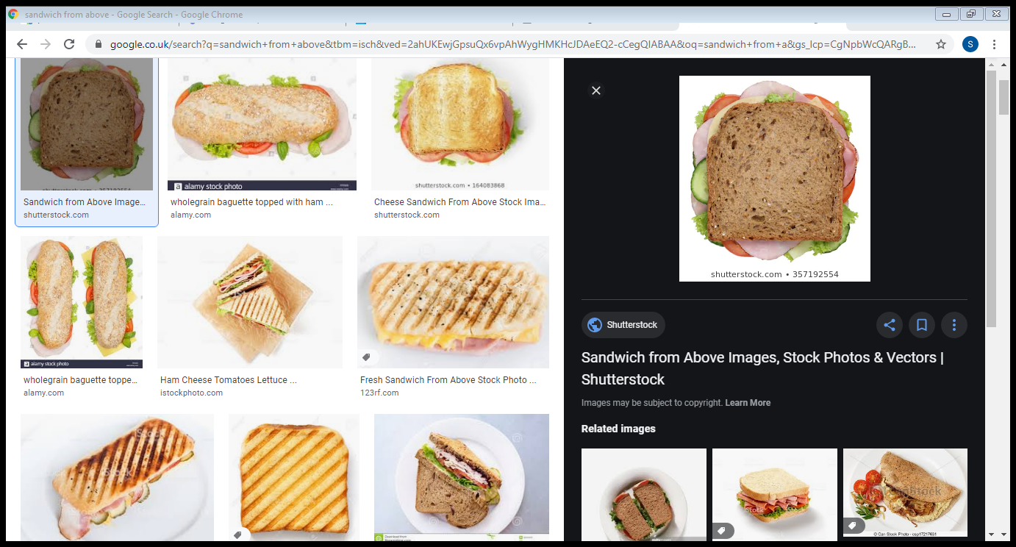
I have a whole sandwich.
I want to share it fairly between me and my 3 toys.
I need to cut it into quarters because I need 4 pieces.
Put your thinking caps on…
Could I cut the sandwich into quarters in a different way?
Tell your adult what you think!
One quarter for me.
One quarter for my toy.
One quarter for my toy.
One quarter for my toy.
Whole means all of the object.
Quarters means 4 parts that are exactly the same.
We can also draw lines to show quarters.

Slide 7
Maybe you were thinking of one of these ways…
Maybe you were thinking of another way.
As long as there are 4 parts that are exactly the same then it is quarters!
Some objects can be cut in to quarters in lots of different ways.
Other objects can only be cut in to quarters in one way.

