Slide 1
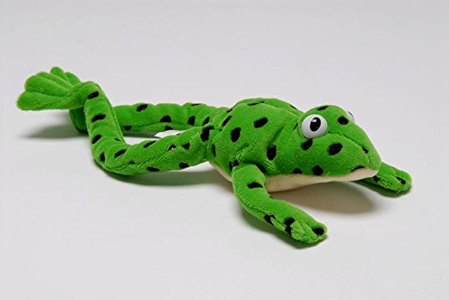
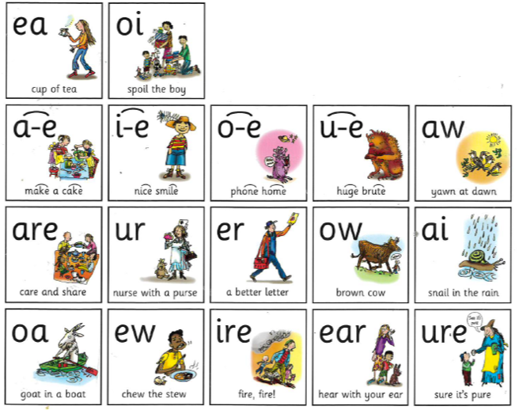
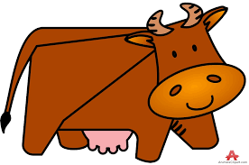
Year 1 Phonics – set 3 sound ‘ow’
Our sound of the day…
What do you notice about this sound and the one we learned yesterday?
Ow
Brown cow

Slide 2
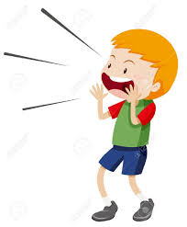
Yesterday we learned the sound ‘ou’
Today we are learning the sound ‘ow’
These two sounds make the same sound when we say them.
ow
ou
cow allow
brown frown
owl clown
shout proud
sound out
count round

Slide 3
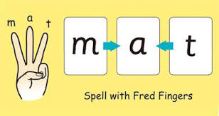
Can you Fred talk the words?
cow allow
brown frown
owl clown
Can you use your Fred fingers for three of the words and write them down without looking?

Slide 4
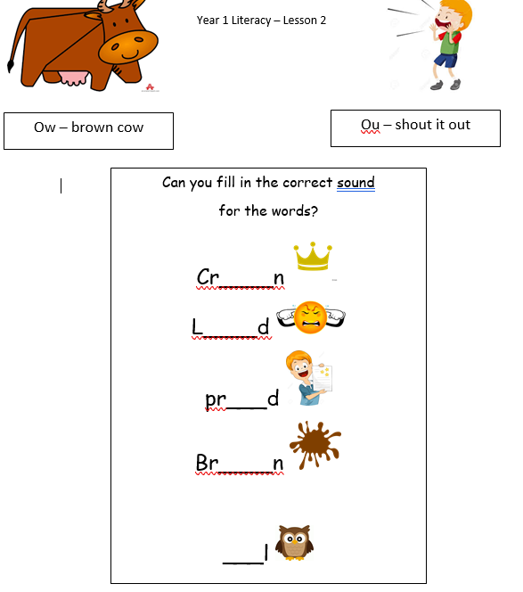
Activity

Slide 5
Super speedy sounds – How many set 3 sounds do you know?

