Slide 1
Year 1- FRACTIONS
Session 6 – Finding a quarter of an amount

Slide 2
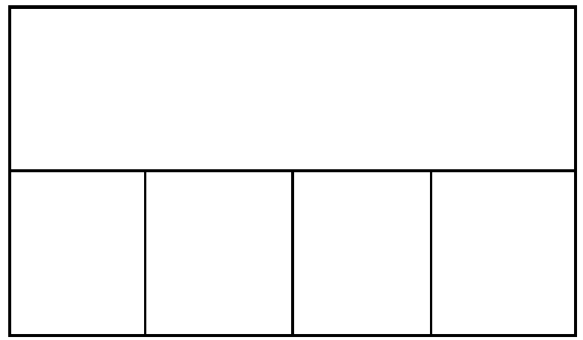

I have 12 pears.
I give a quarter of them to my friend. How many do I give to my friend?
This is a bar model.
It is another way to group objects.
Whole means the total number of objects.
My friend will have 3 apples.
I know because 12 shared fairly between 4 groups equals 3.
We need to share the total number between 4 parts to find a quarter.
Quarter means
4 parts that are exactly the same.

Slide 3
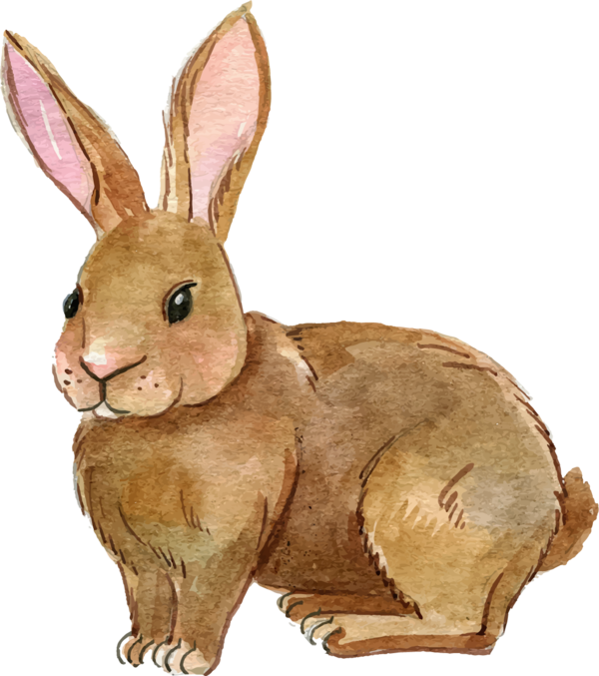
There are 8 rabbits in the field.
One quarter of the rabbits hop away. How many rabbits hop away?
Whole means the total number of objects.
2 rabbits hop away.
I know because 8 shared fairly between 4 groups equals 2.
We need to share the total number between 4 parts to find a quarter.
Quarter means
4 parts that are exactly the same.

Slide 4
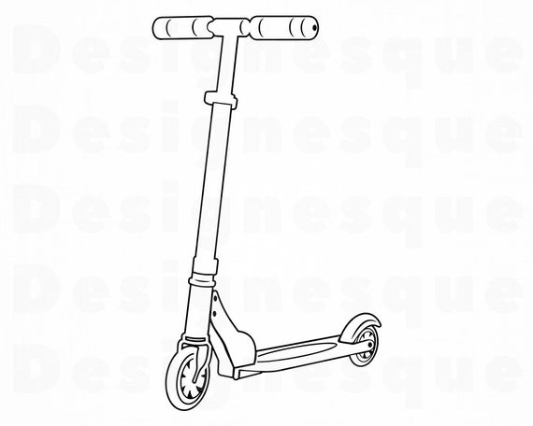
There are 4 scooters in the playground.
A quarter of the scooters are red. How many scooters are red?
Whole means the total number of objects.
1 scooter is red.
I know because 4 shared fairly between 4 groups equals 1.
We need to share the total number between 4 parts to find a quarter.
Quarter means
4 parts that are exactly the same.

Slide 5
There are 16 children on the field. One quarter of the children run to the Summer House. How many children run to the Summer House?
Whole means the total number of objects.
16
4 children run to the Summer House.
I know because 16 shared fairly between 4 groups equals 4.
Quarter means
4 parts that are exactly the same.
We can draw a circle in one part at a time.
We need to count to 16 at the same time as we draw.

Slide 6
There are 24 cars in the car park. One quarter of the cars drive away. How many cars drive away?
Whole means the total number of objects.
6 cars drive away.
I know because 24 shared fairly between 4 groups equals 6.
24
Quarter means
4 parts that are exactly the same.
We can draw a circle in one part at a time.
We need to count to 24 at the same time as we draw.

Slide 7


Lee says… “I can find one quarter of 8 and 9.”
Do you agree?
Can you draw the circles to prove it?
I disagree with Lee. You can only find one quarter of 8. One quarter of 8 is 2. When you share 9 between 4 parts there is one left over.
8
9

