Slide 1
Thursday 14th May 2020
English –Writing.
Notes:
© Copyright Showeet.com – Free PowerPoint Templates. Photo credits: Pixabay (CC0 Public DomainFree for commercial use No attribution required)

Slide 2
Yesterday, we read a set of instructions for making pancakes.
Today, we are going to write our own instructions to make a food of your choice.
Notes:
© Copyright Showeet.com – Free PowerPoint Templates

Slide 3
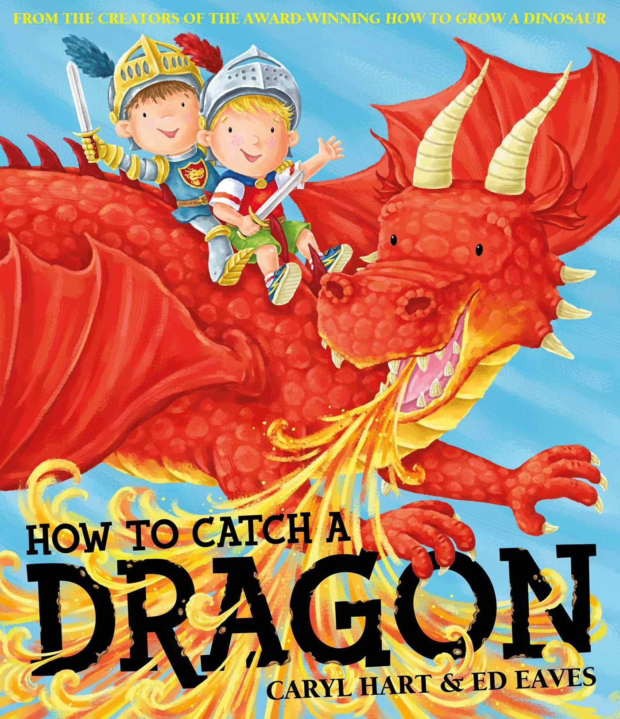
What do instructions need?
Instructions need a clear title that tells you what the instructions are about.
Good examples:
How to grow a bean plant.
How to catch a dragon.
Yesterday, our recipe for pancakes had a very clear title.

Slide 4
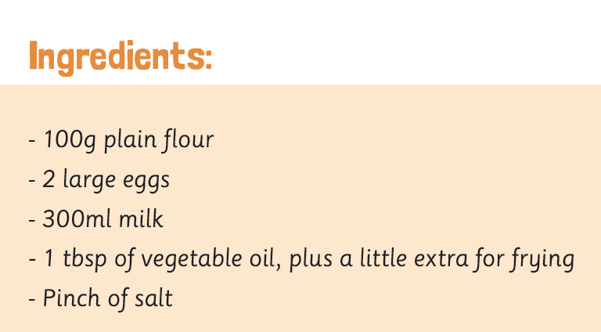
What do instructions need?
Instructions need a list to tell you what you need to complete the project.
Here is yesterday’s example.
They might be called: Equipment list You will need Ingredients
They usually use bullet points.

Slide 5
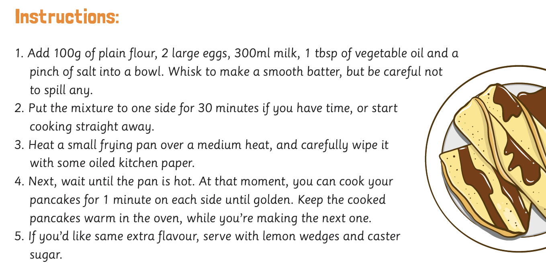
What do instructions need?
Good instructions have numbered steps to make them easy to follow.
Like this:

Slide 6
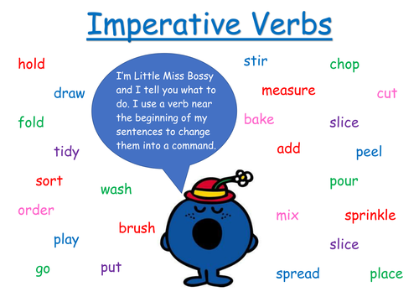
What do instructions need?
Instructions use bossy verbs to tell you what to do.
All these bossy words mean that instructions have lots of command sentences.

Slide 7
What do good instructions need to have? Can you remember?
Clear title Equipment list Numbered steps Bossy verbs

Slide 8
Now, thinking carefully about what we have learnt, You are going to write your own recipe instructions.
You can choose to write a recipe for whatever food item you like!
Maybe you want to stick to breakfast and tell me how to make porridge?
Maybe you have been doing some home baking and want to tell me how to make cakes or biscuits?
Maybe you took the challenge to make curry this week and want to tell me how you did that?

