Slide 1

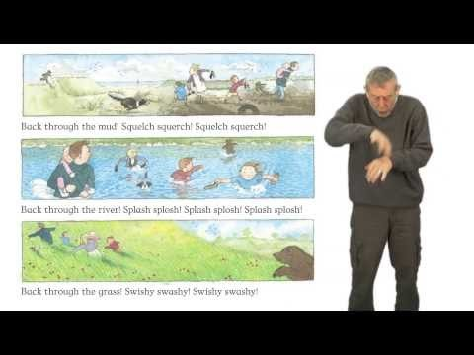
Day 2 – I am learning to make a story map
Listen to the story twice - begin to join in with the words and actions.
https://www.youtube.com/watch?v=0gyI6ykDwds

Slide 2
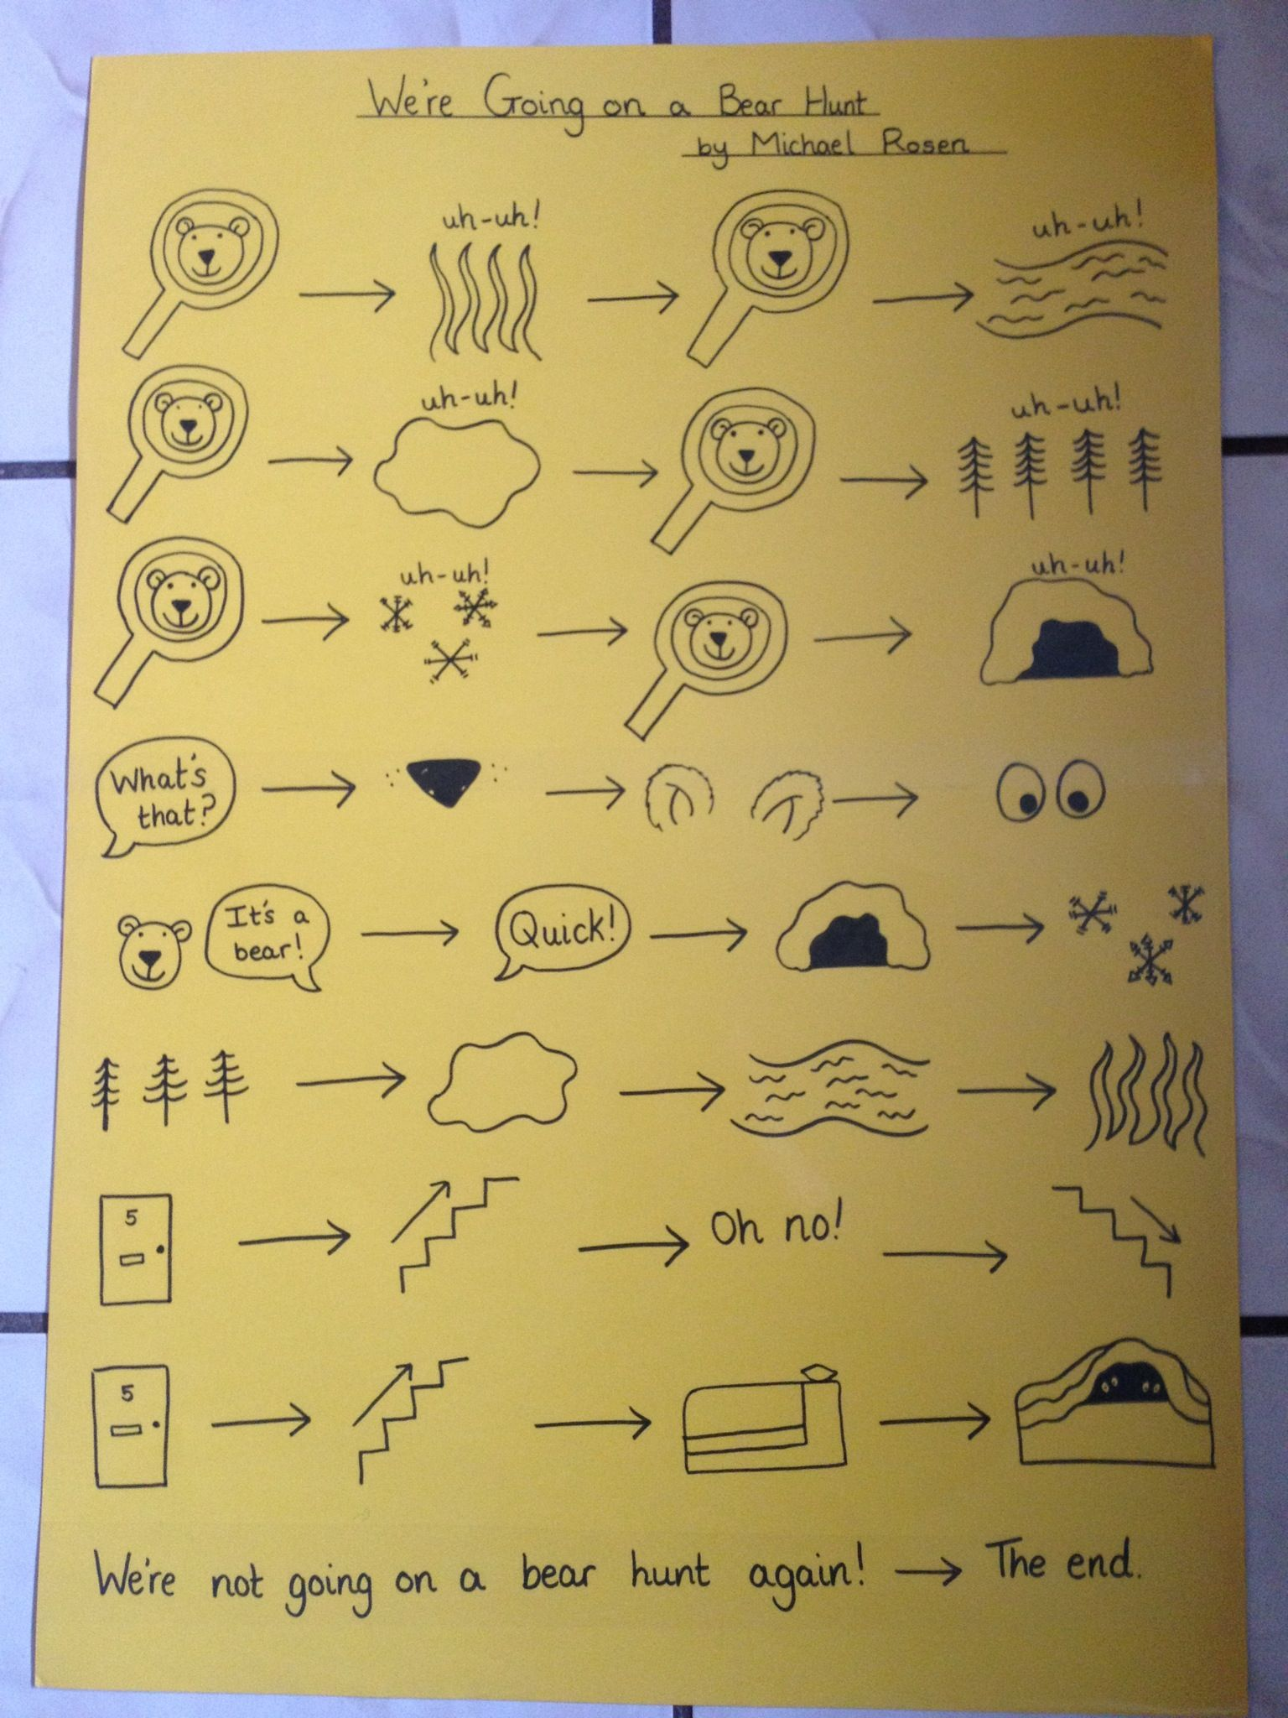
Can you remember the things that the family came across on their bear hunt?
You are going to create a story map to re tell the story.
long
wavy
deep
cold
Once you have finished, can you re-tell the story out loud to your grown up using your story map to help you?
Can you add some key words to go with each picture?

