Slide 1

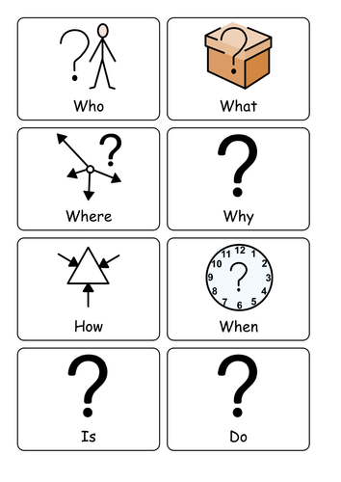
Today I am learning to use a question mark.
Questions always start with…
When do we use a question mark in our writing?

Slide 2
Some example questions…
How did you get to school today?
What did you have for lunch?
What time is it?
Do you like my picture?
When are we going to the park?
Can you practise your question mark?

Slide 3
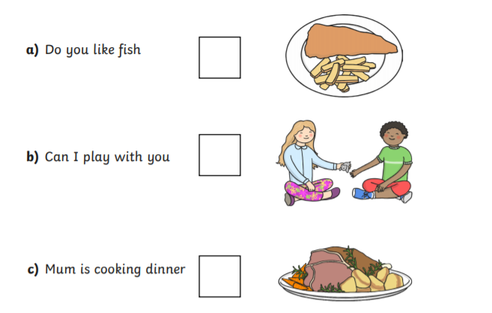
Do these sentences need a full stop or a question mark?

Slide 4
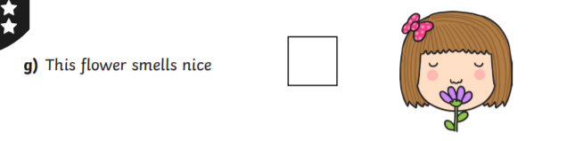
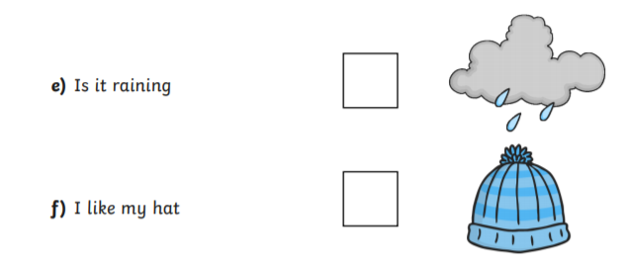
Do these sentences need a full stop or a question mark?

Slide 5
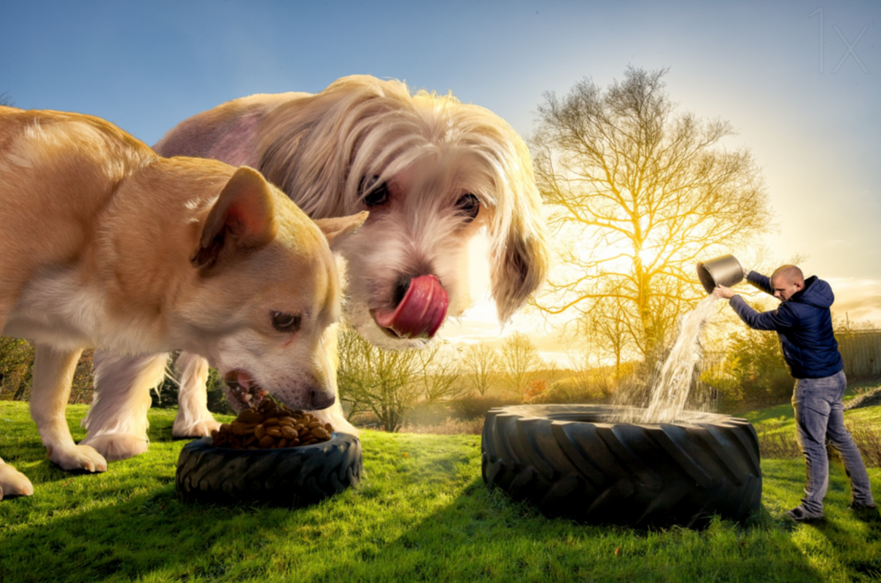
Have a look at the picture… What do you notice?
What questions could you ask the dogs or the person?
Can you write your questions down using the correct punctuation?

