Slide 1
Tuesday 12th May 2020
Grammar

Slide 2
Recap – what is a noun?
A noun is a word used to identify a person, thing or a place.
Noun examples:
Chair
Table
Kitchen
Flower
Apple

Slide 3
Singular and Plural
Singular noun = refers only to one
e.g. one table
one girl
one doctor
Plural nouns = refers to more than one
e.g. two tables
lots of girls
the doctors

Slide 4
Rules to spell plurals
Rule number one:
Add an ‘s’
This is the most common and straight forward rule to make a word plural.
e.g. bike bikes
kitchen kitchens
Can you write the plural of: cat?
dog?
cup?

Slide 5
Recap – vowels and consonants
Vowels A E I O U
Consonants B C D F G H J K L M
N P Q R S T V W X Y Z

Slide 6
Words ending in ‘y’
Rule number two:
If there is a consonant before the y, change the y to i before adding es.
e.g. lady ladies
baby babies
If there is a vowel before the y, just add s.
e.g. toy toys
day days
Can you write the plural of: story?
lorry?
boy?

Slide 7
Words ending in x, sh, or ch or s
Rule number 3:
For words ending in x, ch, sh or s add es
e.g. church churches
fox foxes
bush bushes
Can you write the plural of: bench?
box?
eyelash?

Slide 8
There are other patterns for plurals and even some words that don’t fit the pattern at all. In Year 2, these are the 2 main rules we need to know

Slide 9
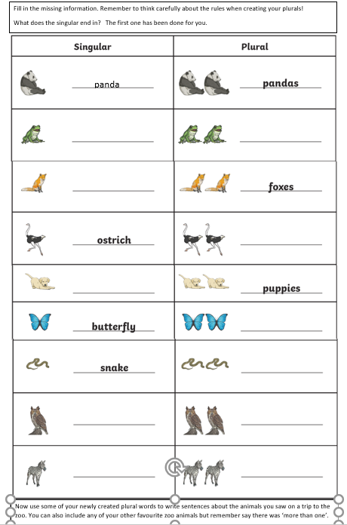
Use the sheet for today to complete this activity. Your sheet should look like this
Task 1: Write the singular or plural noun for the animals using the rules we have practised today.
Task 2: Now use some of your newly created plural words to write sentences about the animals you saw on a trip to the zoo. You can also include any of your other favourite zoo animals but remember say there was ‘more than one’.
Notes:
© Copyright Showeet.com – Free PowerPoint Templates

