Slide 1
I am learning to write in the past tense
When you see an -ed at the end of a verb, it means that it happened in the past. Let’s say these examples:
When writing in the past tense, verbs (doing words) need the –ed suffix. For example: jump would become jumped, walk would become walked.

Slide 2
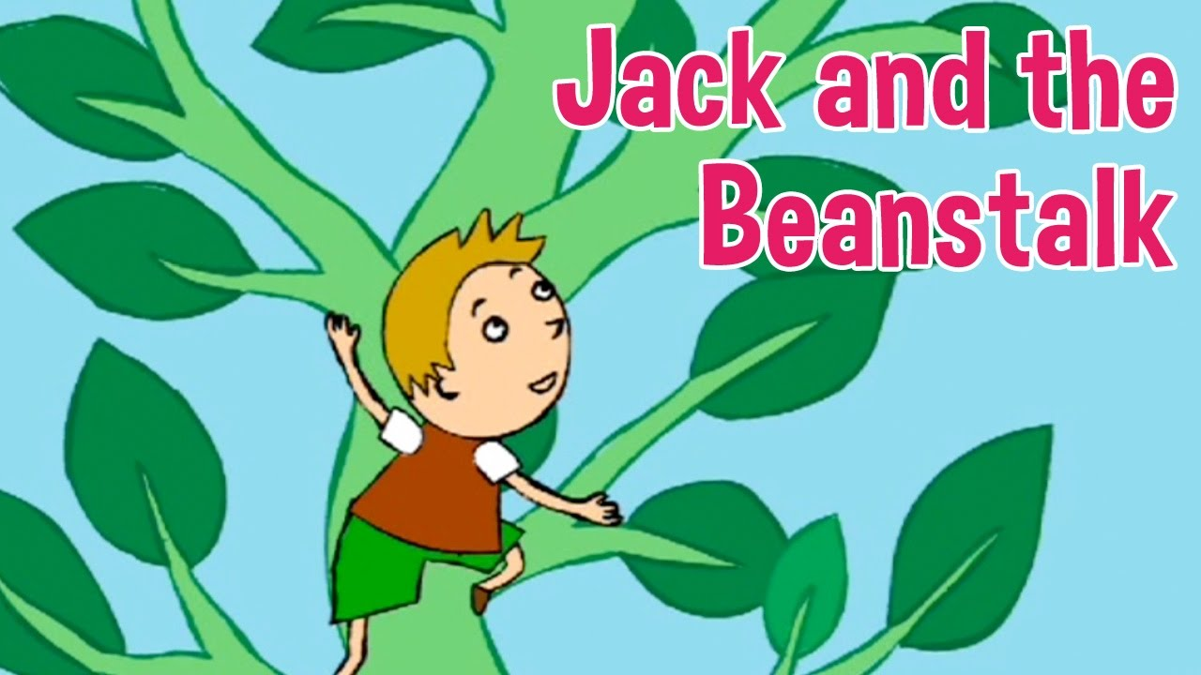
Yesterday you read a story about a boy who grew a magic beanstalk.
Today you are going to write your own story in the past tense about discovering a giant beanstalk!
Remember when writing in the past tense we use the –ed suffix.

Slide 3
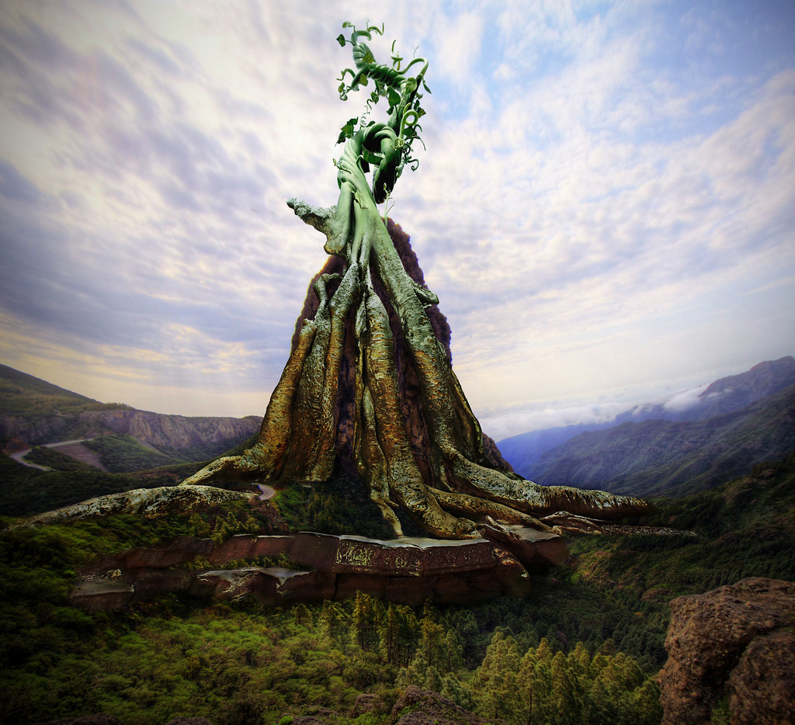
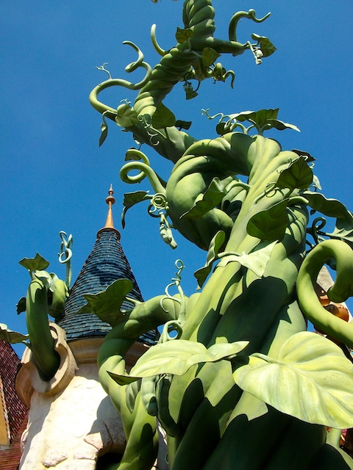
Imagine you have just walked into your garden or the park. You see a huge beanstalk growing from the ground!
How did you feel when you saw the beanstalk?
What did you do next?
Who did you tell about the beanstalk?
Was it a magic beanstalk? Did it have powers?
How is your story going to end?

Slide 4
Example beginning
As I woke up from my long sleep, I strolled into my back garden and saw an enormous, bright green beanstalk growing from the ground, I was very shocked! I wondered where it may had come from and jumped up with excitement as I had never seen a plant so big.

