Slide 1
Year 1- DIVISION
Session 3 – Grouping by drawing pictures

Slide 2
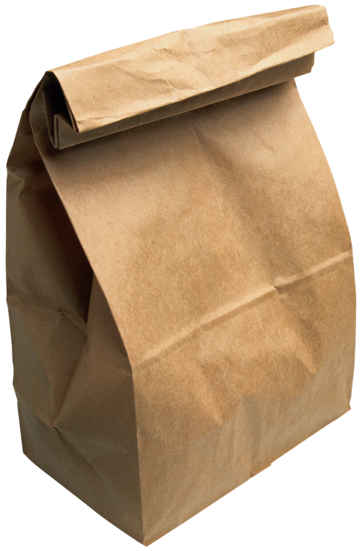
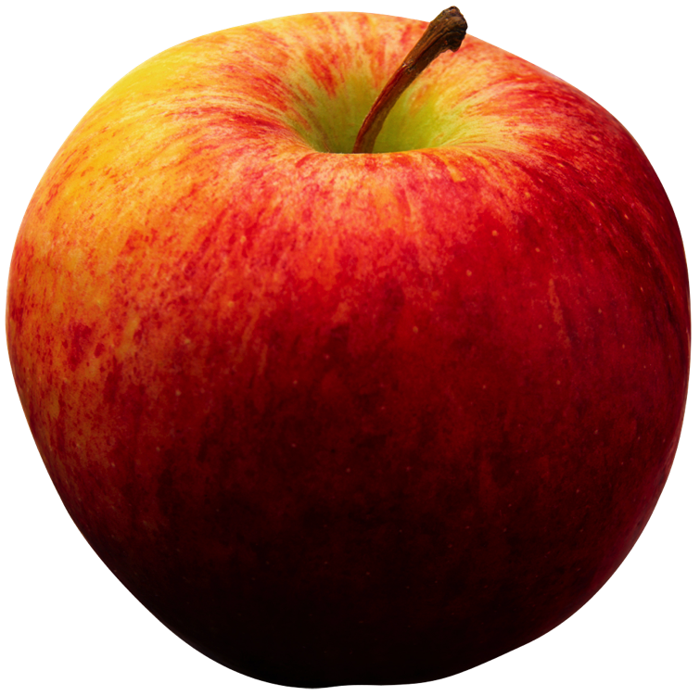
There are 9 apples. I can put 3 in each bag. How many bags do we need?
?

Slide 3
There are 9 apples. I can put 3 in each bag. How many bags do we need?
First, we need to draw 9.
Next, we need to circle groups of 3.
We need 3 bags because there are 3 groups of 3.
Then, we need to count how many groups of 3 we have circled.
1 2 3

Slide 4
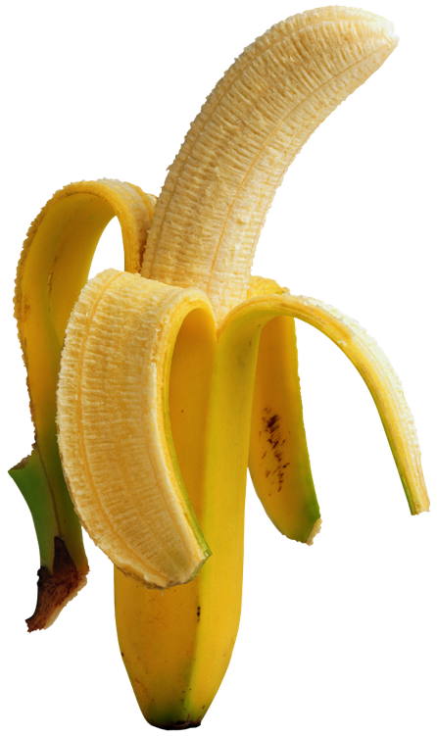
There are 6 bananas. I can put 2 in each bag. How many bags do we need?
?

Slide 5
There are 6 bananas. I can put 2 in each bag. How many bags do we need?
First, we need to draw 6.
Next, we need to circle groups of 2.
We need 3 bags because there are 3 groups of 2.
Then, we need to count how many groups of 2 we have circled.
1 2 3

Slide 6
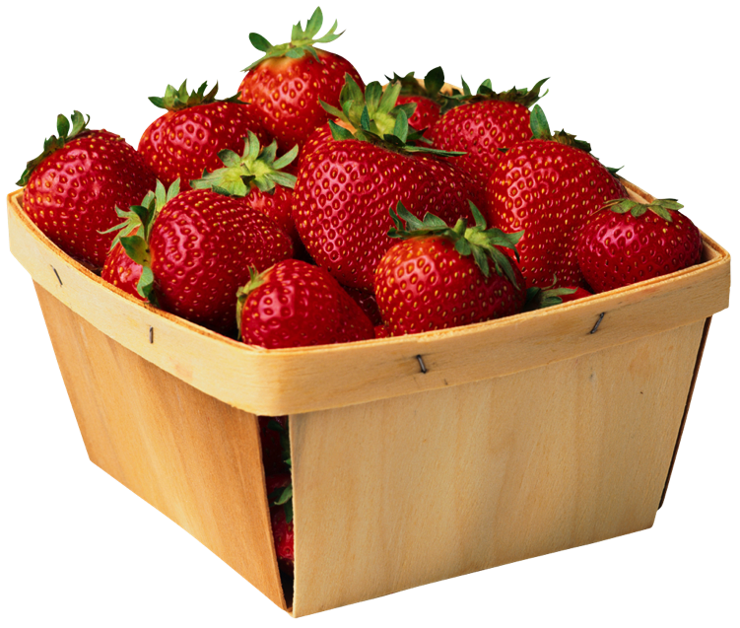
There are 12 strawberries. I put 4 in each basket. How many baskets do we need?

Slide 7
There are 12 strawberries. I put 4 in each basket. How many baskets do we need?
First, we need to draw 12.
Next, we need to circle groups of 4.
We need 3 bags because there are 3 groups of 4.
Then, we need to count how many groups of 4 we have circled.
1 2 3

