Slide 1
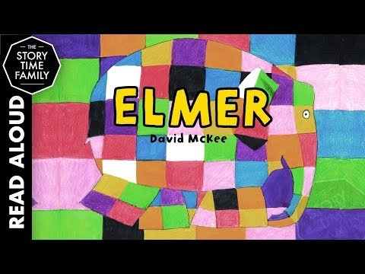
Year 1 Lesson 3 – Comparing two settings.
Listen to the story once more. Questions to discuss:
Do you think there are elephants like Elmer in a real jungle?
How might a real jungle be different to the one in the story?
How might a real jungle be the same as the one in the story?
https://www.youtube.com/watch?v=wdyo4ykh2WA

Slide 2
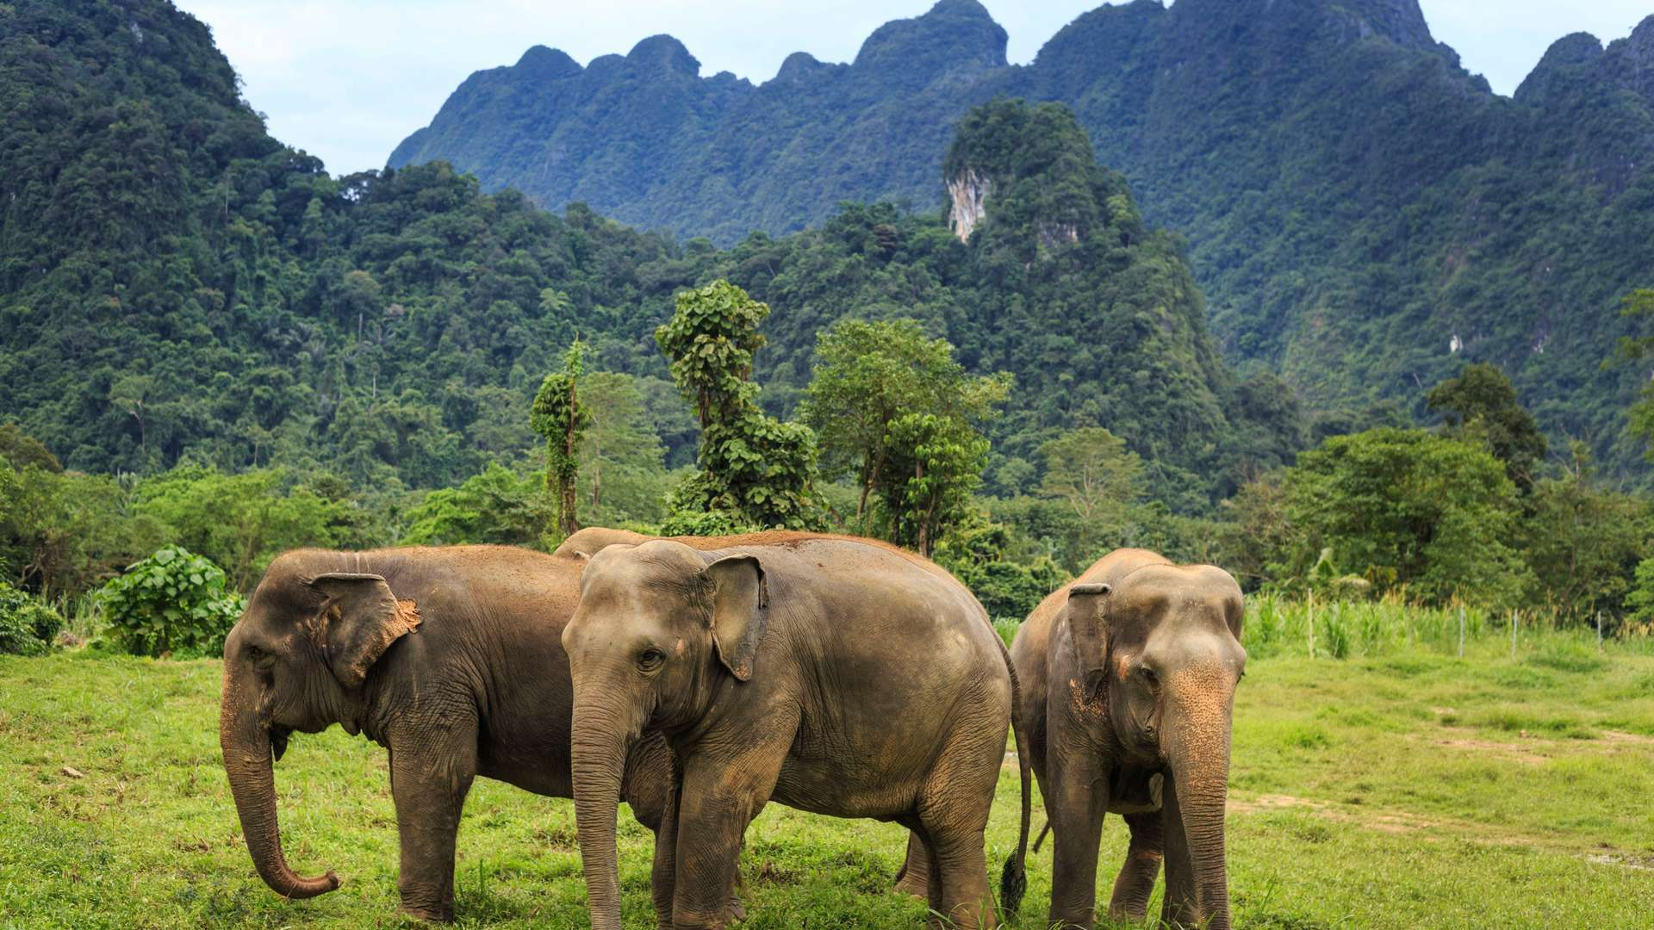
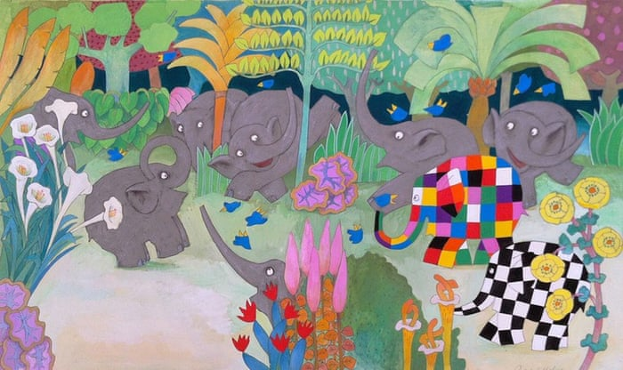
Comparing two settings.
Look at the two settings below. Use the language of comparison to compare and discuss the two settings. How are they the same? How are they different? Use the sentence openers:
They are the same because…
They are different because…

Slide 3
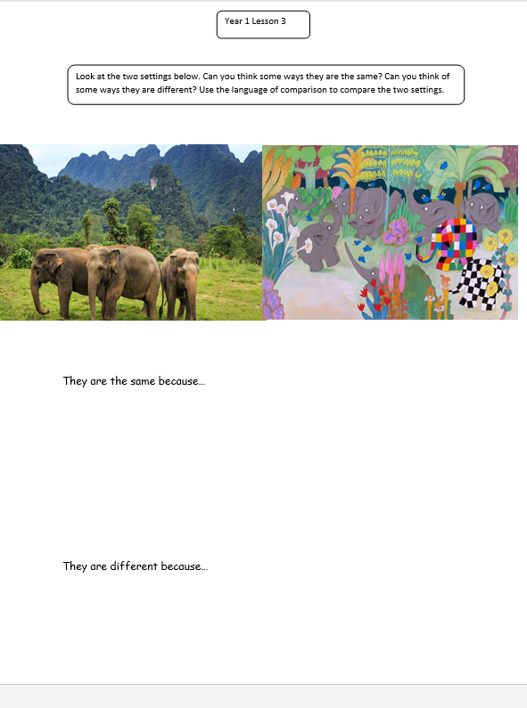
Example:
They are the same because they are both set in the jungle.
They are different because the first setting only has grey elephants but the second has patchwork elephants.
Activity – Use the sheet to compare the two settings.
Use the sentence openers: They are the same because…
They are different because…

