Slide 1
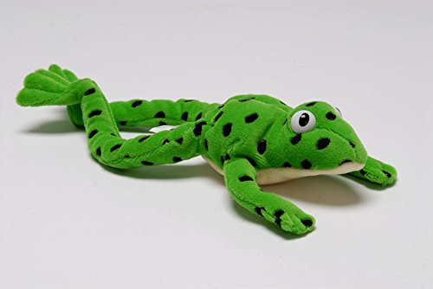
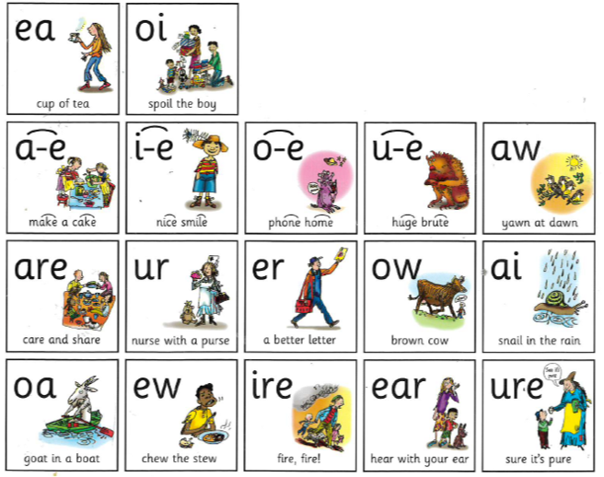
Year 1 Phonics – set 3 sound ‘oi’
Our sound of the day…
aw
yawn at dawn

Slide 2
Follow the video for the first part of the phonics lesson.
Remember to use your Fred fingers!
https://www.youtube.com/watch?v=SyiG1AaTVFk

Slide 3
Can you Fred talk the words?
yawn law
dawn draw
paw straw

Slide 4
Activity – Dictated sentences
Message to parents:
Read the sentences aloud one at a time. Get your children to write the sentence down independently in their green work book.
Mark each sentence together:
Tick for each word spelt correctly and for capital letter and full stop.
Correct any mistakes under each one.
The dog has a big paw.
Can you draw?
I drink from a straw.
I woke up and did a big yawn.
Can you think of your own sentence using the ‘aw’ sound?

Slide 5
Super speedy sounds – How many set 3 sounds do you know?

