Slide 1

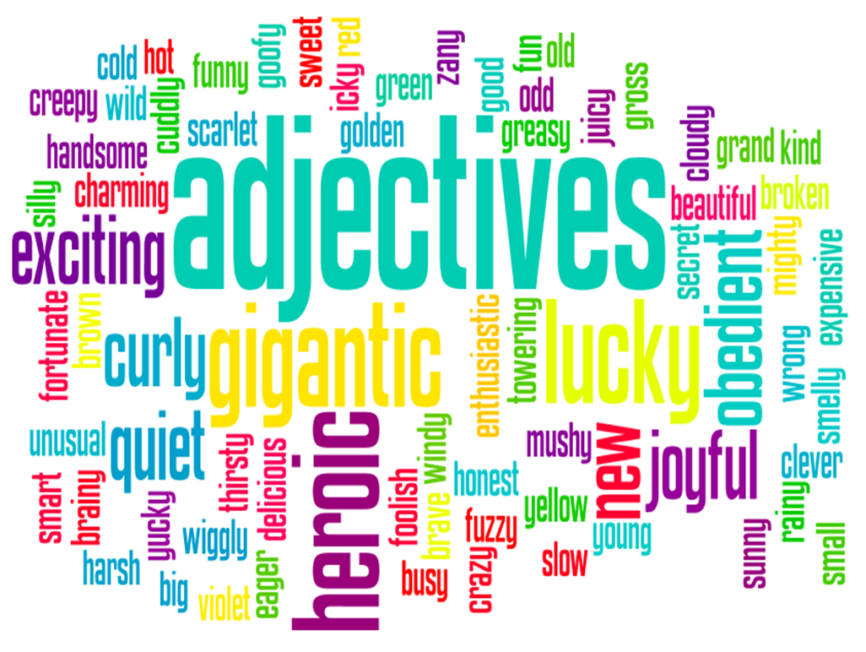
Lesson 3 – I am learning to use adjectives to describe a character or setting
An adjective is…
A word used to describe something.

Slide 2
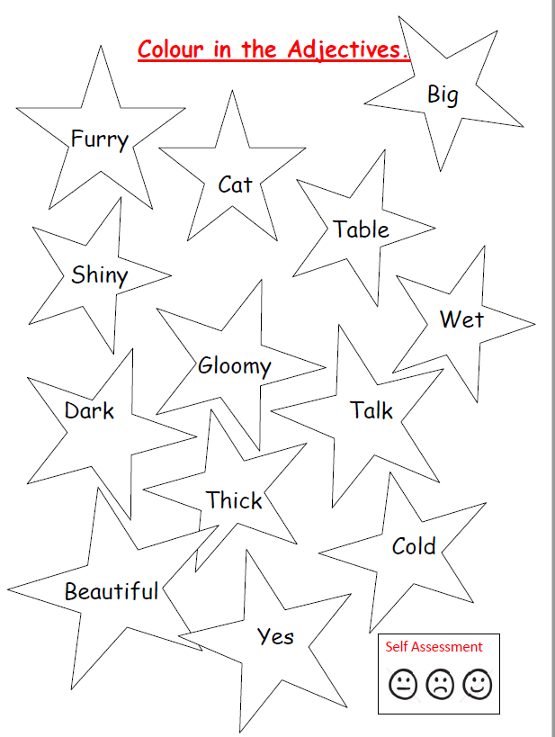
Listen to the story – join in with the words and actions.
https://www.youtube.com/watch?v=0gyI6ykDwds
There are lots of adjectives in this story, can you hear them?
Activity 1 – Which of the words are adjectives? Can you colour in the stars that have the adjectives in? Don’t worry if you can’t print, have a go at writing the adjectives instead.

Slide 3
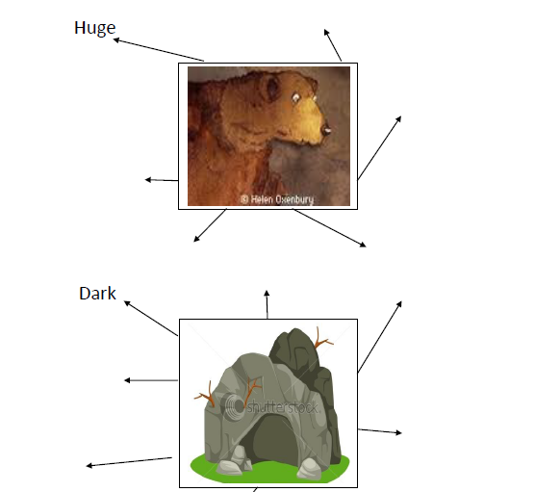
Activity 2- Describe the bear and the cave using adjectives.

