Slide 1
Monday 11^{th May} 2020
English - Spelling
Notes:
© Copyright Showeet.com – Free PowerPoint Templates. Photo credits: Pixabay (CC0 Public DomainFree for commercial use No attribution required)

Slide 2
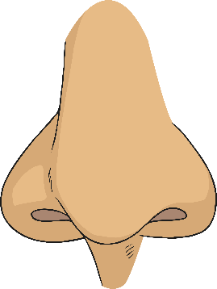
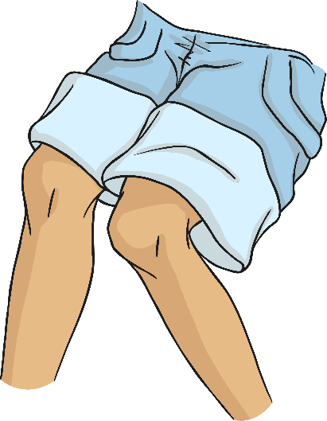
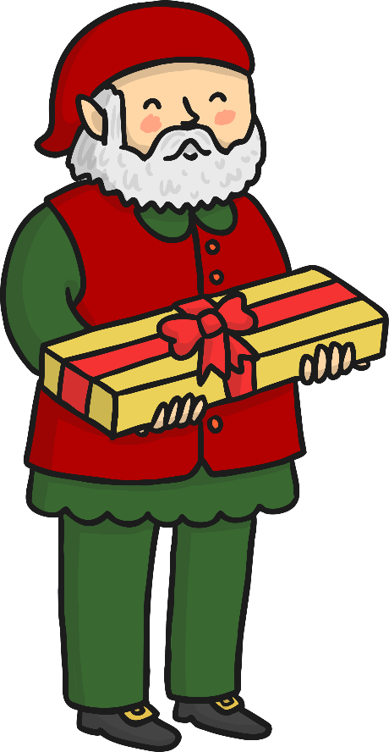
Words that start with the phoneme /n/ are
sometimes spelt with the digraph ‘kn’.
n
ose
kn
ee
Watch out! Very occasionally,
the /n/ sound at the start of a
word can also be spelt with ‘gn’.
gn
ome

Slide 3
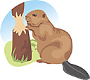
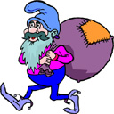
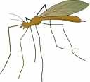

There aren’t many words that use gn.
Here are some examples:
gnome
gnat
gnaw
gnarled

Slide 4
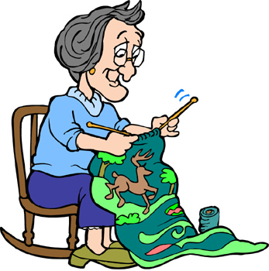
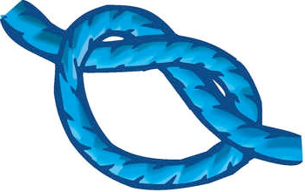
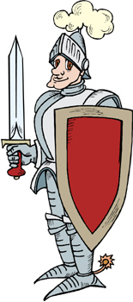

Can you write these words using our spelling pattern - kn?
knee
knit
knot
knight
knock

Slide 5
Spot the gn and kn words in our sentences?
The gnarled tree was very old.
Scouts need to be able to tie knots.
Should we knock or ring the bell?
A gnat is a tiny, annoying bug.
Notes:
© Copyright Showeet.com – Free PowerPoint Templates

Slide 6
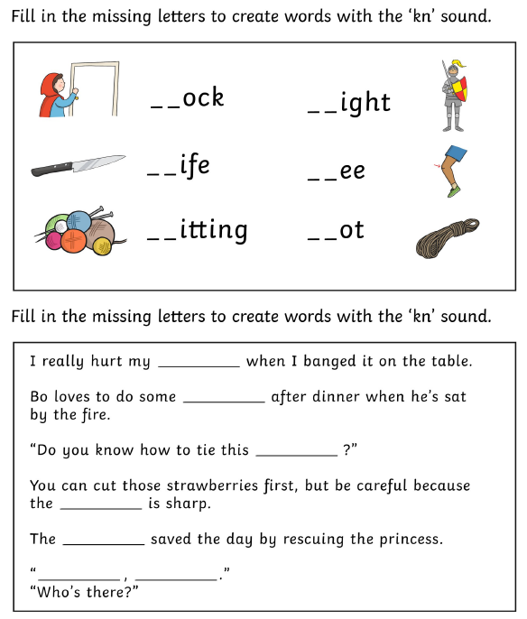
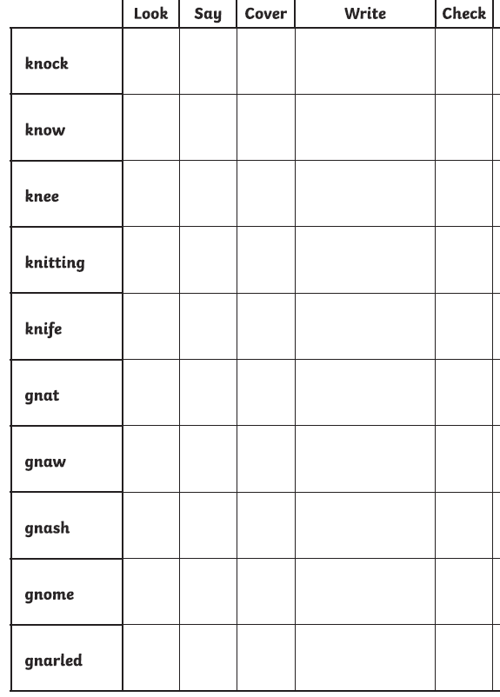
Use the sheet for today to complete this activity. Your sheet should look like this
Task 1 – Complete the missing letters to complete the kn words and then choose the correct one to finish each sentence.
Task 2 Look at the words, say them out loud and the try to write them down without looking!
If you can’t print off the sheet, don’t worry. Just use your finger to track the path on the screen.
Notes:
© Copyright Showeet.com – Free PowerPoint Templates

