Slide 1
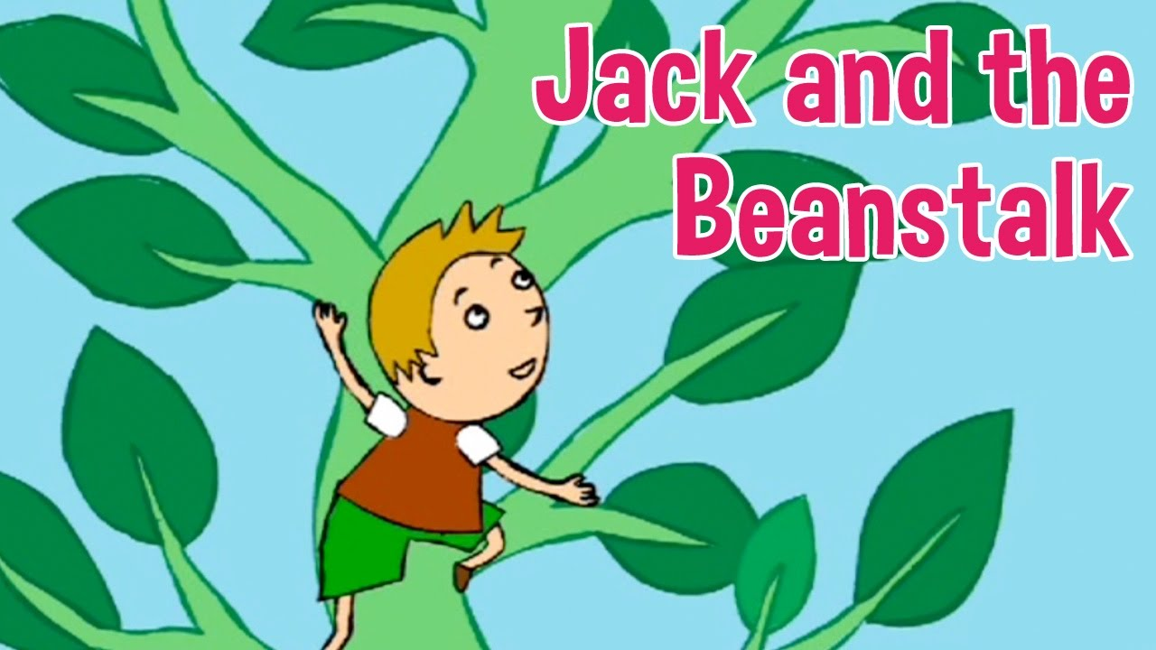
I am learning to retrieve information from a text.
Retrieve:
To find certain information or facts from a text.

Slide 2
Challenge 1: Read the extract from Jack and the beanstalk on the next page or the sheet. Challenge 2: answer the questions by retrieving the information from the text.

Slide 5
Can you find the answers to the questions in the text?
1. What was the boy called?
2. What animal did Jack and his mother have?
3. What did Jack get for the cow?
4. How did Jack’s mother feel when Jack came home?
5. What had grown the next morning?
6. What did the giant do after the harp sang?

