Slide 1
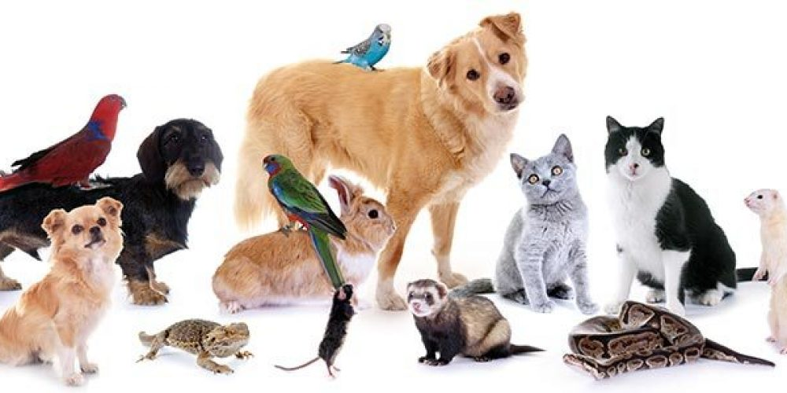
Today I am learning to use adjectives in a poster.
Yesterday you read a story all about Tom wanting a pet.
Today you’re going to create a poster to tell me what the perfect class pet would be!

Slide 2
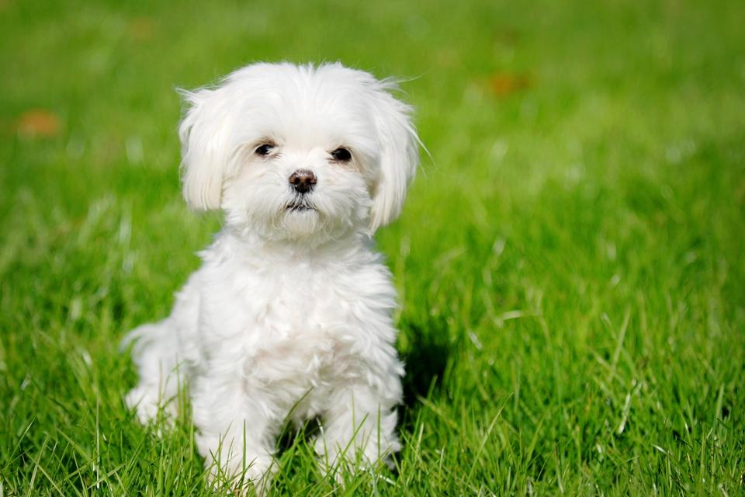
A word used to describe something.
An adjective is…
Can you describe the dog using adjectives?
The dog is ____.
A ___ dog.

Slide 3
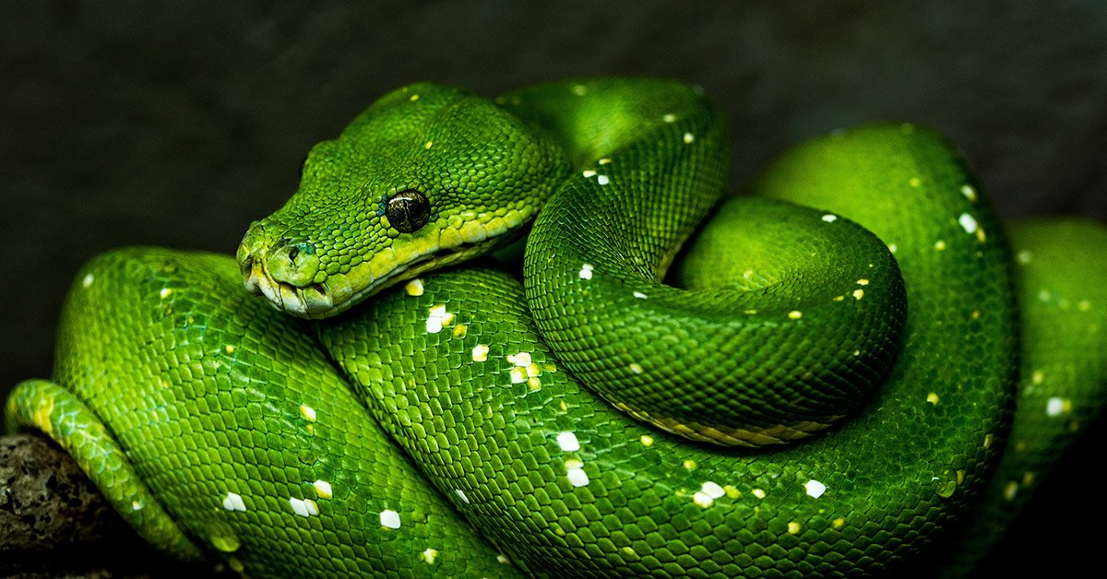
A word used to describe something.
An adjective is…
Can you describe the snake using adjectives?
The snake is ____.
A ___ snake.

Slide 4
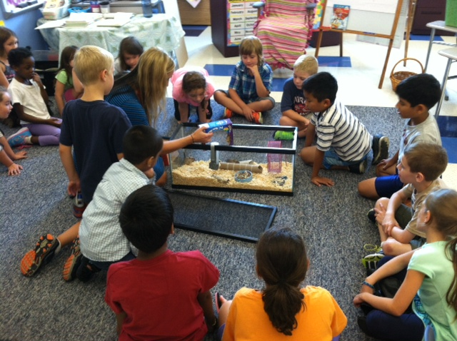
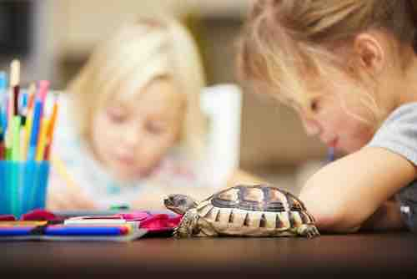
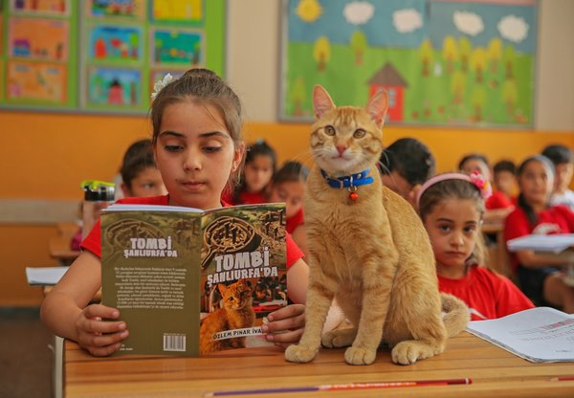
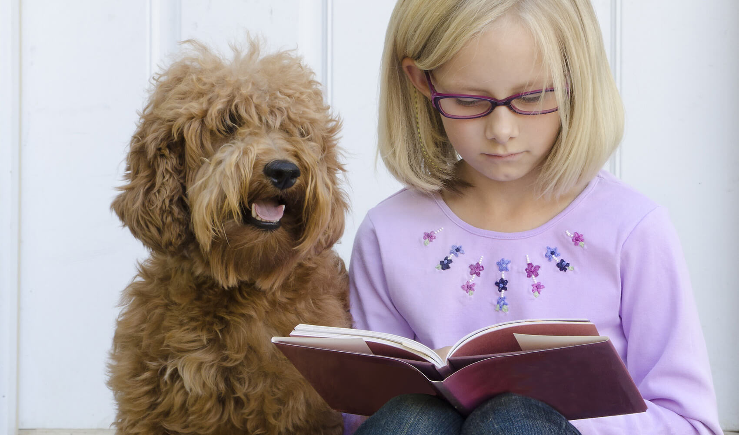
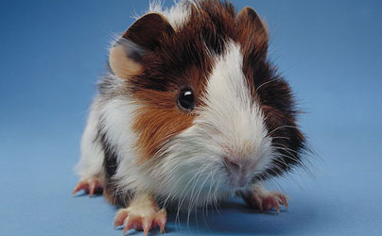
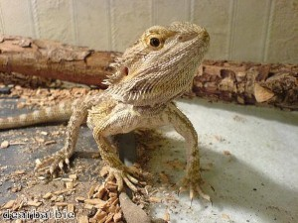
If we could have a classroom pet in Year 1, which pet would you choose?

Slide 5
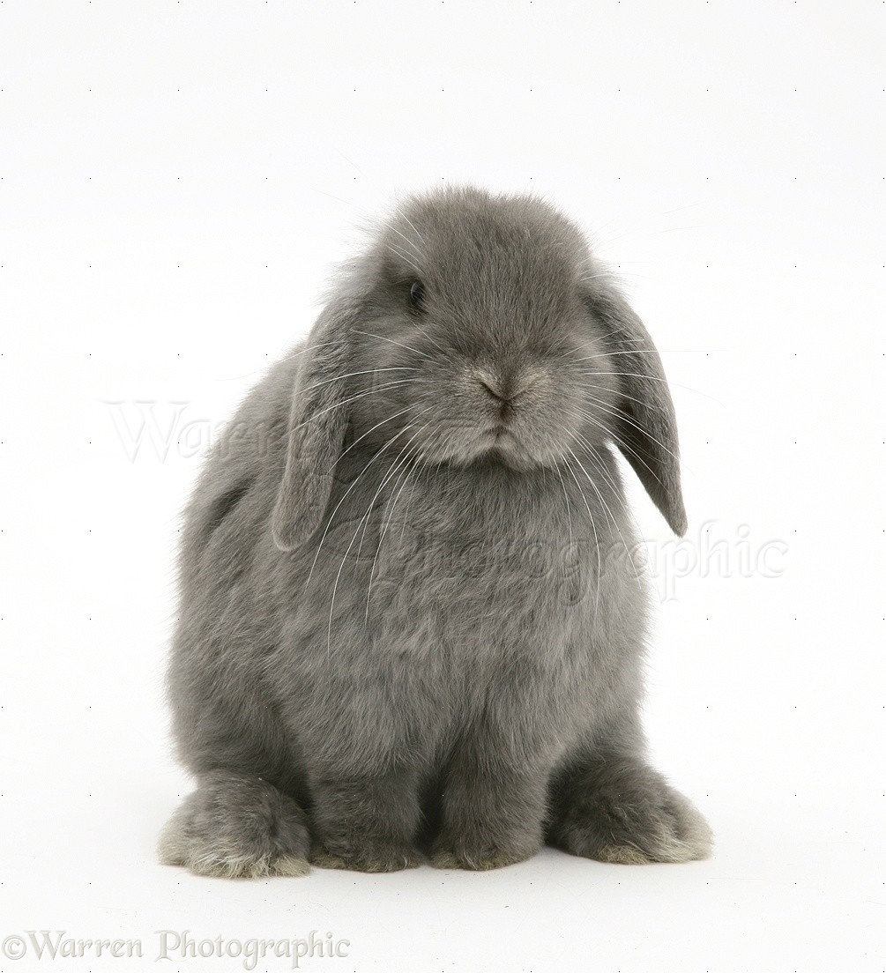
Your poster might look like this…
Our classroom pet: Name: Bugsy
Our pet is a rabbit.
Our class pet is a light grey and very fluffy bunny rabbit. He has huge, floppy ears and white, delicate whiskers.
I chose this pet because ________________________________________.
Miss Cresswell and Mrs Cozens will like this pet because
____________________________________________________________.
Year 1 Classroom Pet
Draw a picture here!
Remember a capital letter for your pet’s name.
Make sure to get those adjectives into this part!
You could draw a picture of our new pet in the classroom!

