Slide 1
Year 1- FRACTIONS
Session 1 – Exploring the idea of half

Slide 2
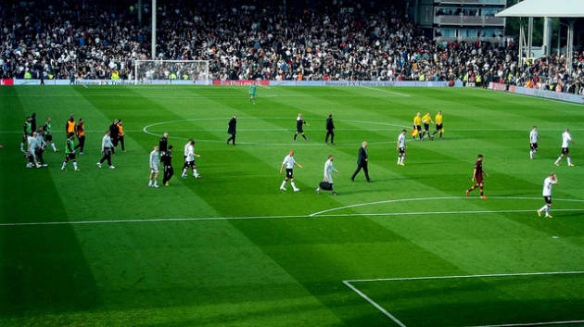
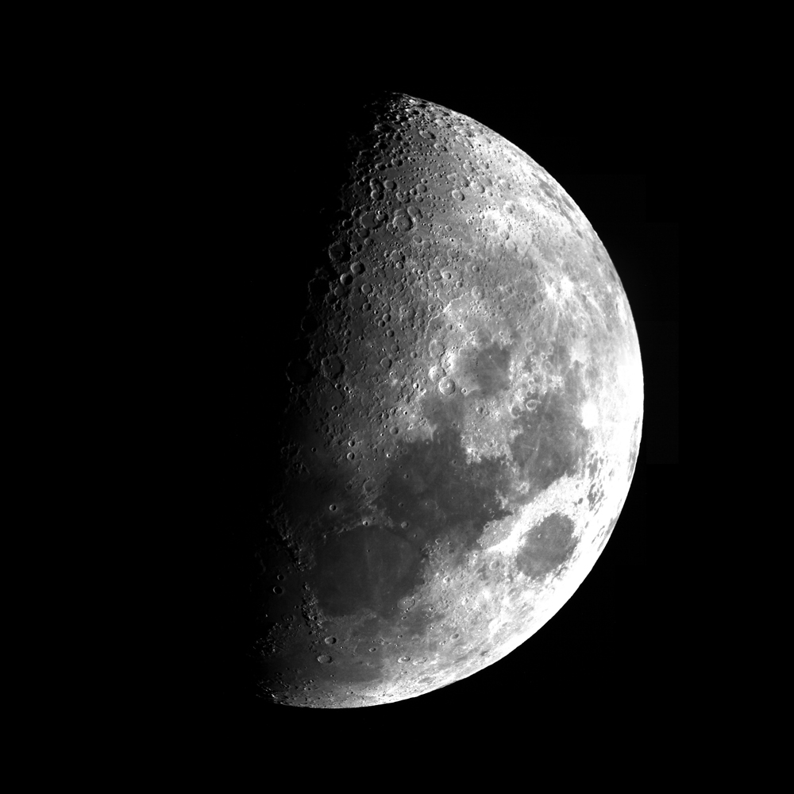
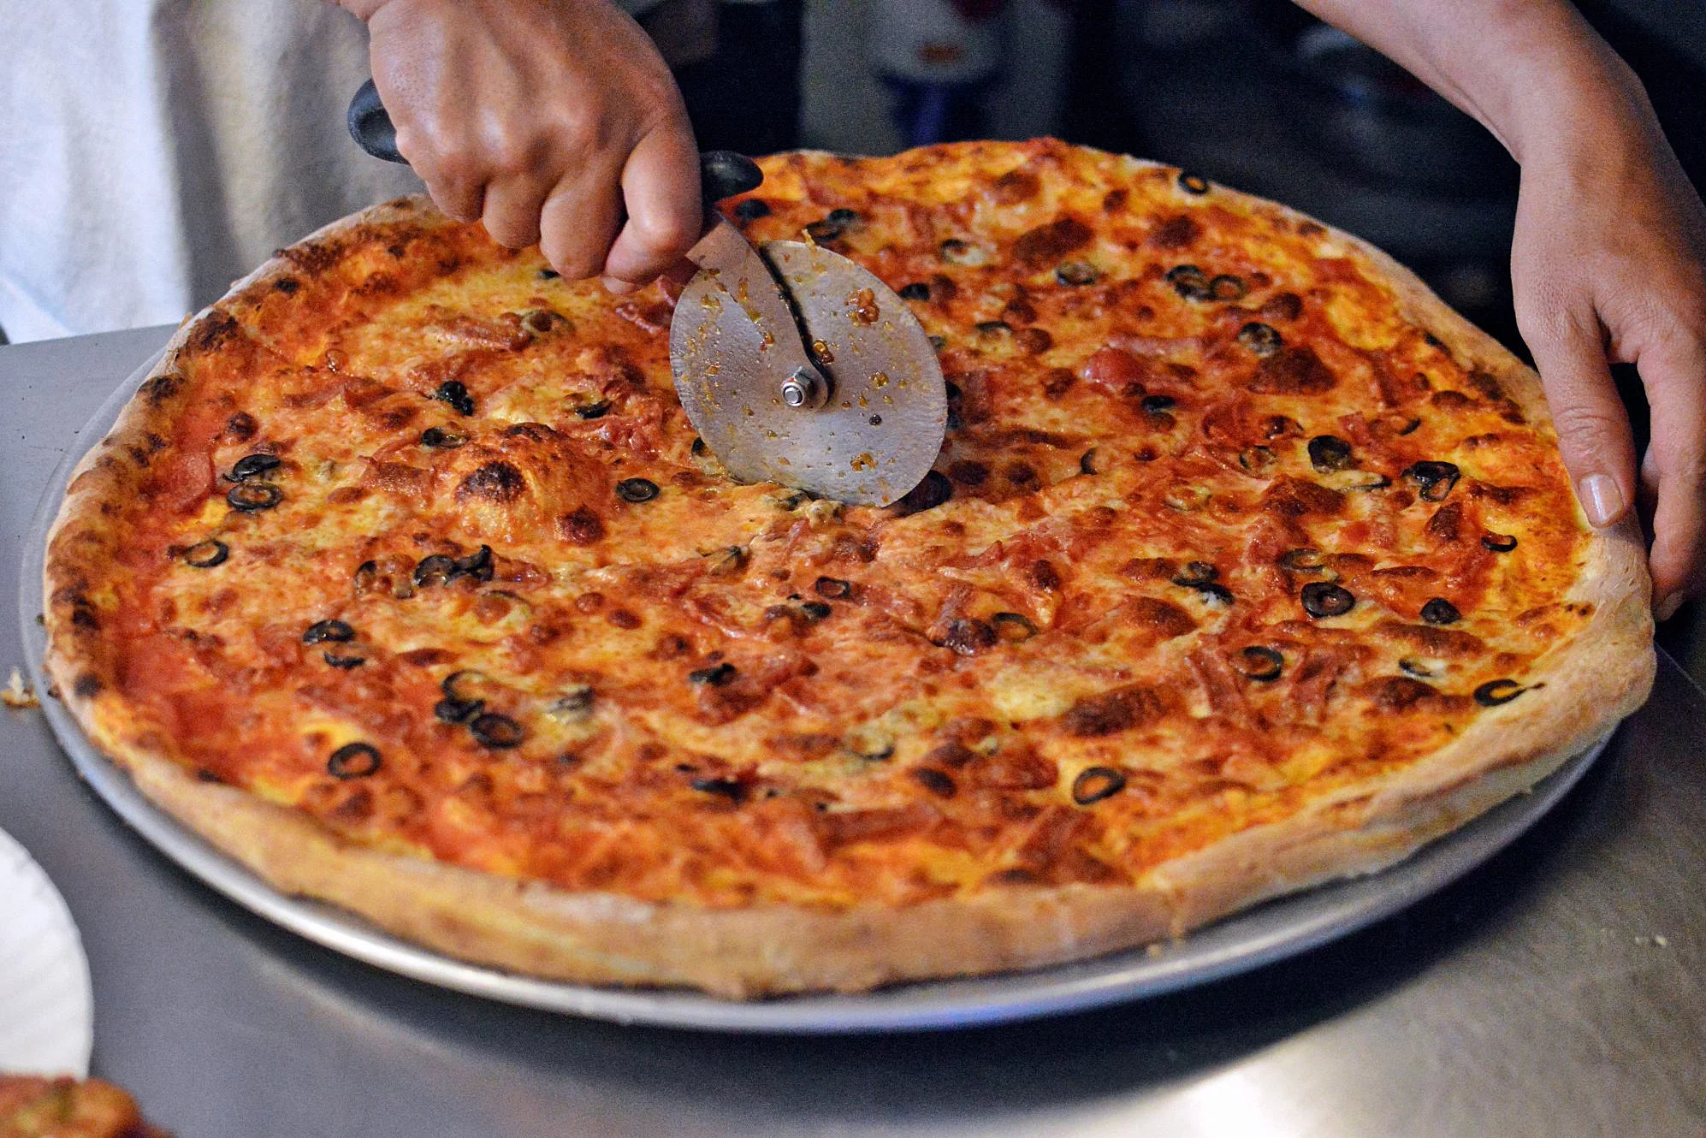
Where have you heard the word half?
Can you think of your own ideas as well?

Slide 3
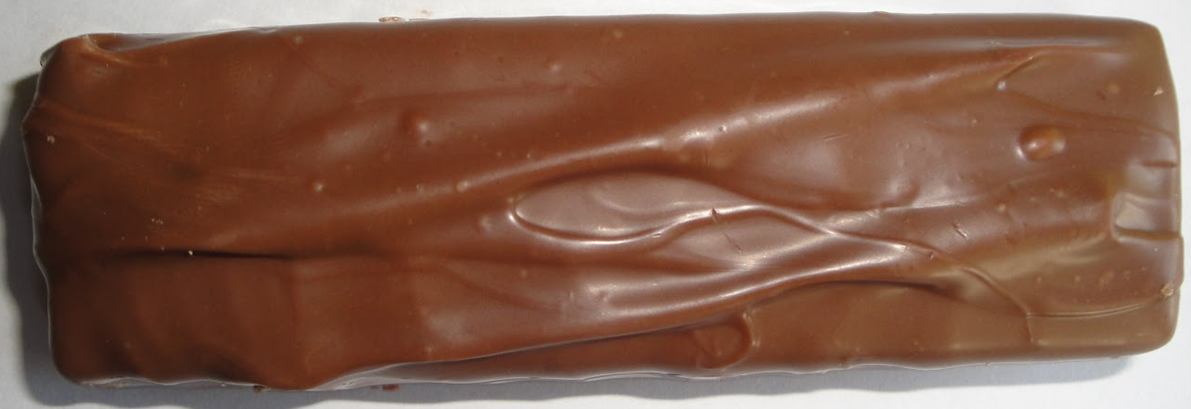
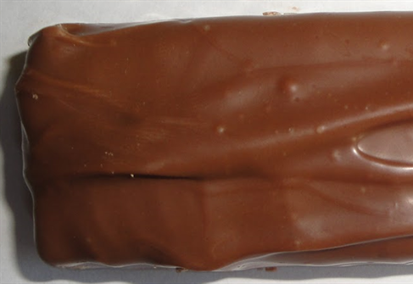
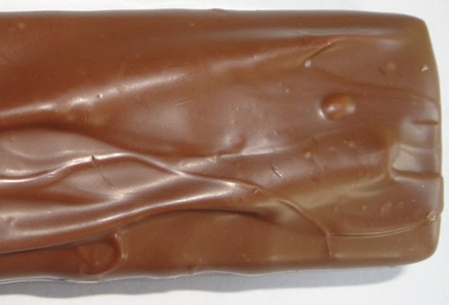
I have a whole chocolate bar. I want to share it fairly with my sister. I need to cut it in half.
Whole means all of the object.
Half means 2 parts that are exactly the same.
One half for me.
The other half for my sister.

Slide 4
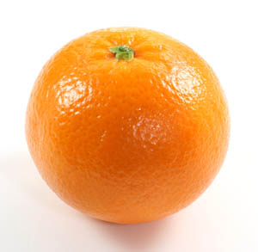
I have a whole orange. I want to share it fairly with my Mum. I need to cut it in half.
One half for me.
The other half for my Mum.
Whole means all of the object.
Half means 2 parts that are exactly the same.
We can also draw a line to show half.

Slide 5
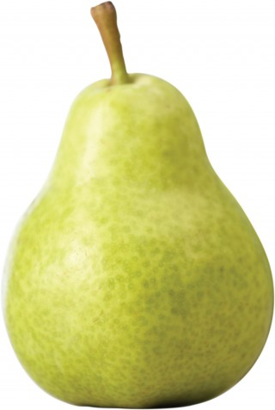
I have a whole pear. I want to share it fairly with my Dad. I need to cut it in half.
One half for me.
The other half for my Dad.
Whole means all of the object.
Half means 2 parts that are exactly the same.
We can also draw a line to show half.

Slide 6
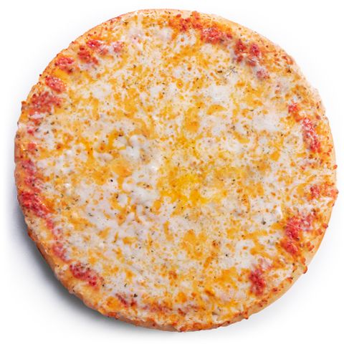
I have a whole pizza. I want to share it fairly with my brother. I need to cut it in half.
Put your thinking caps on…
Could I cut the pizza in half in a different way?
Tell your adult what you think!
One half for me.
The other half for my Brother.
Whole means all of the object.
Half means 2 parts that are exactly the same.
We can also draw a line to show half.

Slide 7
Maybe you were thinking of one of these ways…
Maybe you were thinking of another way.
As long as there are 2 parts that are exactly the same then it is half!
One half for me.
The other half for my Brother.
One half for me.
The other half for my Brother.
One half for me.
Some objects can be cut in half in lots of different ways.
Other objects can only be cut in half in one way.
The other half for my Brother.

