Slide 1
Year 1 Phonics
Our sound of the day…

Slide 2
Can you think of any words which have the ay sound in?
Remove the box to reveal the words!

Slide 3
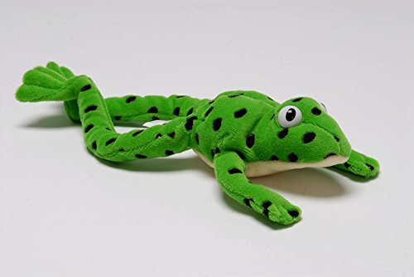
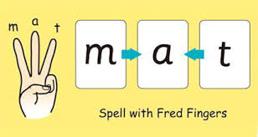
Can you Fred talk the words?
way play
spray clay
day sway
Can you use your Fred fingers for three of the words and write them down without looking?

Slide 4
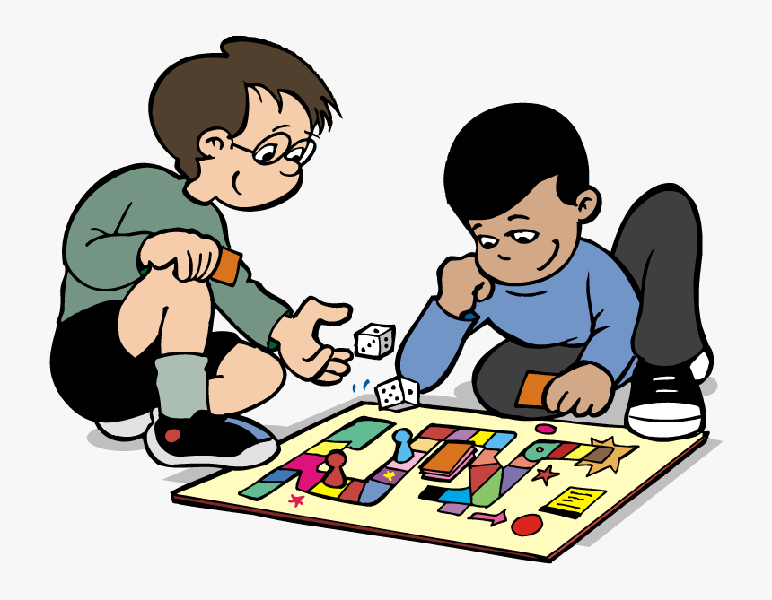
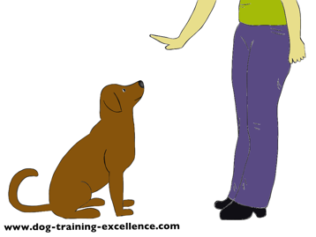
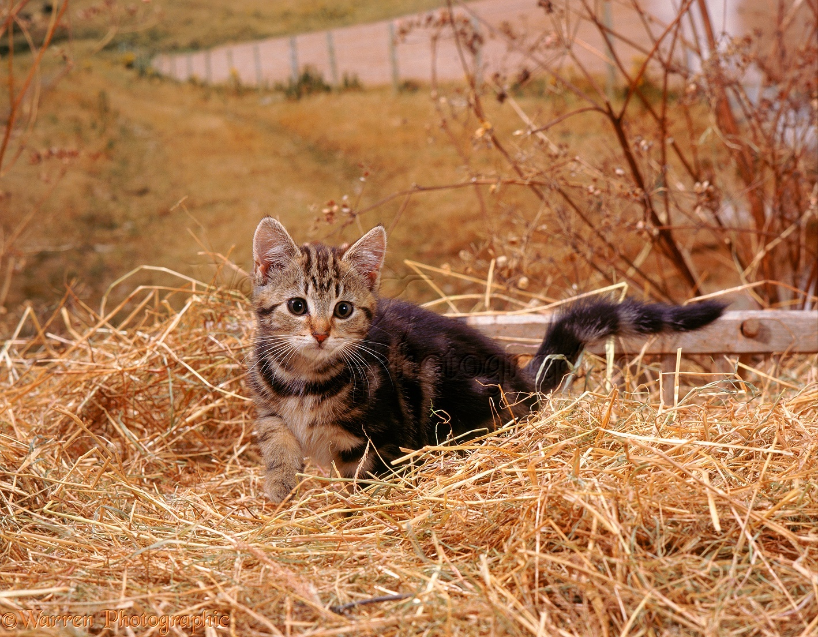
Finish the sentence
Can you work out what the last word of the sentence is by looking at the picture ?
Can you say the sentence first then have a go at writing it down?
Can you come and _________
The dog can sit and ________
I can see a cat in the _____

Slide 5
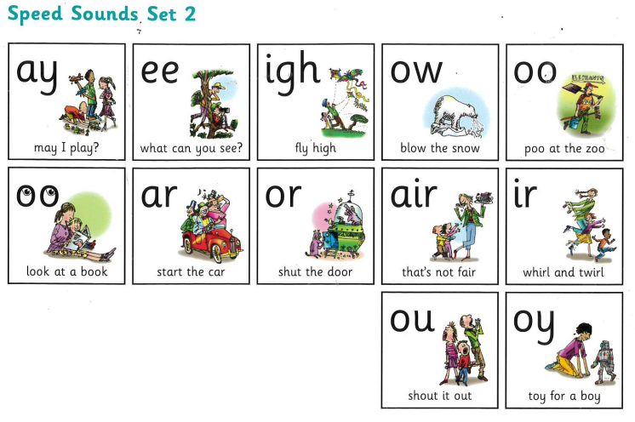
Time to practise! Can you remember these set 2 sounds?

