Slide 1
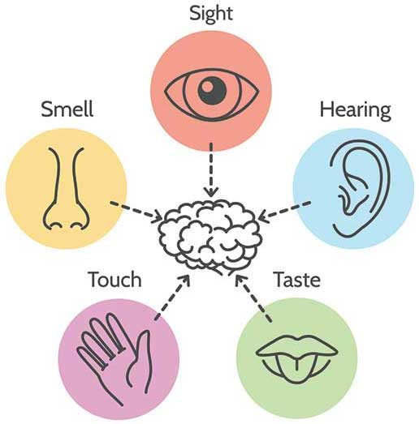


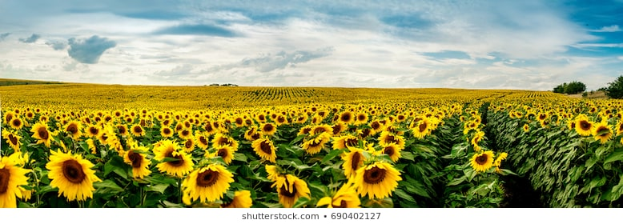
Learning outcome: I am learning to write a poem
In our poem we are going to include:
Personal pronoun ‘I’
Exciting adjectives
Our knowledge of our senses
Our imagination to picture ourselves in a different setting.

Slide 2
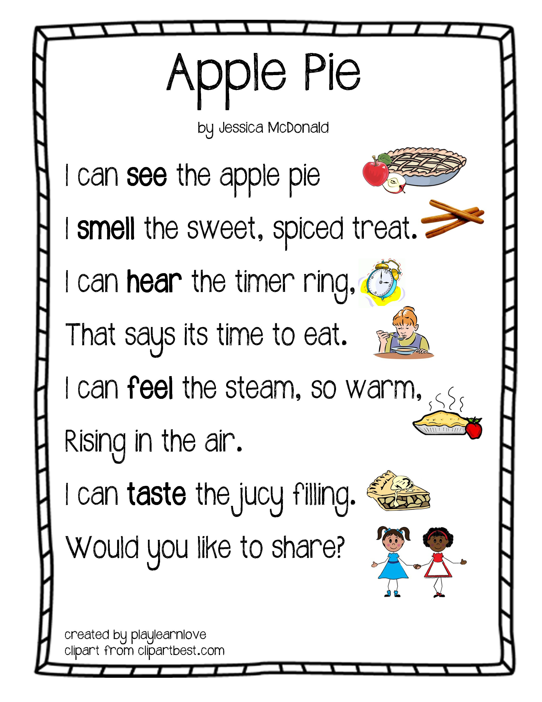
We are going to write a senses poem using our imagination.
Poem: A type of writing put together to express a feeling or create a picture using imagination.
Here is an example of a senses poem all about an apple pie!

Slide 3



Close your eyes and imagine that you are in a huge outdoor field full of tall and bright sunflowers, just like the one in the picture below.
What might you see?
What might you hear?
What might you feel?
Make a note of 1 or more thing for each of the questions above, this will help you when you write your poem.

Slide 4
Here is an example of how you might structure your poem.
I can see…
I can hear…
I can feel…
Can you spot the adjectives I have used in my poem?
I can see beautiful yellow petals.
I can hear giant glorious flowers rustling.
I can feel the large smooth leaves.

Slide 5
One way to make your poem even better is to extend your sentence: have a look at how I have done this here:
I can see beautiful yellow petals stretching far into the distance.
I can hear giant glorious flowers rustling in the breeze.
I can feel the large smooth leaves as I walk past each sunflower.

