Slide 1
Year 1- DIVISION
Session 2 – Grouping using pictures

Slide 2
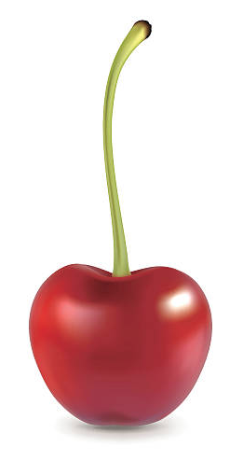
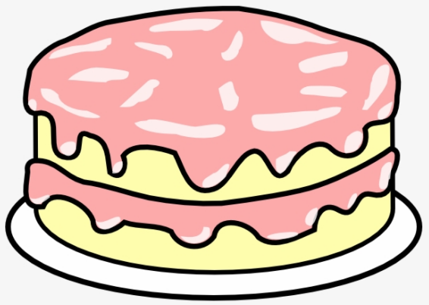
There are 6 cherries. I can put 3 on each cake. How many cakes do I need?
?

Slide 3
There are 6 cherries. I can put 3 on each cake. How many cakes do we need?
First, we need to circle groups of 3.
We need 2 cakes because there are 2 groups of 3.
Then, we need to count how many groups of 3 we have circled.
1 2

Slide 4
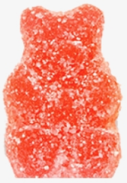
There are 15 sweets. I can put 3 on each cake. How many cakes do I need?
?

Slide 5
There are 15 sweets. I can put 3 on each cake. How many cakes do I need?
First, we need to circle groups of 3.
We need 5 cakes because there are 5 groups of 3.
Then, we need to count how many groups of 3 we have circled.
1 2 3 4 5

Slide 6
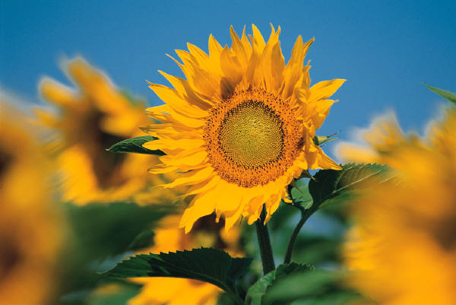
There are 14 flowers. There are 2 flowers on each plant. How many plants are there?

Slide 7
There are 14 flowers. There are 2 flowers on each plant. How many plants are there?
First, we need to circle groups of 2.
There are 7 plants because there are 7 groups of 2.
Next, we need to count how many groups of 2 we have circled.
1 2 3 4 5 6 7

