Slide 1

I am learning to retrieve information from a text.
Retrieve:
To find certain information or facts from a text.

Slide 2
Challenge 1:
Read the story on the next page.
Challenge 2: answer the questions by retrieving the information from the text.

Slide 3





Tom was six and lived in a flat with his Mum and Dad. The flat was very high up! One day, Tom asked Mum for a pet dog. Mum shook her head and said “No Tom, no dogs allowed in the flat.” Tom was very upset. The next day, Tom asked Mum for a cat. Mum shook her head and said “no Tom, no cats allowed in the flat.”!

Slide 4


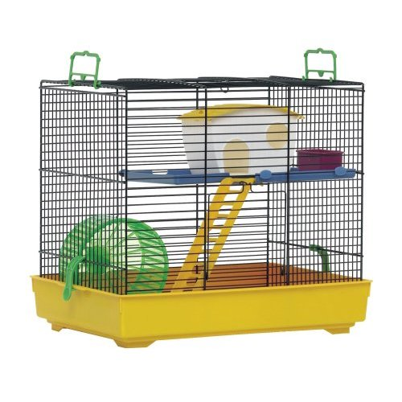
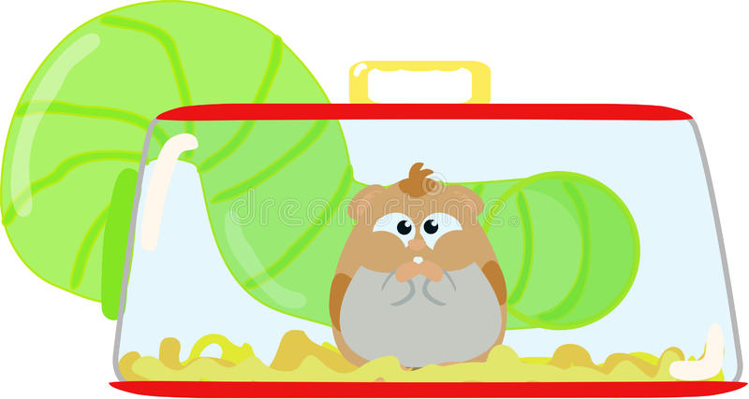
Tom started to cry, “I want my own pet!” he shouted. Mum said “I’ll see what I can do.” The next day,Tom saw a cage on the table, he looked inside and saw a brown and fluffy hamster, he was very happy! He grinned and said “Thank you Mum, I will call it Rusty!”

Slide 5
Can you find the answers to the questions in the text?
How old is Tom?
Where does Tom live?
Which two pets did Tom ask for?
What animal was in the cage?
What did the hamster look like?
What did Tom name the Hamster?

Slide 6
Answers under the box!
Six.
In a flat.
A dog and a cat.
A hamster.
Brown and fluffy.
Rusty.

