Slide 1

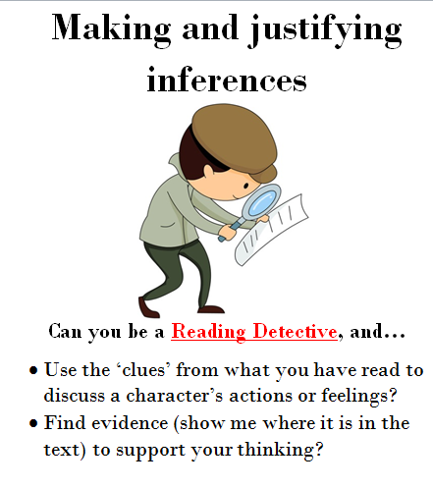
I am learning to use inference to say how a character is feeling.
https://www.youtube.com/watch?v=BXgW9UCgpc8
Listen to the story, think about how Sophie might be feeling when she opens the door to the tiger.
Think about how Sophie might be feeling when the tiger has to leave. Do you think she wanted him to stay longer?

Slide 2
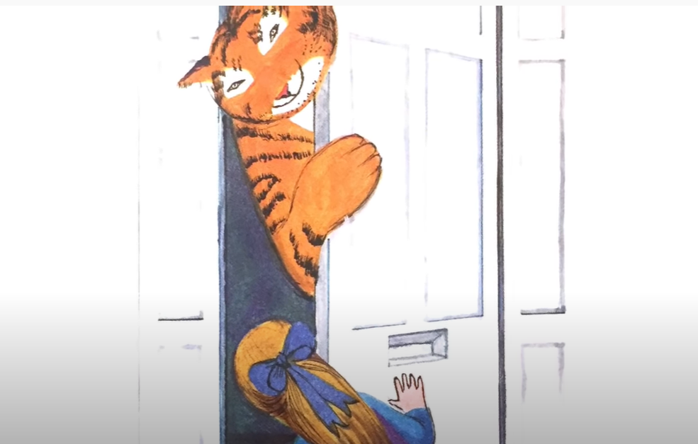
I am learning to use inference to say how a character is feeling.
How would you feel if you opened your door to a huge tiger?
Talk to your grown up about how you think Sophie feels at this point in the story.
I think Sophie is feeling _____________________________ because_____________________.
Can you use the –ing suffix?
Can you explain your answer using because?

Slide 3
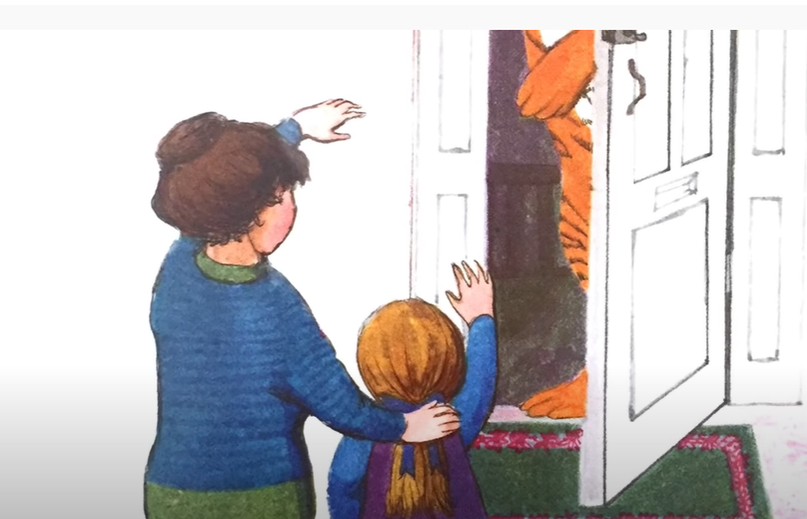
I am learning to use inference to say how a character is feeling.
The tiger had to leave Sophie after having tea. Do you think Sophie wanted him to leave? How do you think she felt?
Talk to your grown up about how you think Sophie feels at this point in the story.
I think Sophie is feeling _____________________________ because_____________________.
Can you use the –ing suffix?
Can you explain your answer using because?

