Slide 1
Year 1- NUMBERS TO 100
Session 3 – Representing numbers to 100.

Slide 2
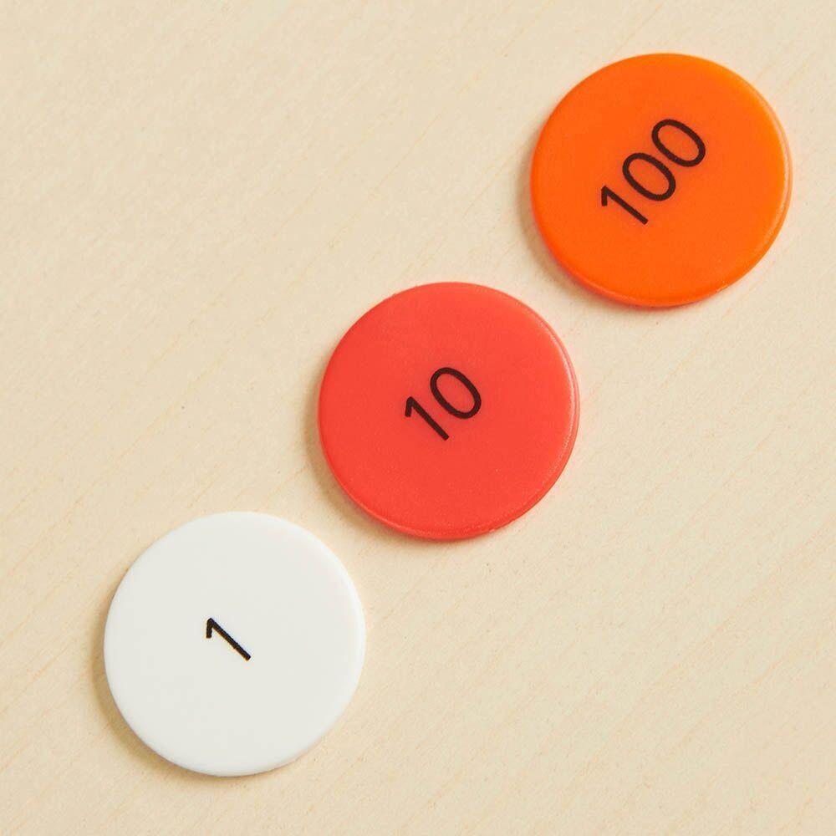

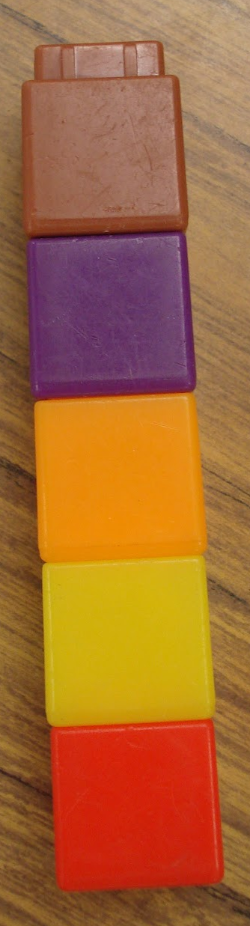


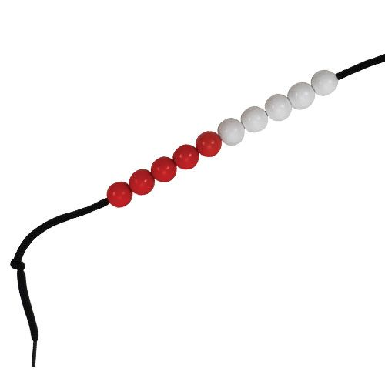
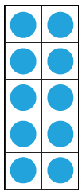


Which images represent 10? Which images are more than 10? Which images are less than ten?

Slide 3
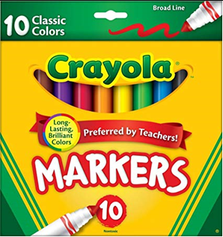
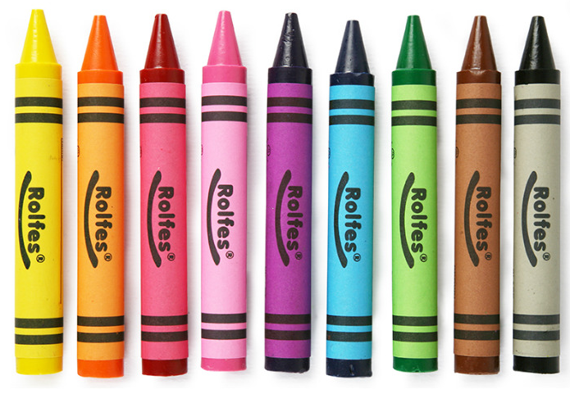
Which number is represented?
6 big groups of 10 makes
60
9 small ones
69

Slide 4
We can also show this using the tens and ones objects called ‘Base Ten.’
6 big groups of 10 makes
60
9 small ones
69

Slide 5
Which number is represented?
82
8 big groups of 10 makes
80
2 small ones

Slide 6
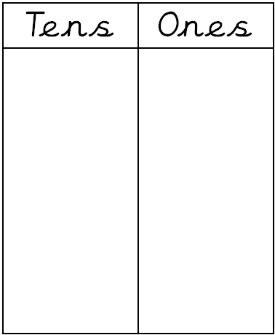
We can also represent this using a place value chart.
2 small ones
8 big groups of 10 makes
80
82

Slide 7
Which number is represented?
5 small ones
7 big groups of 10 makes
70
75

Slide 8
Can you explain how to represent the number ?
58
8 small ones
5 big groups of 10 makes
50

