Slide 1
Year 1 Phonics
Our sound of the day…

Slide 2
Can you think of any words which have the ea sound in?
tea scream
lean east
sea teacher
peach
Remove the box to reveal the words!

Slide 3
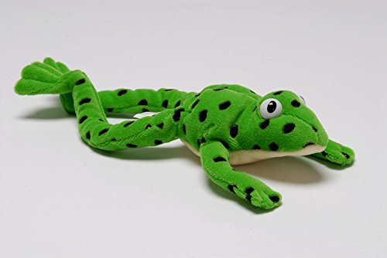
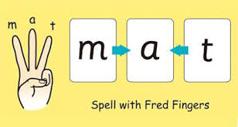
Can you Fred talk the words?
tea sea
peach east
teacher lean
Can you use your Fred fingers for three of the words and write them down without looking?

Slide 4
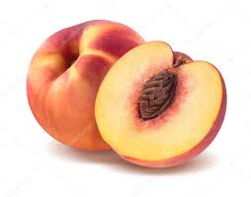
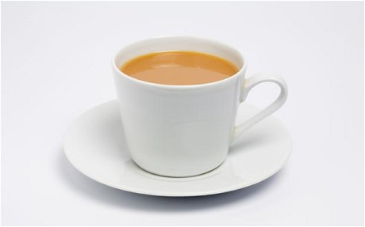
complete the sentence
Can you work out what the last word of the sentence is by looking at the picture ?
Can you say the sentence first then have a go at writing it down?
I ask my _________ for help.
After lunch I had a ________.
I drank a cup of _____.

Slide 5
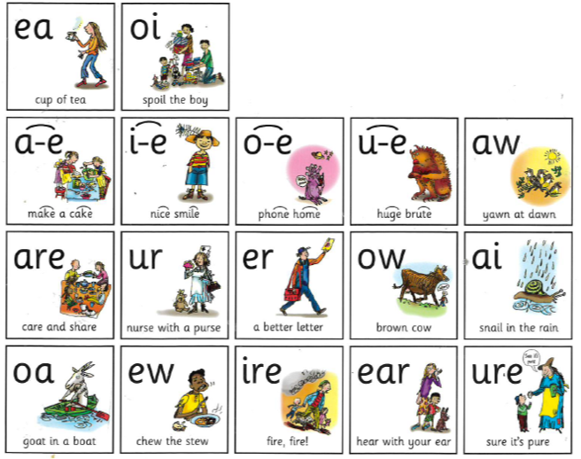
Time to practise! Do you know any more set 3 sounds?

