Slide 1
Year 1- NUMBERS TO 100
Session 4 – Representing numbers to 100 using pictures.

Slide 2
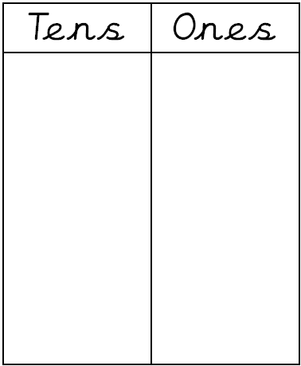
Tim says... “The place value charts show the same number.” Do you agree with him? Why?
73
63
7 big groups of 10 makes
70
6 big groups of 10 makes
60
I disagree with Tim because the second number is 10 less than the first number.
3 small ones
3 small ones

Slide 3
We can also draw the tens and ones to represent a number.
88
88

Slide 4
Can you draw the tens and ones to represent the number?
61

Slide 5
Can you draw the tens and ones to represent the number being described?
There are 9 tens.
There are 7 ones.
97

Slide 6
Can you draw the tens and ones to represent the number being described?
There are 8 tens.
There are 0 ones.
There are no ones because 80 has a zero in the ones column.
80

