Slide 1
Year 1- FRACTIONS
Session 2 – Finding half of a shape

Slide 2


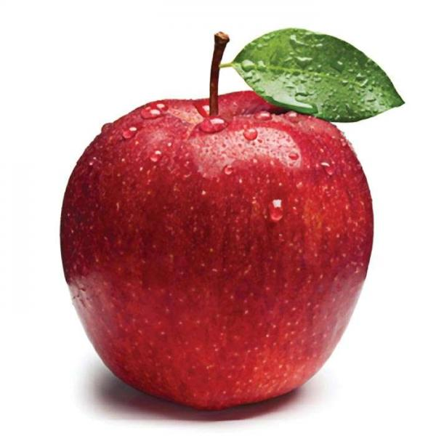
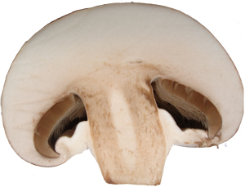
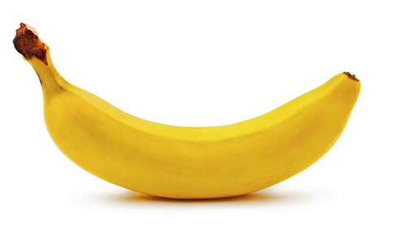

We can also find half of a shape.
The mushroom and the apple have 2 parts that are equal but the cake and the banana have 2 parts that are unequal.
Remember…
Whole means all of the object.
Half means 2 parts that are exactly the same.
Which objects are cut in half?
How do you know?

Slide 3
This is a 2D shape called a rectangle.
How could we find half of the rectangle?
Whole means all of the shape.
Half means 2 parts that are exactly the same.
We can draw a line to show half.
We can also fold the shape in half.

Slide 4
This is a 2D shape called a triangle.
How could we find half of the triangle?
Whole means all of the shape.
Half means 2 parts that are exactly the same.
We can draw a line to show half.
We can also fold the shape in half.

Slide 5
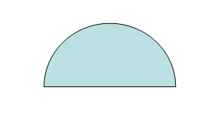
This is a 2D shape called a circle.
How could we find half of the circle?
Whole means all of the shape.
Half means 2 parts that are exactly the same.
We can draw a line to show half.
We can also fold the shape in half.

Slide 6
This is a 2D shape called a square.
Put your thinking caps on…
Could find half of the square in a different way?
Tell your adult what you think!
How could we find half of the square?
Whole means all of the shape.
Half means 2 parts that are exactly the same.
We can draw a line to show half.
We can also fold the shape in half.

Slide 7
Did you think of all of these ways?
Maybe you could check by cutting out a square and folding it in half.
As long as there are 2 parts that are exactly the same then it is half!
Some shapes can be cut in half in lots of different ways.
Other shapes can only be cut in half in one way.

