Slide 1
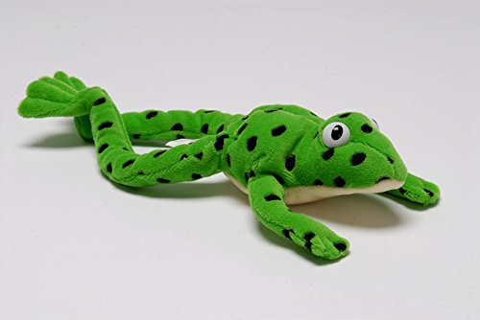
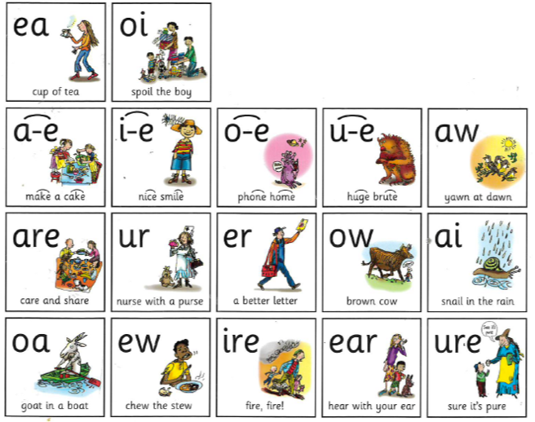
Year 1 Phonics – set 3 sound ‘a-e’
Our sound of the day…
This sound makes the same sound as:
ay
ai
a-e
make a cake

Slide 2
Follow the video for the first part of the phonics lesson.
Remember to use your Fred fingers!
https://www.youtube.com/watch?v=5HtZxme7iic
This sound is called a split diagraph. It has two letters but makes one sound. There will be one or more letters in between the split diagraph. We say the split diagraph first and then the letter in the middle.

Slide 3
Can you Fred talk the words?
make grape
cake shade
state plate

Slide 4
Can you Fred talk the words?
Have a go at reading this sentences aloud:
Today I made a cake. My cake was red and it was a round shape. I made my cake look just like a grape. I sat in the shade to eat my cake.

Slide 5
Activity – Dictated sentences
Message to parents:
Read the sentences aloud one at a time. Get your children to write the sentence down independently in their green work book.
Mark each sentence together:
Tick for each word spelt correctly and for capital letter and full stop.
Correct any mistakes under each one.
I can make a cake.
One green grape.
How many cakes are on the plate?
I am sitting in the shade.
Can you think of your own sentence using the ‘a-e’ sound?

Slide 6
Super speedy sounds – How many set 3 sounds do you know?

