Slide 1
Wednesday 11th May 2020
English –Reading
Notes:
© Copyright Showeet.com – Free PowerPoint Templates. Photo credits: Pixabay (CC0 Public DomainFree for commercial use No attribution required)

Slide 2
Since our afternoon topic lessons this week are all about making and food, for the next two days we are going to look at instructions in the form of recipes.
Notes:
© Copyright Showeet.com – Free PowerPoint Templates

Slide 3
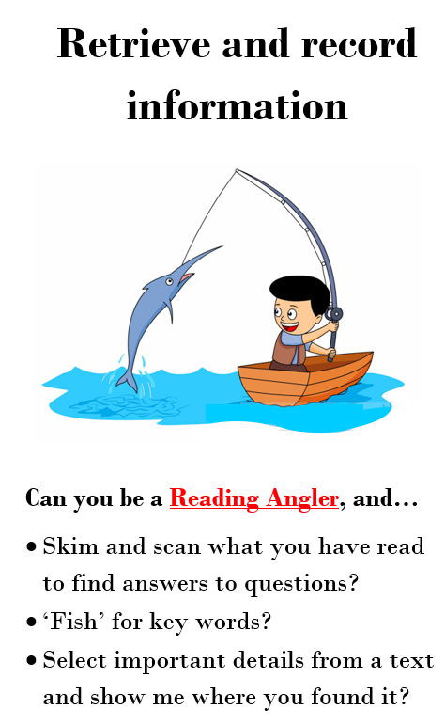
Today, our question types focus on 2 of the reading characters that we have already met.
Sue and Sally
These questions are about
Vocabulary.
Reggie
The answers are right there in the text.

Slide 4
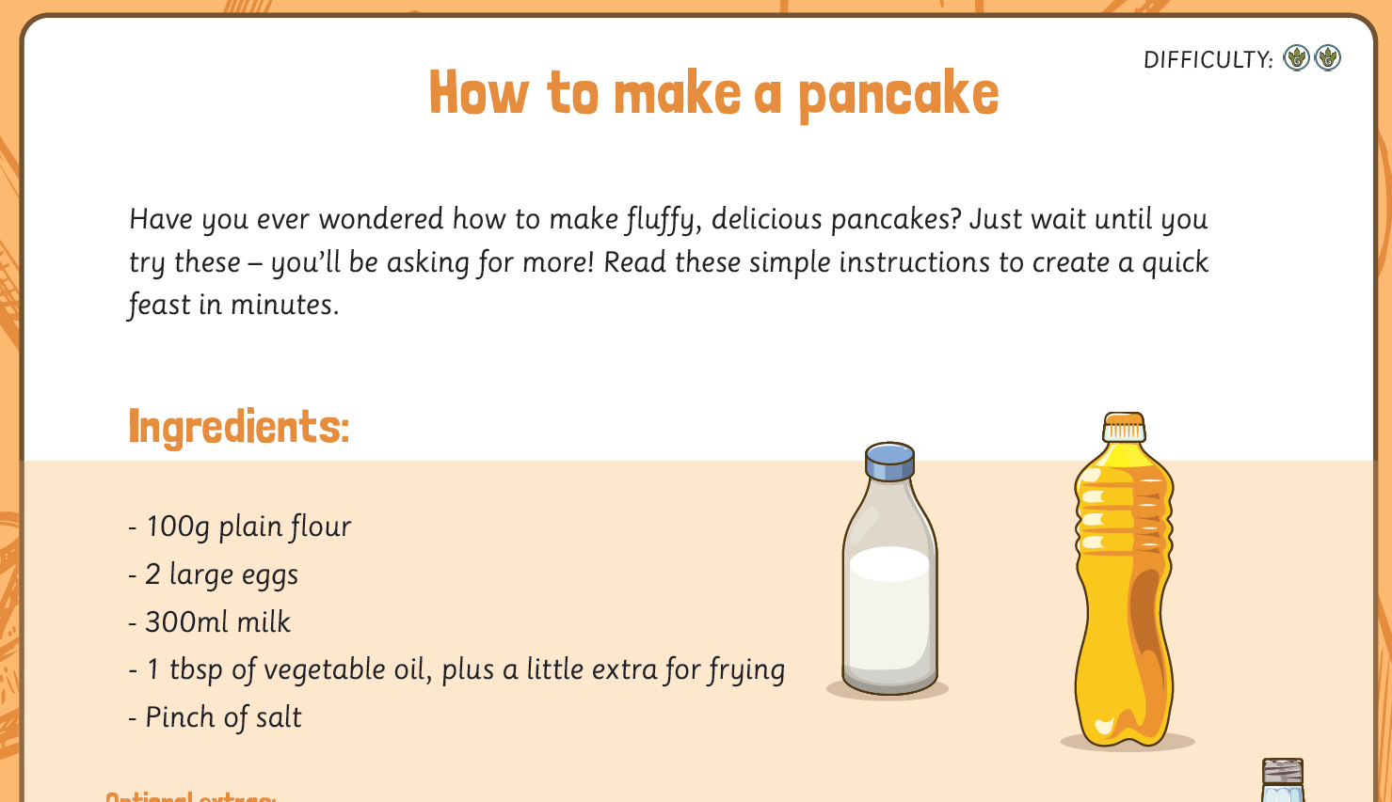
Now, tackle the reading comprehension task.
It should look like this. If you need an adult to help you read, that’s totally okay! ☺ We are practising finding the answers.
If you can’t print, don’t worry, read on the screen and write your answers in your book.
Notes:
© Copyright Showeet.com – Free PowerPoint Templates

