Slide 1
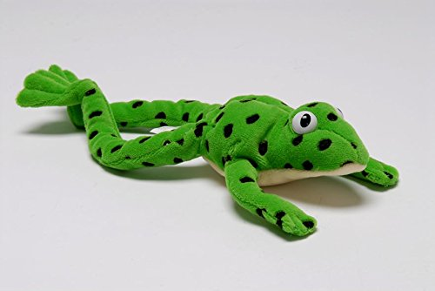
Year 1 Phonics – set 2 sound ‘ou’
Our sound of the day…
Ou
Shout it out
Note to parents: For this lesson you will need:
Word cards with words including the ‘ou’ sound (see next slide)
A bag.

Slide 2
Can you think of any words which have the ou sound in?
Loud around
Proud out
Sound aloud
Shout count
Remove the box to reveal the words!

Slide 3
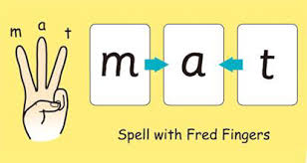
Can you Fred talk the words?
shout proud
round sound
out count
Can you use your Fred fingers for three of the words and write them down without looking?

Slide 4
Activity
Create word cards with up to 10 words using the ‘ou’ sound. Put the cards into a bag. Put your hand in the bag and pick a card one at a time. Read the word they have chosen. Use Fred talk to help.
Choose three or more words that you have read. Use these words in a sentence and write the sentence in your home work book.
Proud
I am very proud of the work I have done today.
Remember capital letters and full stops.

Slide 5
Super speedy sounds – How many set 2 sounds do you know?

