Slide 1
Year 1- FRACTIONS
Session 3 – Finding half of an amount

Slide 2
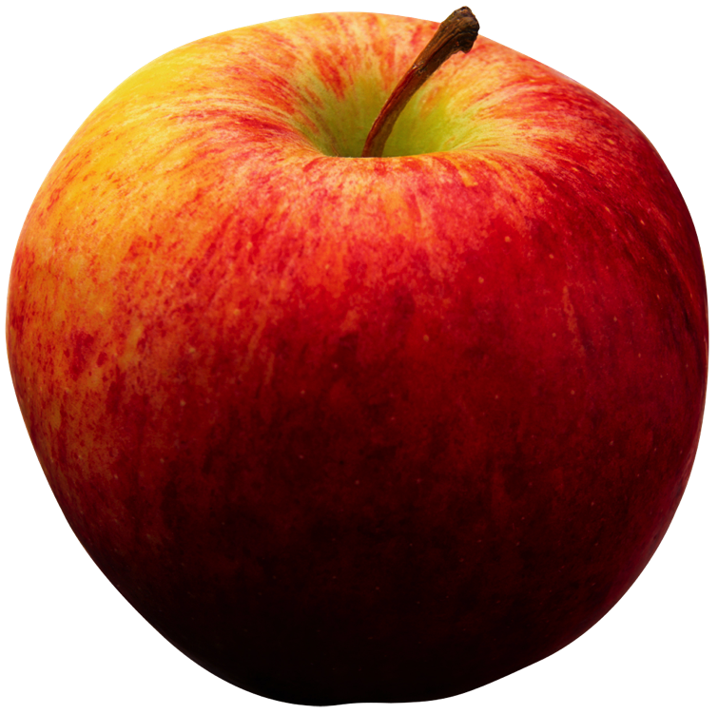
I have 8 apples. I give half to my friend. How many do I give to my friend?
This is a bar model.
It is another way to group objects.
Whole means the total number of objects.
My friend will have 4 apples.
I know because 8 shared fairly between 2 groups equals 4.
We need to share the total number between 2 parts to find half.
Half means 2 parts that are exactly the same.

Slide 3
I have 10 sweets. I eat half of them. How many do I have left?
Whole means the total number of objects.
I will have 5 sweets left.
I know because 10 shared fairly between 2 groups equals 5.
We need to share the total number between 2 parts to find half.
Half means 2 parts that are exactly the same.

Slide 4
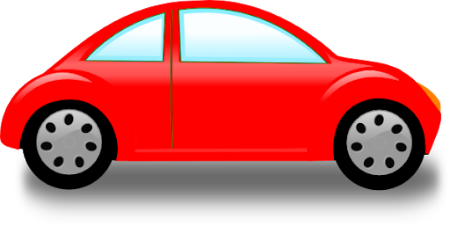
There are 14 cars in the car park. Half of the cars drive away. How many cars are there left?
Whole means the total number of objects.
There will be 7 cars left.
I know because 14 shared fairly between 2 groups equals 7.
We need to share the total number between 2 parts to find half.
Half means 2 parts that are exactly the same.

Slide 5
There are 12 children in the line. Half of the children walk inside. How many children walk inside?
Whole means the total number of objects.
12
6 children walk inside.
I know because 12 shared fairly between 2 groups equals 6.
Half means 2 parts that are exactly the same.
We can draw a circle in one part at a time.
We need to count to 12 at the same time as we draw.

Slide 6
There are 6 children at the table. Half of the children go to the carpet. How many children go to the carpet?
Whole means the total number of objects.
6
3 children go to the carpet.
I know because 6 shared fairly between 2 groups equals 3.
Half means 2 parts that are exactly the same.
We can draw a circle in one part at a time.
We need to count to 6 at the same time as we draw.

Slide 7
There are 16 bikes in the shed. Half of the bikes are taken home. How many bikes are left in the shed?
Whole means the total number of objects.
16
There are 8 bikes left in the shed.
I know because 16 shared fairly between 2 groups equals 8.
Half means 2 parts that are exactly the same.
We can draw a circle in one part at a time.
We need to count to 16 at the same time as we draw.

