Slide 1
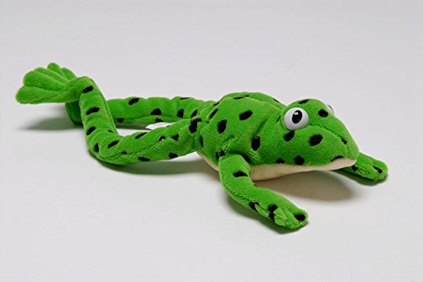


Year 1 Phonics – set 3 sound ‘oi’
Our sound of the day…
oi
Spoil the boy

Slide 2

Follow the video for the first part of the phonics lesson.
Remember to use your Fred fingers!
https://www.youtube.com/watch?v=Pvvr1KY9ZB8

Slide 3
Can you Fred talk the words?
spoil point
foil coin
joint

Slide 4
Activity – Dictated sentences
Message to parents:
Read the sentences aloud one at a time. Get your children to write the sentence down independently in their green work book.
Mark each sentence together:
Tick for each word spelt correctly and for capital letter and full stop.
Correct any mistakes under each one.
I went to the shop and I paid with a coin.
I want to join in with the song.
You can plant a seed in soil.
If you cheat it spoils the game.

Slide 5
Super speedy sounds – How many set 3 sounds do you know?

