Slide 1
Year 1- NUMBERS TO 100
Session 2 – Writing numbers to 100.

Slide 2
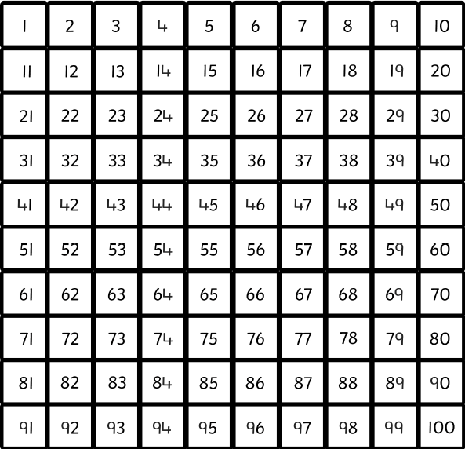
Let’s practice counting in multiples of 10!
10
20
30
40
50
60
70
80
90
100

Slide 3
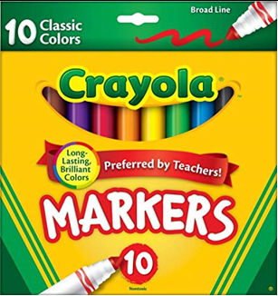
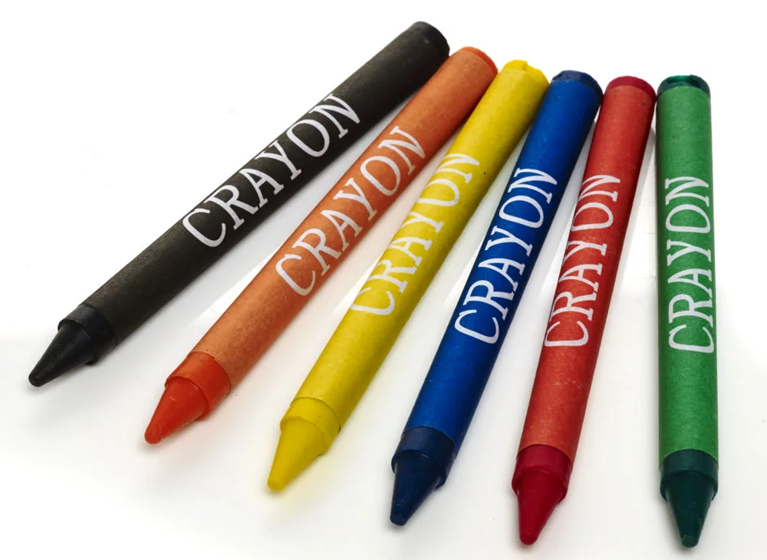
We are going to practice counting objects up to 100 and then writing the number down. How many crayons altogether?
Find this number on the hundred square.
First, count the big groups of 10.
Then, count on the ones.
10
20
30
40
50
60
70
71 72 73 74 75 76

Slide 4
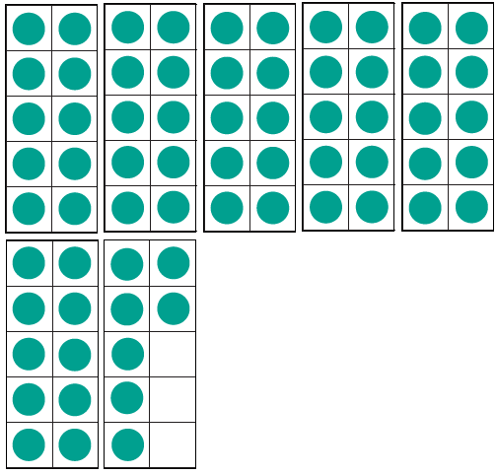
How many counters altogether?
Find this number on the hundred square.
10
30
50
20
40
First, count the big groups of 10.
Then, count on the ones.
60
61 62 63 64 65 66 67

Slide 5
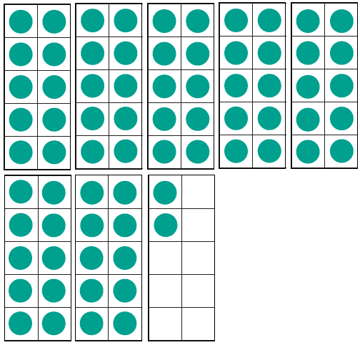
How many counters altogether?
Find this number on the hundred square.
10
30
50
20
40
70
First, count the big groups of 10.
71 72
Then, count on the ones.
60

Slide 6
Which number is represented in the tens and ones?
Find this number on the hundred square.
First, count the big groups of 10.
10 20 30 40 50 60 70 80 90
Which numbers would come next? Can you use the hundred square to write them down?
Then, count on the ones.
91
92
93
94

