Slide 1
Year 2– Measures
Session 2 – Weighing using kilograms

Slide 2
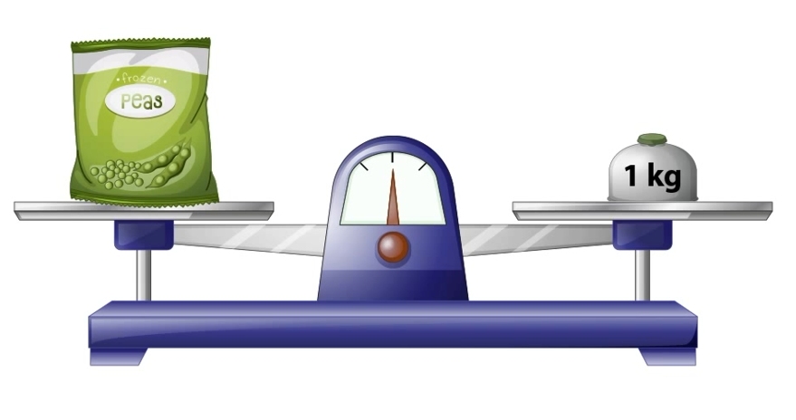
Yesterday, we learnt to compare mass using a balance scale.
Today, we are going to begin looking at standard units for measuring mass.
A standard measure is the same where ever you go in the world. Our unit of measure today is kilograms.
On one side of the balance is a bag of peas.
On the other is a 1 kilogram weight.
The balance is level.
Kg is a short way of writing
Kilograms.
The mass (weight) of the bag of peas is 1 kilogram.

Slide 3
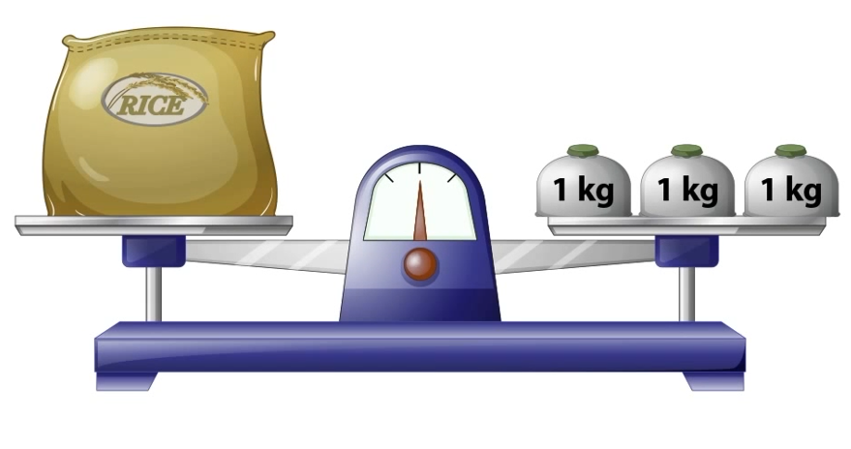
Yesterday, we learnt to compare mass using a balance scale.
Today, we are going to begin looking at standard units for measuring mass.
A standard measure is the same where ever you go in the world. Our unit of measure today is kilograms.
On one side of the balance is a bag of rice.
On the other there are three 1 kilogram
weights.
The balance is level.
Kg is a short way of writing
Kilograms.
The mass (weight) of the bag of rice is 3 kilograms.

Slide 4
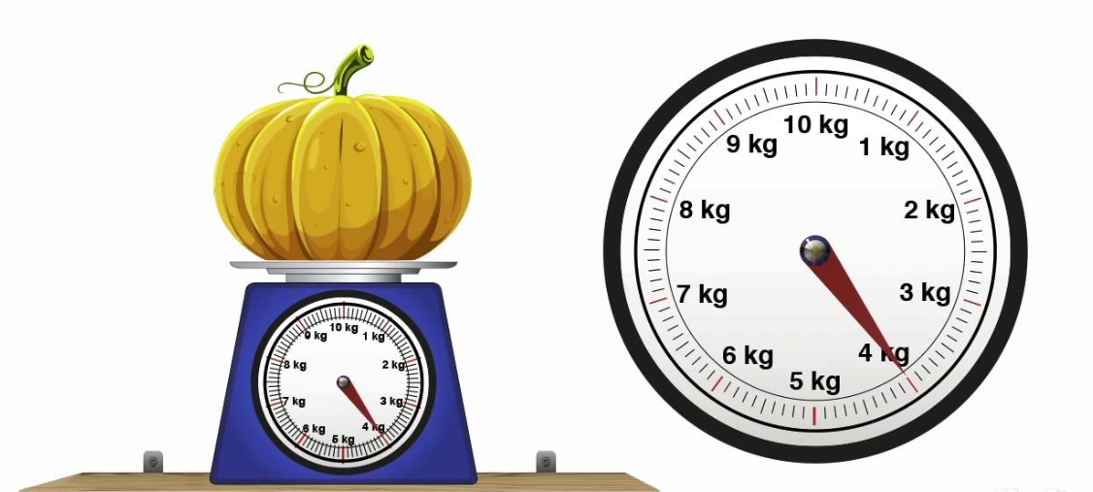
We will also be looking at a different
type of weighing scale today called a mechanical scale.
Mechanical scales have a dial on the front. When something is placed
on top of the scales. A needle moves around the dial and points to how heavy an item is.
Today we will be working with a large unit of measure called a Kilogram (kg)

Slide 5
Let’s measure the mass of the pumpkin.
We need to look carefully at where the needle is pointing.
Kg is a short way of writing
Kilograms.
The needle is pointing at 4kg. The mass of the pumpkin is 4 kilograms.

Slide 6
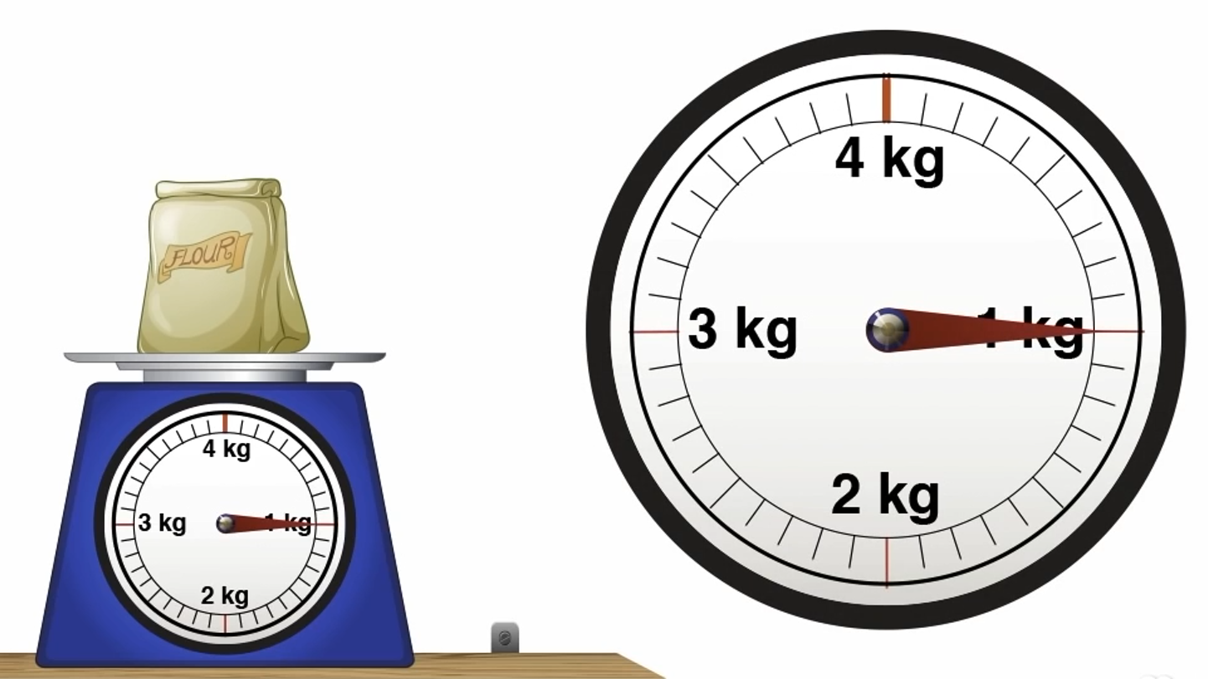
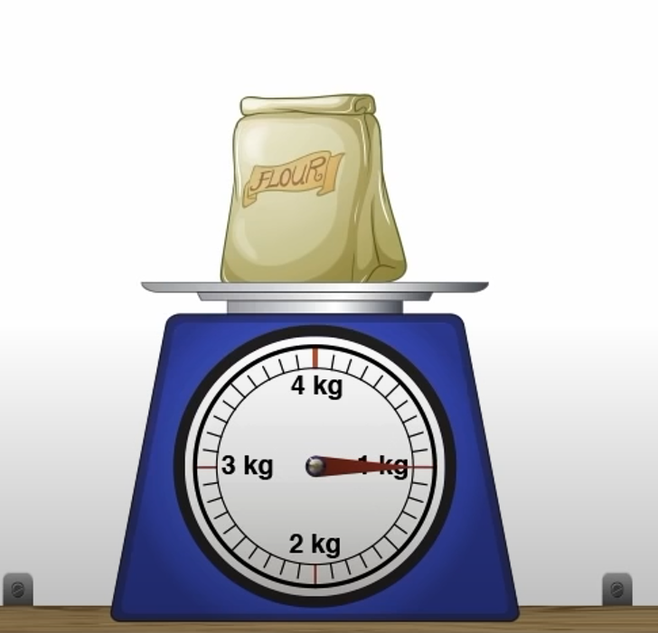
Try this one….How heavy is the flour?
Kg is a short way of writing
Kilograms.
The needle is pointing at 1kg. The mass of the flour is 1 kilogram.

Slide 7
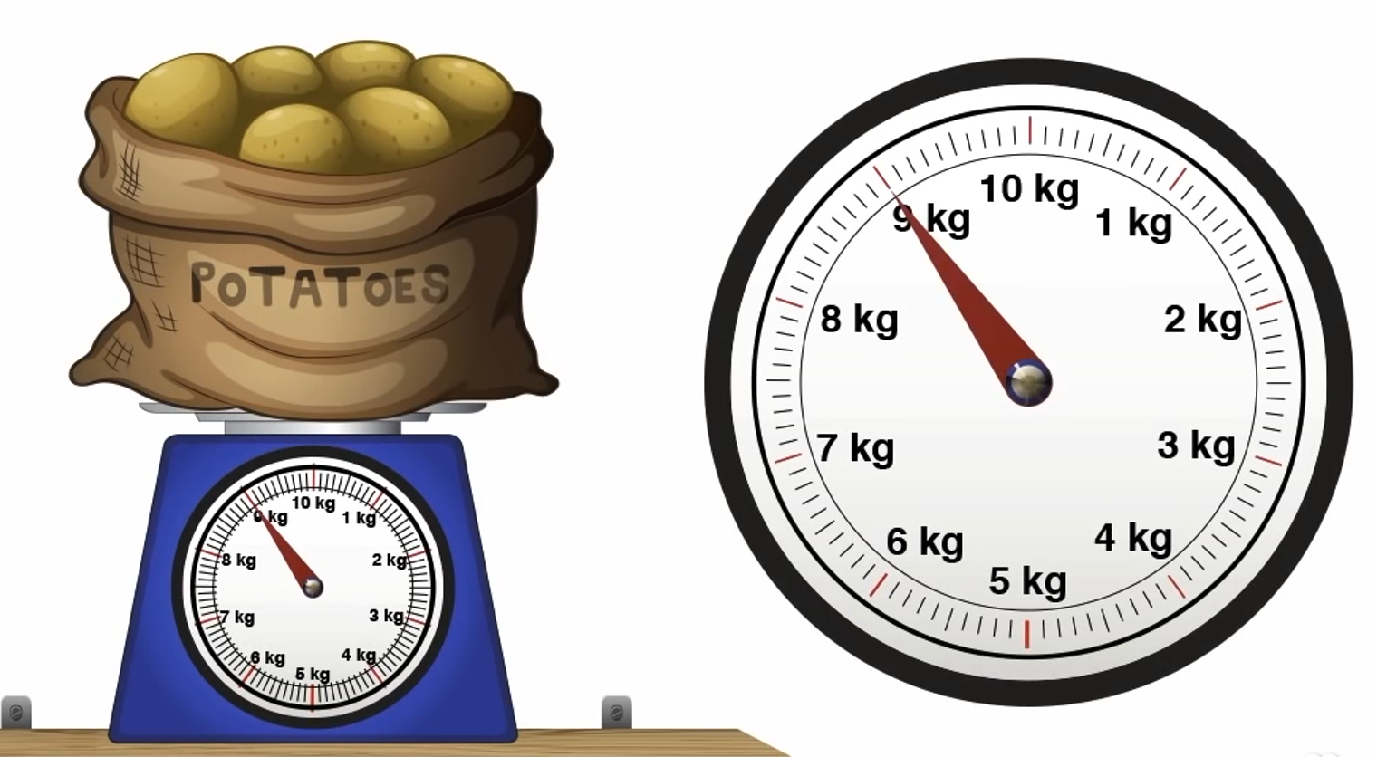
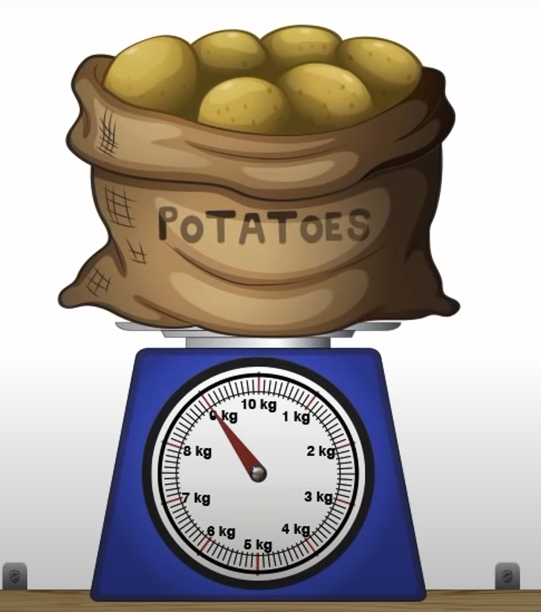
Try this one….How heavy are the potatoes?
Kg is a short way of writing
Kilograms.
The needle is pointing at 9kg. The mass of the potatoes is 9 kilograms.

Slide 8
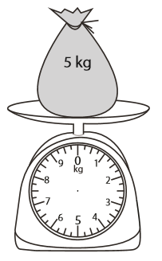
The needle has fallen off this mechanical scale.
I’m going to fix it by drawing the needle back on.
The bag weighs 5kg.
The needle needs to point to 5kg.

Slide 9
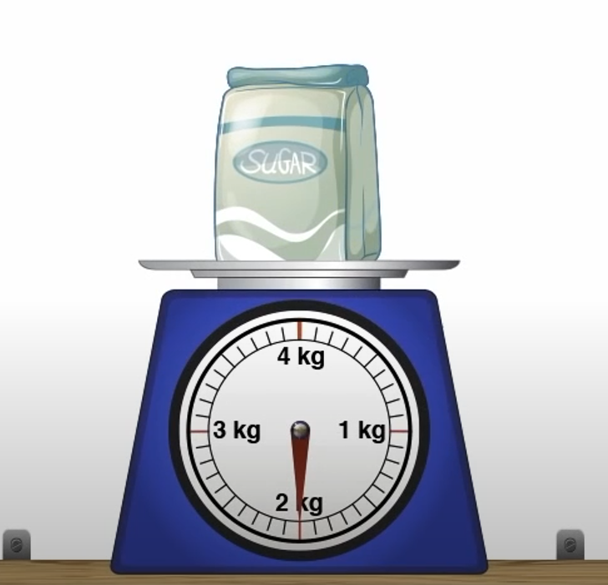
Which is heavier?
The sugar is heavier because it weighs 2kg and the flour only weighs 1kg.

Slide 10
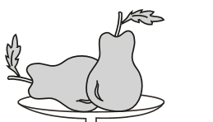
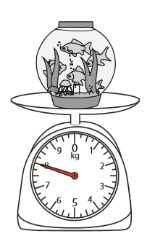
How much does 1 pear weigh?
The needle is pointing to 8kg.
There are 2 pears on the scale.
I need to divide 8kg into 2 to find the weight of one pear.
O O O O
4
O O O O
4
One pear weighs 4 kilograms.

