Slide 1
Year 2– Multiplication and division
Session 3 – The 2 times table.

Slide 2
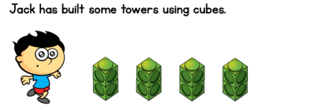




2
4
6
8
4
Or we could swap this to make another calculation
2
4 lots.
2 in each lot.
8
We could write this calculation like this..
2 x 4 = 8

Slide 3
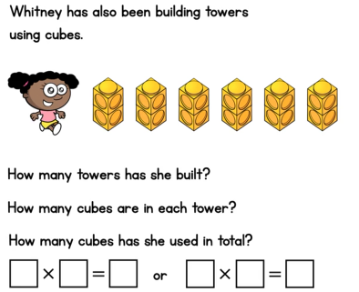
Can you fill in the missing details for Whitney’s towers?

Slide 4
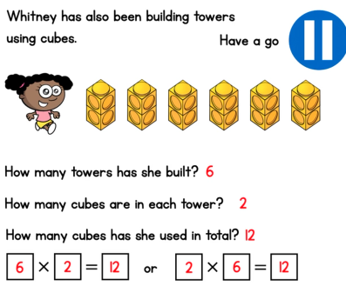

Slide 5
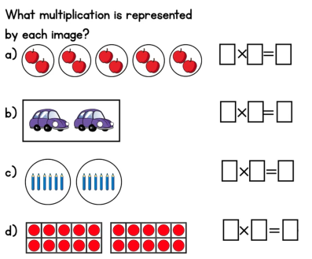
Remember to count how many groups first. Then, how many are in each group.

Slide 6
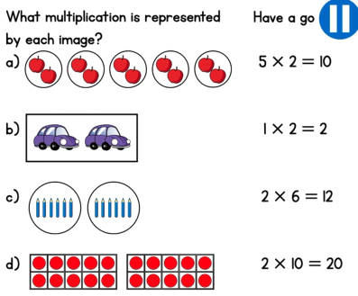
2 x 5 = 10
2 x 1 = 2
6 x 2 = 12
10 x 2 = 20
Can we find the other linked multiplication fact for each of these number sentences?

Slide 7
We’re getting good at our 2 times table now!
Let’s see if we can use counting in twos to answer these questions speedily.
3 x 2 =
6

Slide 8
1 x 2 =
2
5 x 2 =
10
4 x 2 =
8
9 x 2 =
18

