Slide 1
Thursday 7th May 2020
English –Writing.
Notes:
© Copyright Showeet.com – Free PowerPoint Templates. Photo credits: Pixabay (CC0 Public DomainFree for commercial use No attribution required)

Slide 2
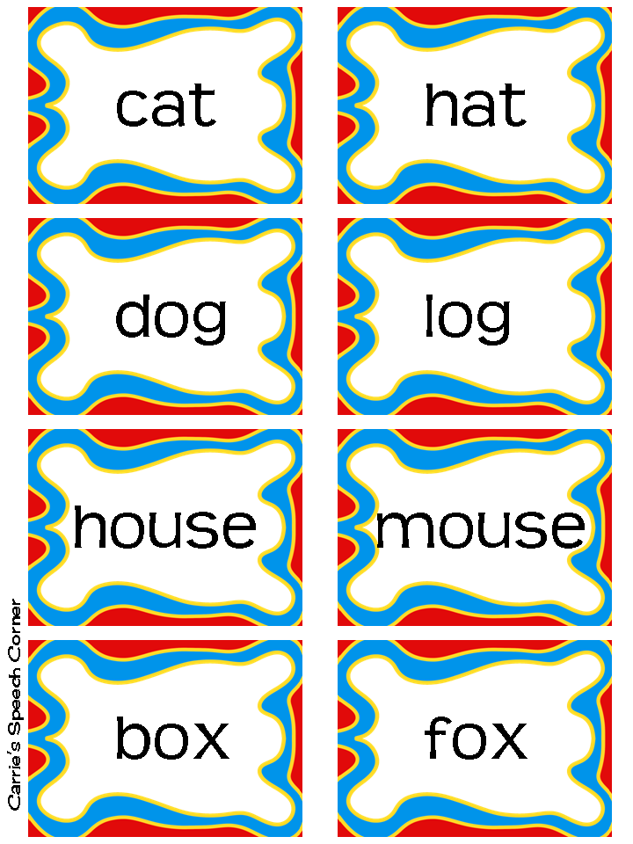
Today, we are going to use the skills that we have been practicing this week in some creative writing.
We have been reading poems and thinking about rhyming.
Notes:
© Copyright Showeet.com – Free PowerPoint Templates

Slide 3
Step 1: Re-read the poem using expression.
Sea Poem The glimmering blue sea was calm, As the waves floated upon the sand, The seagulls cry was loud and sharp, As they flew across the warm land. The sun was shining brightly, As the rays lit up the sky, The water danced and tumbled, As the day went flying by. Later the roaring, crashing storm rolled in, As the thunder boomed over head, The powerful waves were tall as giants, As they splashed over the seawall instead.
Notes:
© Copyright Showeet.com – Free PowerPoint Templates

Slide 4
We are going to use the sea poem as inspiration for writing our own.
We will need:
Expanded noun phrases
Good word choices
Rhyming words.

Slide 5

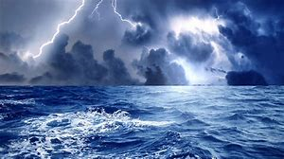
Our poem will have at least 2 Stanzas. A stanza is a group of lines.
Our poem has 4 lines in each stanza.
Stanza 1 - A lovely day at sea where the weather is good.
Stanza 2 - A stormy day at sea.

Slide 6
Let’s gather some ideas for writing each
Stanza by looking at pictures and videos.
Stanza 1 Stanza 2
Stormy day video - click me
Sunny day video - click me
What would you see? What would hear? What would you feel?

Slide 7
Patterns in our poem
Sea Poem
The glimmering blue sea was calm,
As the waves floated upon the sand,
The seagulls cry was loud and sharp,
As they flew across the warm land.
The sun was shining brightly,
As the rays lit up the sky,
The water danced and tumbled,
As the day went flying by.
Later the roaring, crashing storm rolled in,
As the thunder boomed over head,
The powerful waves were tall as giants,
As they splashed over the seawall instead.
Each stanza in our poem has a pattern at the start of it’s lines.
The
As
The
As

Slide 8
Patterns in our poem
Where are the rhyming words in this poem?
Sea Poem
The glimmering blue sea was calm,
As the waves floated upon the sand,
The seagulls cry was loud and sharp,
As they flew across the warm land.
The sun was shining brightly,
As the rays lit up the sky,
The water danced and tumbled,
As the day went flying by.
Later the roaring, crashing storm rolled in,
As the thunder boomed over head,
The powerful waves were tall as giants,
As they splashed over the seawall instead.
Today, our rhyming words in each stanza are at the end of line 2 and line 4

Slide 9
Poem punctuation
What punctuation do we need in our poem?
Sea Poem
The glimmering blue sea was calm,
As the waves floated upon the sand,
The seagulls cry was loud and sharp,
As they flew across the warm land.
The sun was shining brightly,
As the rays lit up the sky,
The water danced and tumbled,
As the day went flying by.
Later the roaring, crashing storm rolled in,
As the thunder boomed over head,
The powerful waves were tall as giants,
As they splashed over the seawall instead.
Every line needs a capital letter at the start.
Lines 1,2,3 in each stanza need commas at the end.
Line 4 needs a full stop.

Slide 10
Word choice…. Think carefully about which words would be most effective. Here are some ideas.
Super vocabulary box!
calm tranquil peaceful quiet still cool bright dazzling
sparkle cloudless sunny fine gleam
glimmer glisten shimmer glitter
rough bumpy jagged tough
Shadowy shady murky gloomy bleak overcast
Windy blustery crashing stormy froth bubble fizz
waves ripple flood
You could use a dictionary to look up any words that you don’t know. This will help you to understand the words and grow your vocabulary!

Slide 11
Your turn!
Stanza 1 is about a sunny day.
The _______________________,
As ________________________,
The _______________________,
As ________________________.
The________________________,
As the______________________,
The________________________,
As_________________________.
Line starting pattern.
Lines 2 and 4 rhyme.
Capital letters for each line.
Lines 1,2,3 have commas.
Line 4 has a full stop.
Stanza 2 is about a stormy day.
You can use the template sheet provided or write in your green book.

Slide 12
Now that you have written your poem.
Practise reading it with expression!
Have a poetry performance in your house!
Don’t forget, I would love to see your super work too on Twitter or by email ☺

