Slide 1
Monday 6th July 2020
Story planning

Slide 2
Today we are going to be planning a new helping story based on
‘The Elves and The Shoemaker’.

Slide 3
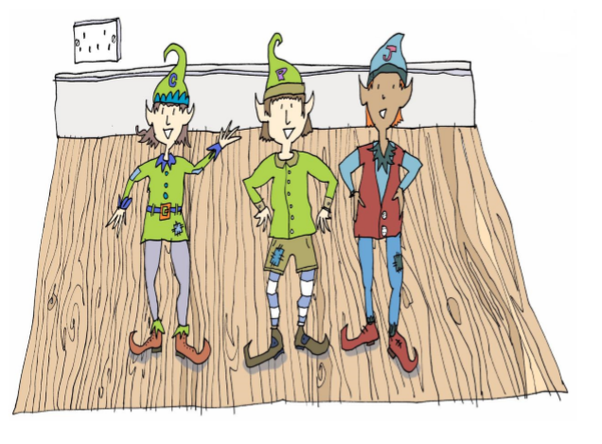
Clary, Jaz and Pepper have lots of
Friends all over the world who like to
Help people too.

Slide 4
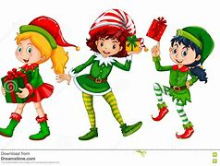
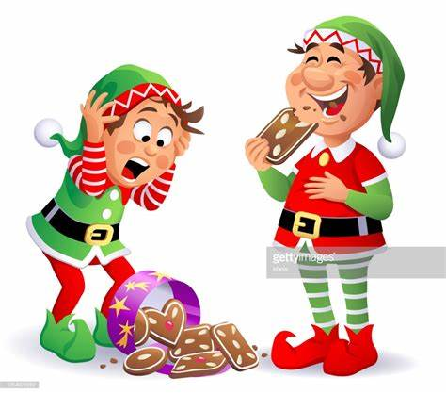
Holly, Jolly and Merry all help Father Christmas in the North Pole.
Cookie and Cupcake
help Mr and Mrs Pie
at the bakery.

Slide 5
We are going to create new characters.
First, who could our magical
Characters help and what could they
help them to do?
Could they be:
Bakers? Teachers? Carpenters?
Toy makers? Chefs?

Slide 6
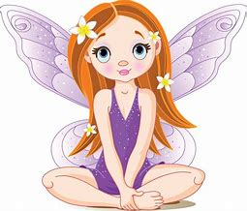
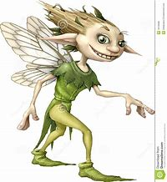
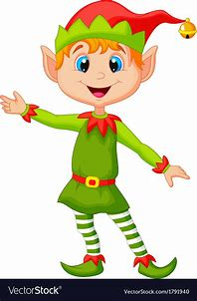
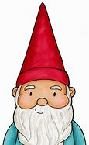
Who are your magical characters?
Are your magical characters:
Elves? Pixies? Fairies? Gnomes?
What are their names? Are their names
linked to who they are helping – Like
Cookie and Cupcake?

Slide 7
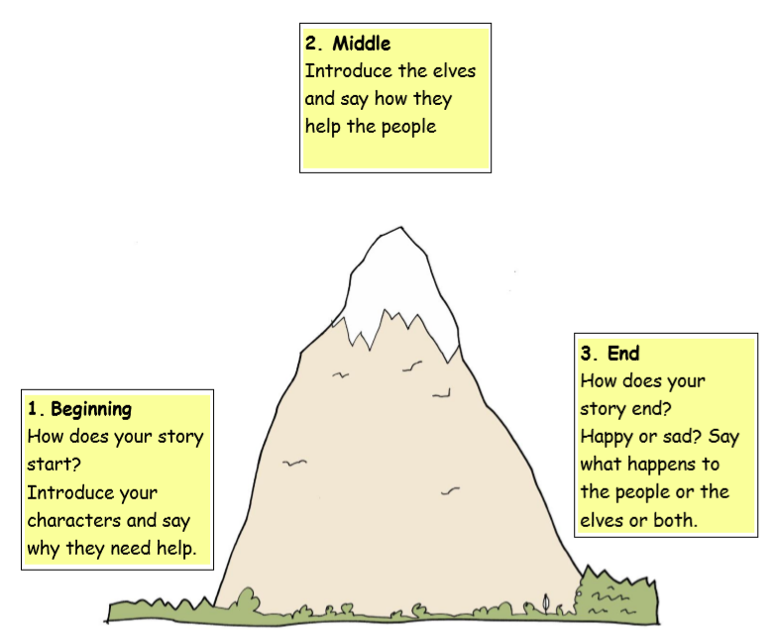
Now that you have your characters, use the story mountain to help you plan what is going to happen.

