Slide 1
Tuesday 23rd June 2020
Notes:
© Copyright Showeet.com – Free PowerPoint Templates. Photo credits: Pixabay (CC0 Public DomainFree for commercial use No attribution required)

Slide 2
Yesterday, we worked really hard to complete our explanation texts to tell people how our marvellous medicines work.
Let’s read our texts to remind ourselves. You can re-read yours or you can read mine on the next page.

Slide 3
Miss Lacey’s magical medicine
Do you have the world’s grumpiest teacher? Do they have a black cloud over their head?
If so, worry no more! Use Miss Lacey’s magical medicine and your teacher will be a ray of sunshine! So, how does it work?
First, the mouthwash will trickle down their neck as a result all the mean words will be washed straight out of their mouth.
Next, the slimy conditioner starts to bubble consequently your teacher’s voice will be
silky and smooth.
After that, the toothpaste blasts away all the brown dirt from their teeth so that they
have a beautiful, clean smile.
Soon, the washing powder will crackle away in their brain as a result all their
thoughts clean and kind.
Finally, the pop will begin to fizz so that your teacher is full of energy.
Warning: Only use 1 spoon of medicine. If they take more the fizziness of the
pop might make your teacher explode.
As you can see this medicine is incredible. Your grumpy teacher problem will be gone
forever!

Slide 4

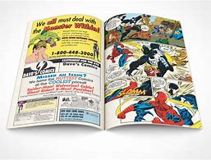
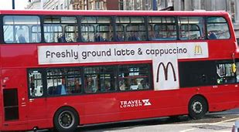

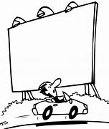
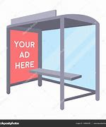
Today, we are going to design adverts for our medicines to encourage people to buy them.
Where do you see or here adverts?
Magazine
On the side of a bus
Television
radio
Bus stop
billboards

Slide 5
You can choose today how you want to advertise your medicine.
Will you plan and record a TV commercial?
Will you draw an advert for a magazine or
for the side of a bus?
Will you make a voice recording like on the radio?

Slide 6
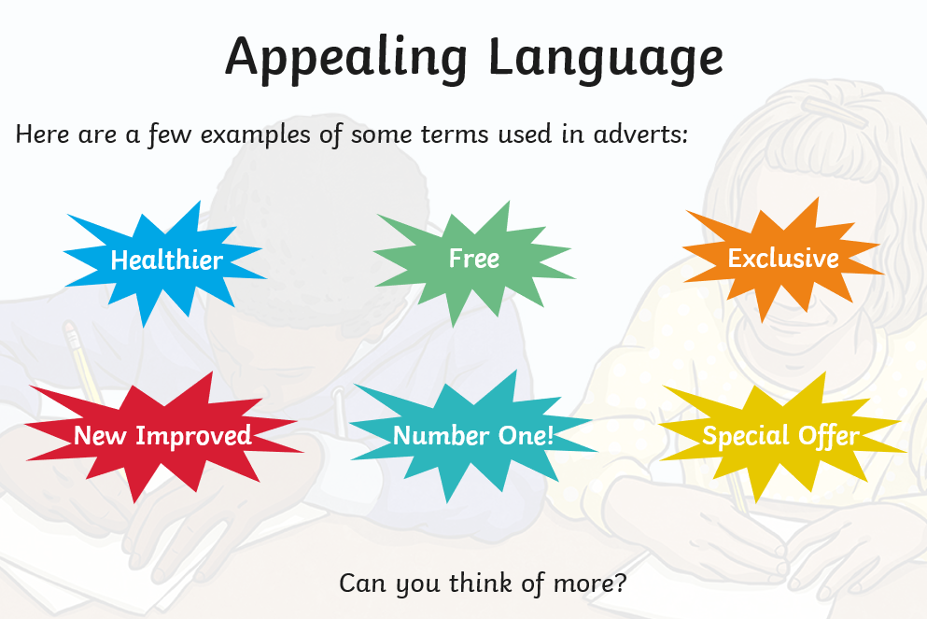
No matter how you choose to advertise you will need to use language that makes people want to buy your product.
Best selling!

Slide 7
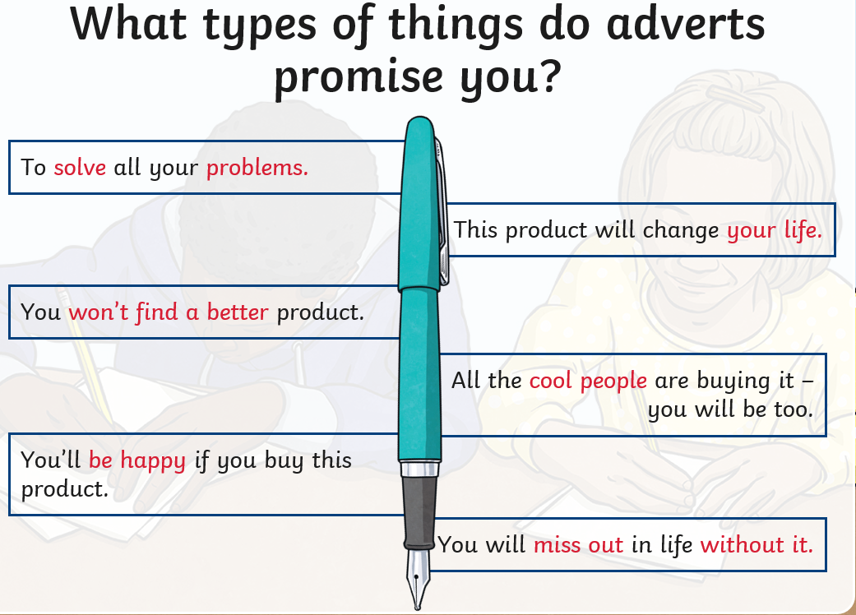
No matter how you choose to advertise you will need to use language that makes people want to buy your product.

Slide 8
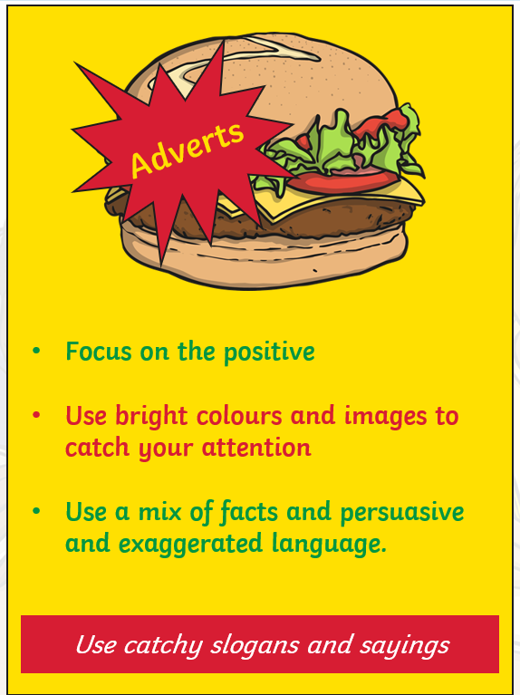
They wouldn’t tell you the warnings in an advert!

Slide 9
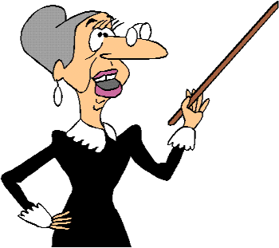
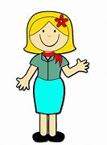

Miss Lacey’s
Magical Medicine!
Grumpy teacher be gone!!!!
Special offer!
Buy one get
one free!
You won’t regret buying this!
Instant happiness in a bottle!

Slide 10
Time to relax
Chapter 12
Marvellous Medicine Number Two
https://www.youtube.com/watch?v=al-QK5MGgOA
Notes:
© Copyright Showeet.com – Free PowerPoint Templates. Photo credits: Pixabay (CC0 Public DomainFree for commercial use No attribution required)

Slide 11
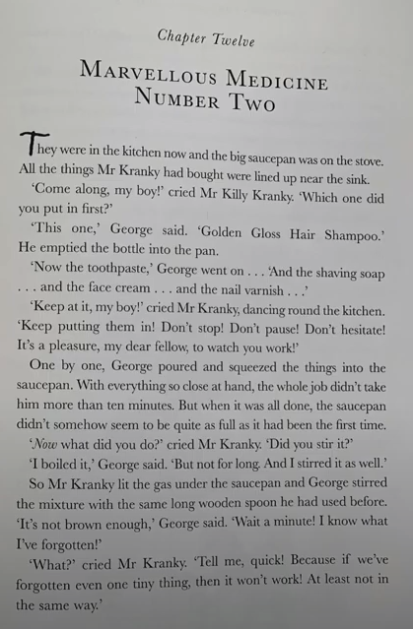
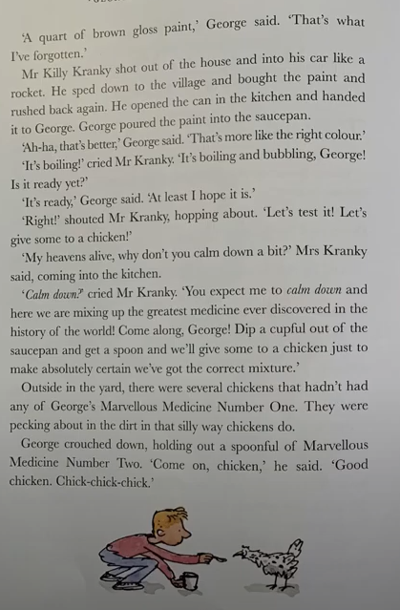

Slide 12
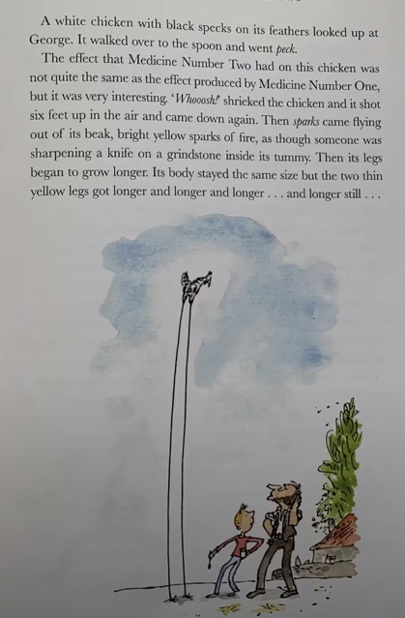
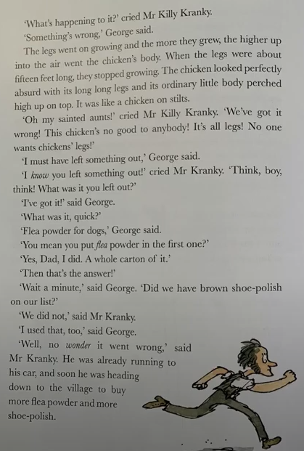

Slide 13
See you tomorrow for more of George’s Marvellous Medicine!
Notes:
© Copyright Showeet.com – Free PowerPoint Templates. Photo credits: Pixabay (CC0 Public DomainFree for commercial use No attribution required)

