Slide 1
Wednesday 6th May 2020
English – Writing skills
Notes:
© Copyright Showeet.com – Free PowerPoint Templates. Photo credits: Pixabay (CC0 Public DomainFree for commercial use No attribution required)

Slide 2
Today, we are focusing on a skill that many poets use in their writing.
Today we are learning about rhyme and rhyming couplets.
Notes:
© Copyright Showeet.com – Free PowerPoint Templates

Slide 3
Can you think of a word that rhymes with these words?
man
net
shop
dog
What similarities do you notice between your rhyming word and my word?

Slide 4
All words are split into two parts. The Onset and the Rime.
The onset is the initial phoneme (sound).
The rime is all the sounds after the onset put together.
Dog
Cat
Horse
Farm

Slide 5
In a rhyming word which part of the word stays the same?
Onset or rime?
Dog Log Frog
You’re right! The sound of the rime stays the same.

Slide 6
The ONSET is the phoneme (sound) at the start of the word. This is changed to create a new rhyming word.
The RIME is the end part of the word that sound the same as the rest of the words. This is the rhyming part. Sometimes it can be spelt using the same letters and sometimes using alternative letters that make the same sound such as ea and ee
An example of this is
pat read,
hat bead
cat seed
bat need

Slide 7
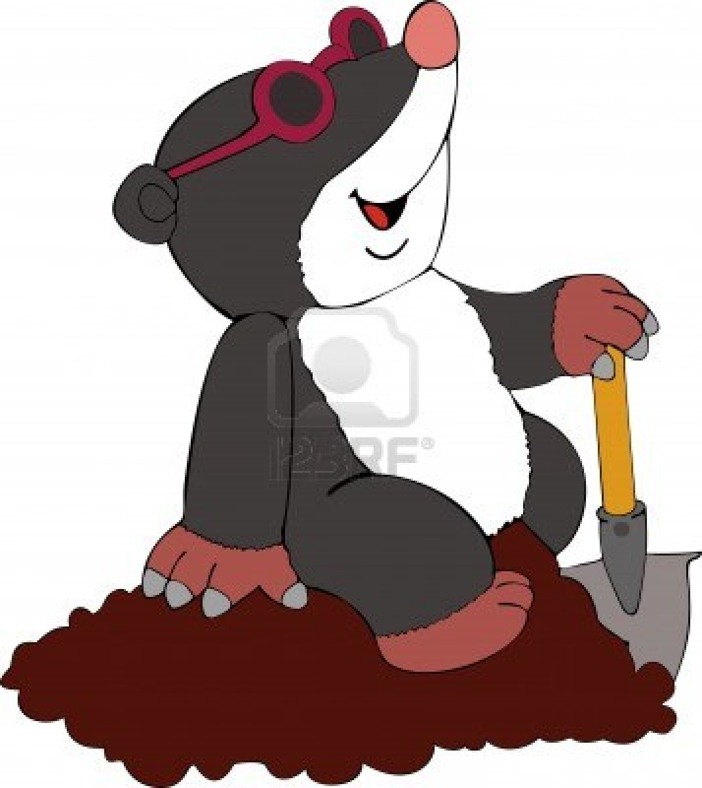
What do you notice about this picture? What could you say?

Slide 8
In poetry, when the words at the end of
two lines rhyme we call this a rhyming couplet.
In poetry when you start a new line of your poem, you need
a capital letter, even though there is not a full stop.
There is a mole,
Digging a hole.

Slide 9
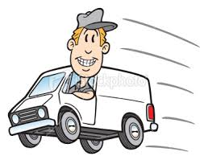
Write a rhyming couplet to match this picture.
Key things to remember:
A rhyming couplet has two lines.
At the end of each of the lines there should be a rhyming word.
Capital letter to start your second line.

Slide 10
Which sentence is correct?
Which is wrong and Why?
There was a man,
Driving a car.
There was a man, driving a van.
There was a man,
Driving a van.
This example does not have 2 clear lines of poetry to make a rhyming couplet. They needed to start a new line
After driving.

Slide 11
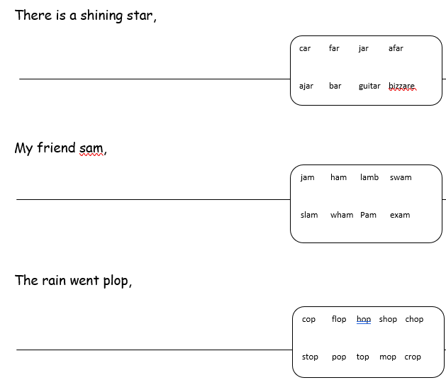
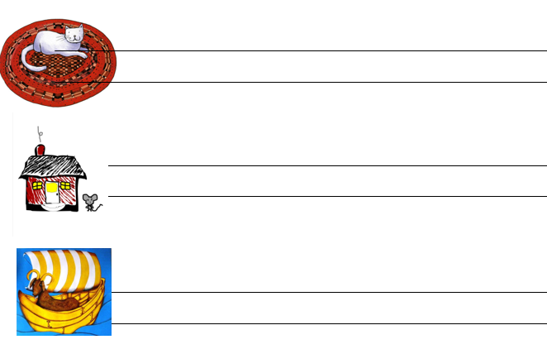
Now, tackle today’s activities.
Complete the rhyming couplet
Write your own rhyming couplet using the picture clues. What 2 things rhyme?

