Slide 1
Thursday 16th
July2020

Slide 2
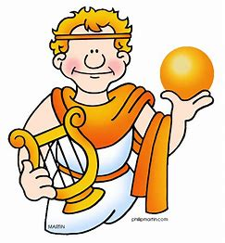
As well as knowledge,
Apollo was also the
God of poetry.
Yesterday, we made our own ideas for a magical box and we listed 8 things that we would put in our box.
Today, we are going to use Kit Wright’s poem to inspire our own.

Slide 3
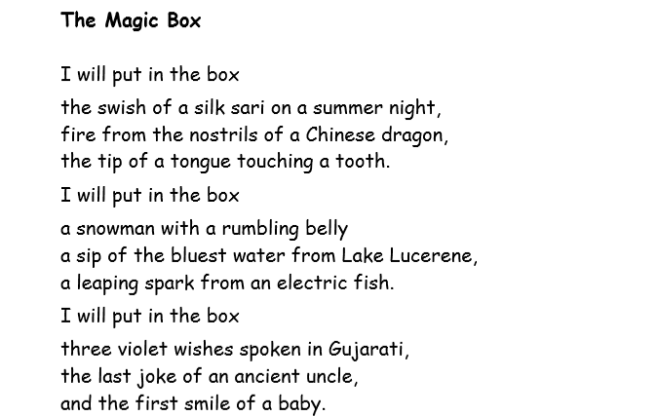
Let’s recap the poem.
You can read the poem yourself or you can here Kit Wright the author reading it here :
https://www.bbc.co.uk/bitesize/clips/zd9bwmn

Slide 4
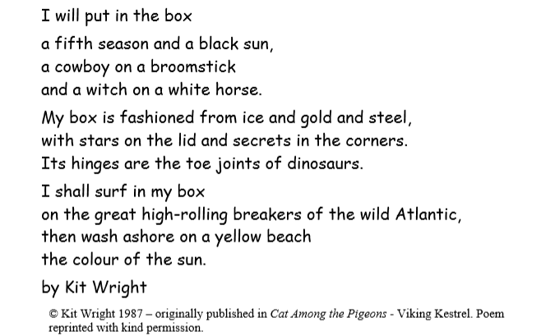

Slide 5
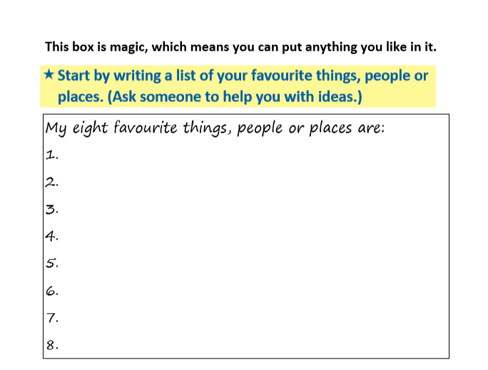
Read back your ideas from yesterday.

Slide 6
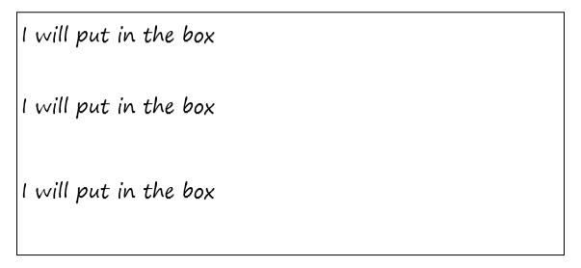
Now use the starting line from Kit Wright’s poem to
organise your 8 ideas into 3 verses.

Slide 7
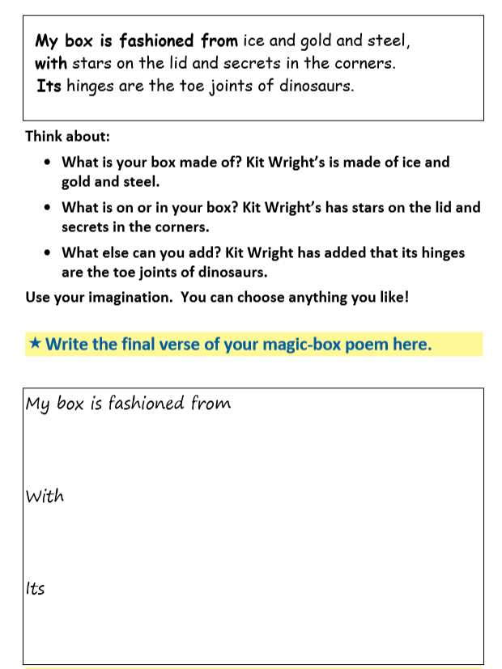
This is the final verse of Kit Wright’s poem.

Slide 8
Here is my version to help you.
I will put in the box
The sound of waves on Cornwall Beach
The soft touch of Tilly’s fur
The colourful flowers of my garden.
I will put in the box
A hot, steaming cup of tea
The smell of the pages of an old book.
I will put in the box
The sound of Year 2’s laughter
The smiles on their faces in the morning
The feeling of pride I feel for their hard work ad progress.
My box is fashioned from dark, mahogany wood
With diamonds shimmering from the top
Its lock is magical and unbreakable.

