Slide 1
Year 2– Geometry
Session 8 – grouping 3D shapes

Slide 2
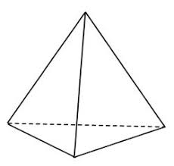
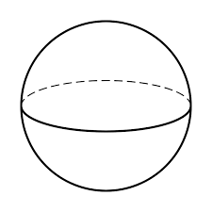
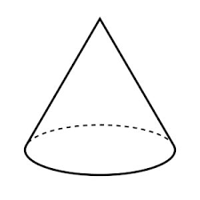
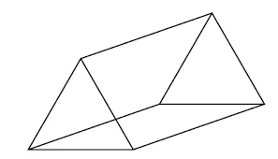
Recap – can you name these 3D shapes?
Sphere
Cuboid
Triangular based pyramid
Cone
Triangular prism

Slide 3
Today we are going to be sorting shapes.
When we sort shapes we are grouping them together based on their properties e.g. the types of faces, the number or vertices, the number of edges etc.

Slide 4
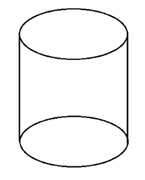
I want to sort my 3D shapes into this Venn diagram.
Rectangular faces
Circular faces
I’m going to put the shapes with rectangular faces here.
I’m going to put shapes with circular faces here.
I’m going to put shapes with both rectangular and circular faces here.

Slide 5
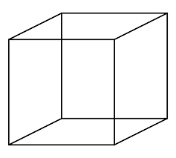
I want to sort my 3D shapes into this table.
Shapes with 4 vertices or less. | Shapes with 5 vertices or more.

