Slide 1
Year 2– Number knowledge
Odd and Even

Slide 2




What Is An Even Number?
0, 2, 4 , 6, 8
Even numbers have a mate.
If a number ends in a 0, 2, 4, 6 or 8 it is an even number.
0
2
4
6
8
We can see that on the numicon, that the numbers match in neat pairs..
Even numbers are in the 2 times table.

Slide 3





What Is An Odd Number?
1 ,3, 5, 7, 9
Odd numbers have one out of line.
If a number ends in a 1,3,5,7 or 9 it is an odd number.
1
3
5
7
9
We can see that on the numicon, that the numbers do not match in neat pairs. There is always an odd one out!

Slide 4
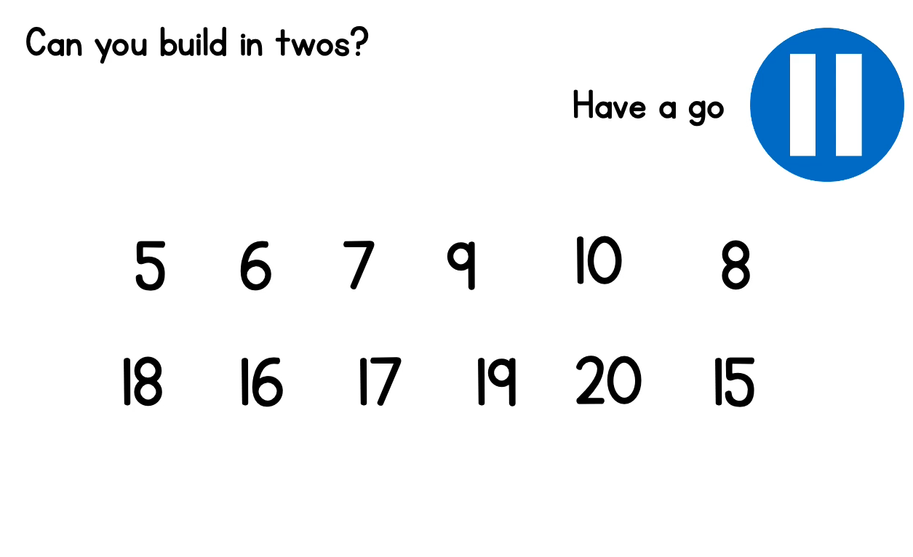
Using objects from the house, can you make these numbers by building in neat pairs? Or do they have an odd one out?
Which ones are even? (Remember these have equal pairs.)
Which ones are odd? (Remember these have an odd one out.)

Slide 5
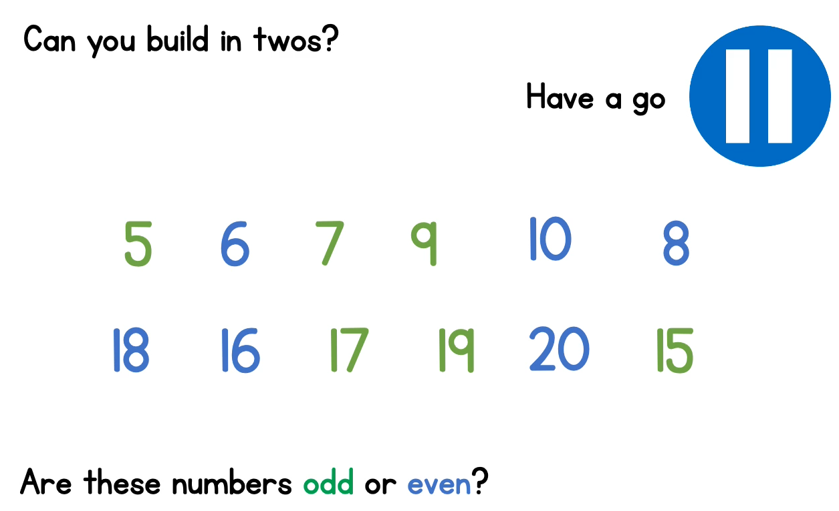

Slide 6
Can You Sort These Numbers?
Read each number out loud and then write down odd or even.
Click on the numbers to reveal the answers!
7
1
15
3
4
20
6
13
11
9
5
16
19
10
12
18
2
17
8
14
Odd
Even

