Slide 1
Year 2– Measures
Session 6 – Measuring volume in millilitres.

Slide 2
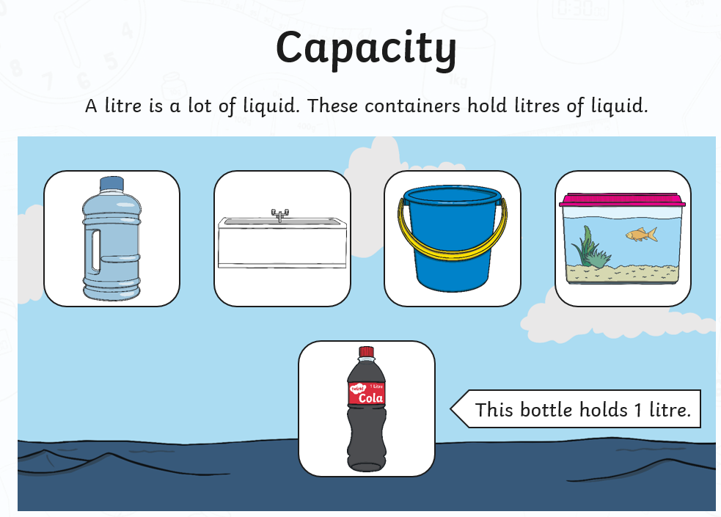
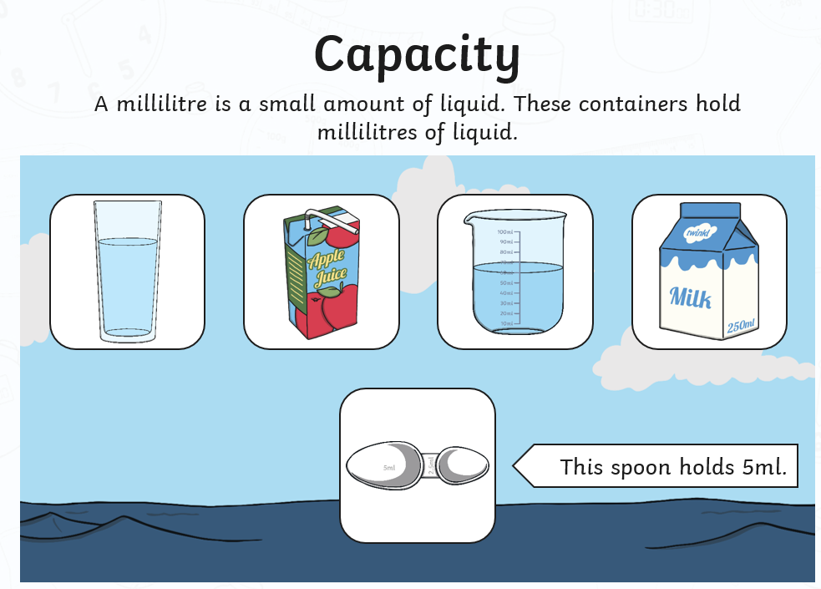
Yesterday, we began looking at standard units for measuring volume.
A standard measure is the same where ever you go in the world. Our unit of measure today is millilitres.
We learnt to read scales yesterday.
We are going to use these skills
again today.
ml is a short way of writing
millilitres.
There are 1000ml in 1 litre.

Slide 3
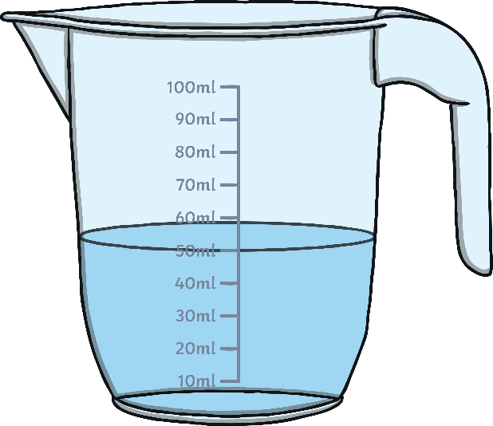
How much water is in this beaker?
We can see that the water is level with the 50 ml
line.
There are 50 millilitres of water in the beaker.

Slide 4
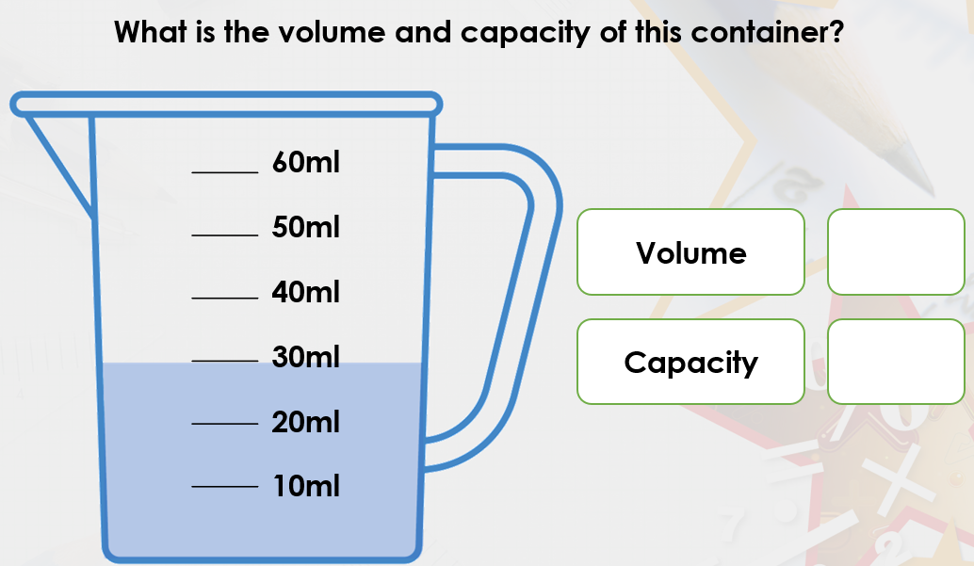
Reminder – volume is how much is in a container right now.
30ml
60ml
Reminder –Capacity is how much water could
a container hold.

Slide 5
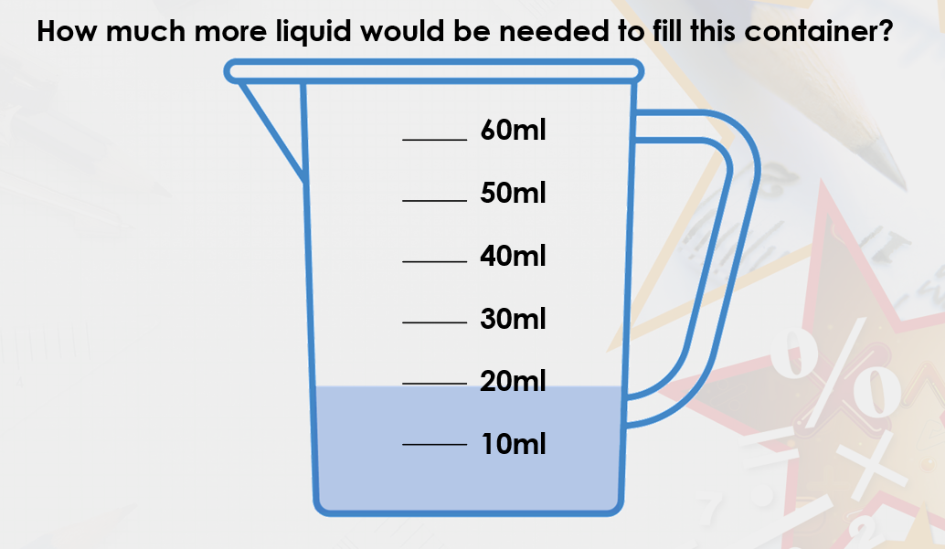
The beaker can hold 60ml.
It currently has 20 ml in inside. We need to work out the difference.
We could do this by counting on.
10
20
30
40
We could also do a take away
60 – 20 = 40

