Slide 1
Thursday 2nd July 2020
Vocabulary

Slide 2
Today we are going to be thinking about vocabulary and word classes.
We are going to be unpicking words and thinking about what they mean and also what type of words they are.

Slide 3
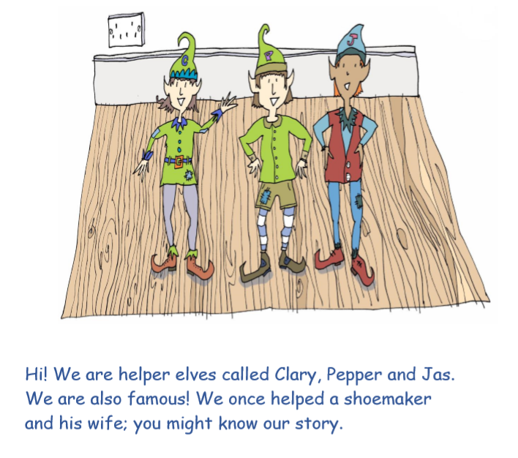
Start by re-reading our story from yesterday.

Slide 4
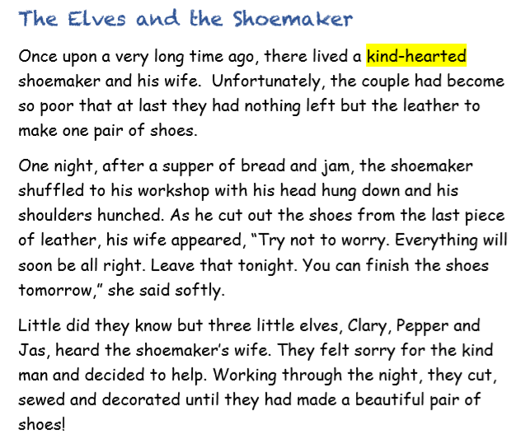

Slide 5
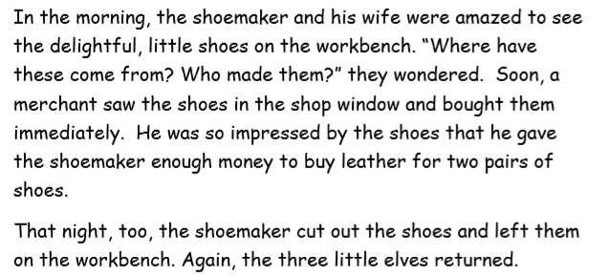

Slide 6
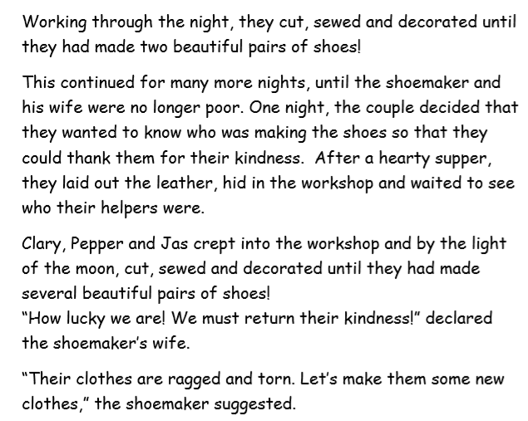

Slide 7
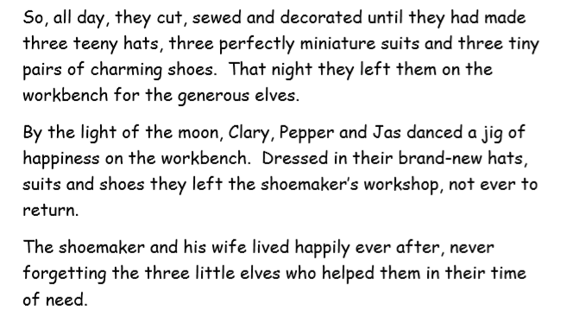

Slide 8
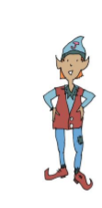
Today, Jaz the elf is going to
be helping us.
He loves playing about
with words.

Slide 9
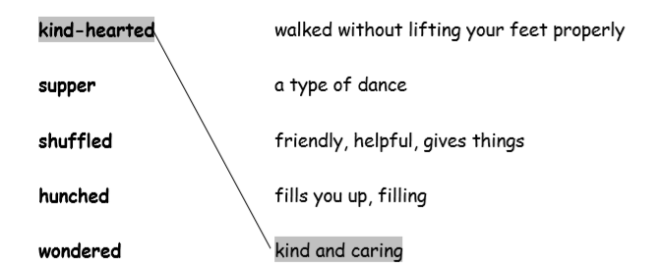
In Jaz’s first game, we are going to think about what
words mean.
To do this, we need to find the
word in the text by skimming and scanning
with our eyes.
Then we need to read the sentence to help
us work out the meaning.
Finally, we will make a matching pair on our
work sheet, like this:

Slide 10
In Jaz’s second game, we are
going to be sorting words into groups
using their word classes – what type of
words they are.
E.G are they nouns? Verbs? Adjectives?
Let’s refresh our memory before we have a go at his task.

Slide 11
What is a verb?
A verb is a doing word. It is the name of something you can do.
Examples: run swim sing

Slide 12
What is a noun?
A noun is the name of a person, a place or an object.
Examples: Ben table London

Slide 13
What is an adjective?
An adjective is a describing word.
Examples: big, shiny, colourful

Slide 14
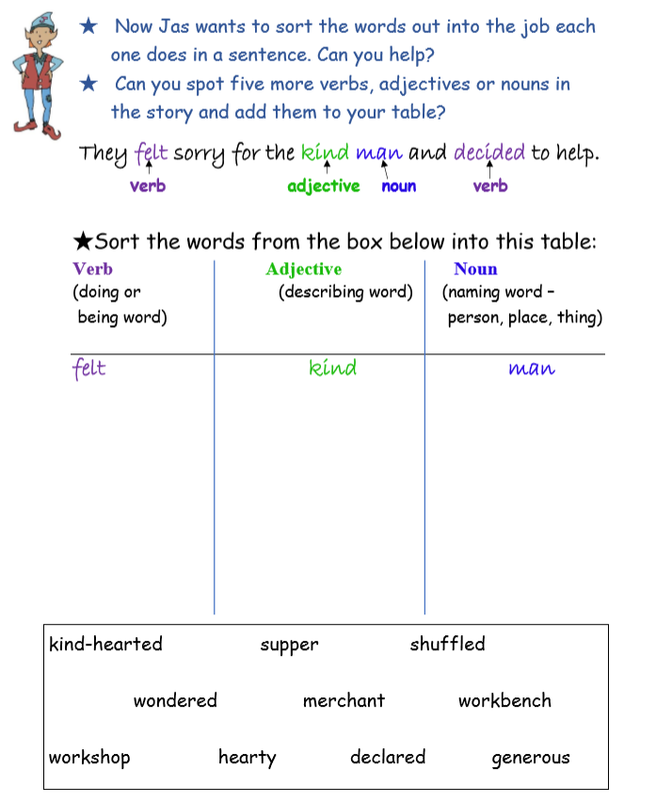
Jaz’s second game…
Sort these words first.
Then, look back over the story to find 5 more words that you can sort into your table.

