Slide 1
Wednesday 10th June 2020
Notes:
© Copyright Showeet.com – Free PowerPoint Templates. Photo credits: Pixabay (CC0 Public DomainFree for commercial use No attribution required)

Slide 2

George’s Marvellous Medicine is a short
Chapter book. We will be reading or listening to a chapter or 2 every day.
I will include the text for you to read but remember that it is okay to share the reading with an adult, or even listen to it and follow along.
Our reading sections might look a little longer but if you can read it, push yourself to have a go! You can always listen again after or have a break and listen for a while ☺
Notes:
© Copyright Showeet.com – Free PowerPoint Templates

Slide 3
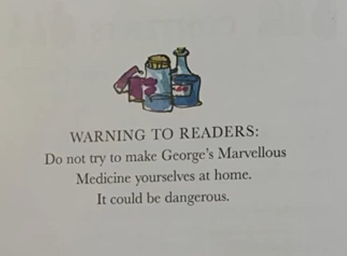
First, a small message from Roald Dahl and I…
Remember, this is a story.
We do not make
mixtures from things at home and
drink them…especially some of the things
George uses. They could make us very poorly
and it is not safe.

Slide 4
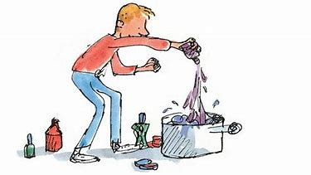
Before we do, let’s remind ourselves.
What is happening at the moment?
Can you remember anything that George put into his medicine?
We are going to listen to Chapter 4 today.

Slide 5
Chapter 4
Animal pills
https://www.youtube.com/watch?time_continue=5&v=Lx7eMBR_cOs&feature=emb_logo
Notes:
© Copyright Showeet.com – Free PowerPoint Templates. Photo credits: Pixabay (CC0 Public DomainFree for commercial use No attribution required)

Slide 6
We are going to listen to Chapter 4 today using this online video.
You can read along at the same time.
Remember to stop the video at the end of Chapter 4.
https://www.youtube.com/watch?time_continue=5&v=Lx7eMBR_cOs&feature=emb_logo

Slide 7
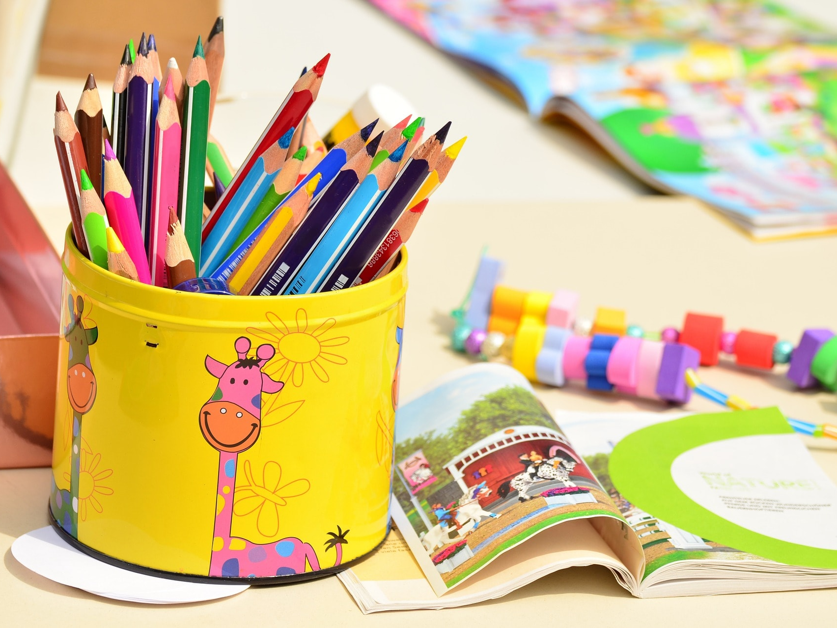
Today, we are going to practice an important punctuation skill. We are learning to use commas in a list.
Notes:
© Copyright Showeet.com – Free PowerPoint Templates. Photo credits: Pixabay (CC0 Public DomainFree for commercial use No attribution required)

Slide 8
This is a list sentence.
Miss Lacey likes reading, drinking tea, gardening and cooking.
It tells you all the things that I like to do without starting a new sentences every time.
Like this:
Miss Lacey likes reading. Miss Lacey likes drinking tea. Miss Lacey likes gardening. Miss Lacey likes cooking.

Slide 9
This is a list sentence.
George emptied the bottles one by one. He added
as tin of curry powder, a tin of mustard powder,
a bottle of horseradish sauce and some chilli sauce.
It tells use some of the things that George put into his medicine.
In between each thing is a comma. This separates the
Items and tell the reader to take a small breath between each thing.

Slide 10
George emptied the bottles one by one. He added
as tin of curry powder, a tin of mustard powder,
a bottle of horseradish sauce and some chilli sauce.
Before we add on the very last item on the list, we use and to separate the times, not a comma.

Slide 11
Spot the commas and the ‘and’ in this sentence.
The medicine looked murky, brown and yucky.
This sentence is using a list of adjectives to describe.

Slide 12
What have I missed? Can you fix my list sentence?
George went to the bathroom the bedroom the kitchen the shed.

Slide 13
Let’s build a list sentence together.
Think of 4 adjectives to describe George.
George is a _____________ ____________
________________ and
________________ boy.
What do we need here?

Slide 14
Your turn….
Challenge 1 – Fix the sentences by adding the commas into the correct places. Write the sentences back out properly.
Challenge 2 – Write your own list sentences to match the description. Make sure you remember your commas and ‘and’

Slide 15
See you tomorrow for more of George’s Marvellous Medicine!
Notes:
© Copyright Showeet.com – Free PowerPoint Templates. Photo credits: Pixabay (CC0 Public DomainFree for commercial use No attribution required)

