Slide 1
Monday 4^{th May} 2020
English - Spelling
Notes:
© Copyright Showeet.com – Free PowerPoint Templates. Photo credits: Pixabay (CC0 Public DomainFree for commercial use No attribution required)

Slide 2

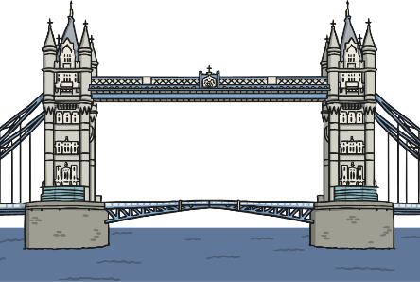
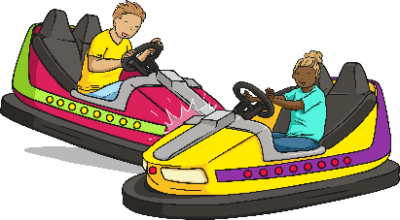
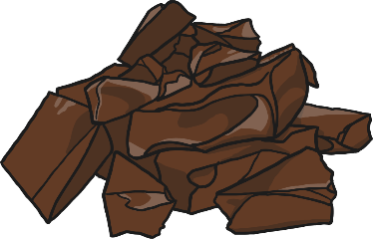
What do you notice about the letters dge in these words? What sound is it making?
badge
bridge
dodge
fudge
The dge in all these words makes an ‘j’
sound. We use –dge to spell a ‘j’ sound
at the end of a word after a short vowel.
(See week 1 Monday Powerpoint if you can’t remember what these are).
Notes:
© Copyright Showeet.com – Free PowerPoint Templates

Slide 3
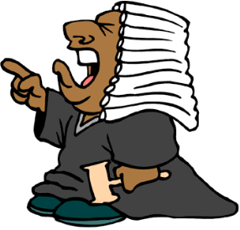
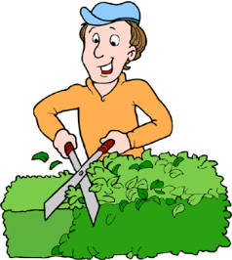
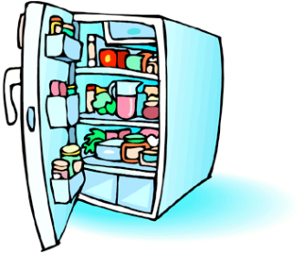
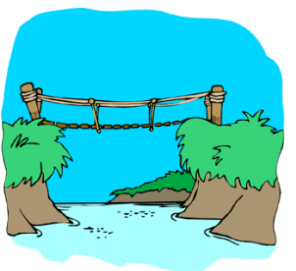

Can you write these words using our spelling pattern?
judge
hedge
fridge
sledge
bridge

Slide 4
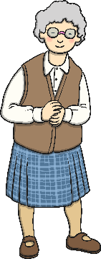
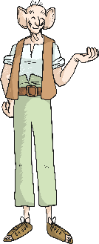

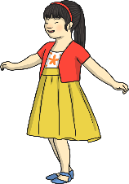


What do you notice about the letters dge in these words? What sound is it making?
age
huge
charge
The ge in all these words makes an ‘j’
sound. We use –ge to spell a ‘j’ sound
at the end of a word after any other sound.
These could be long vowels or consonants.
Notes:
© Copyright Showeet.com – Free PowerPoint Templates

Slide 5

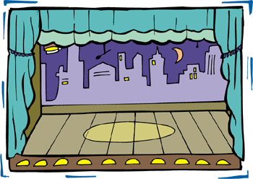

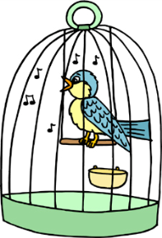
Can you write these words using our spelling pattern?
Orange
Stage
hinge
cage

Slide 6
Which words in these sentences use our spelling patterns? Can you explain why they are dge or ge?
Stages need to have lighting and sound.
Should we put the fudge in the fridge?
Their oranges were nice and huge!
A bridge goes across a river.
Notes:
© Copyright Showeet.com – Free PowerPoint Templates

Slide 7
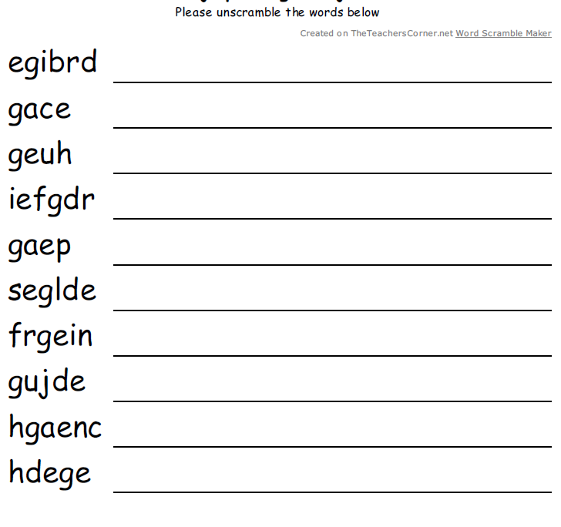
Use the sheet for today to complete this activity. Your sheet should look like this
Unscramble the letters to make words that use the dge or ge spelling patterns.
The first one has been done for you.
If you can’t print off the sheet, don’t worry. Just use your finger to track the path on the screen.
Notes:
© Copyright Showeet.com – Free PowerPoint Templates

