Slide 1
Year 2– Multiplication and division
Session 1 – Using the multiplication sign.

Slide 2
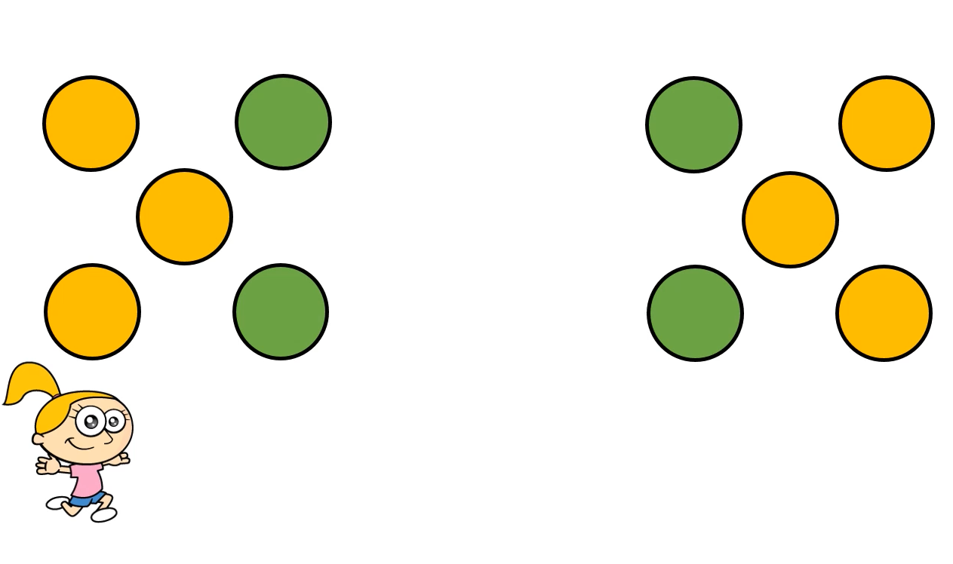
Eva has been organising some circles.
When you see this image, what do you see?

Slide 3
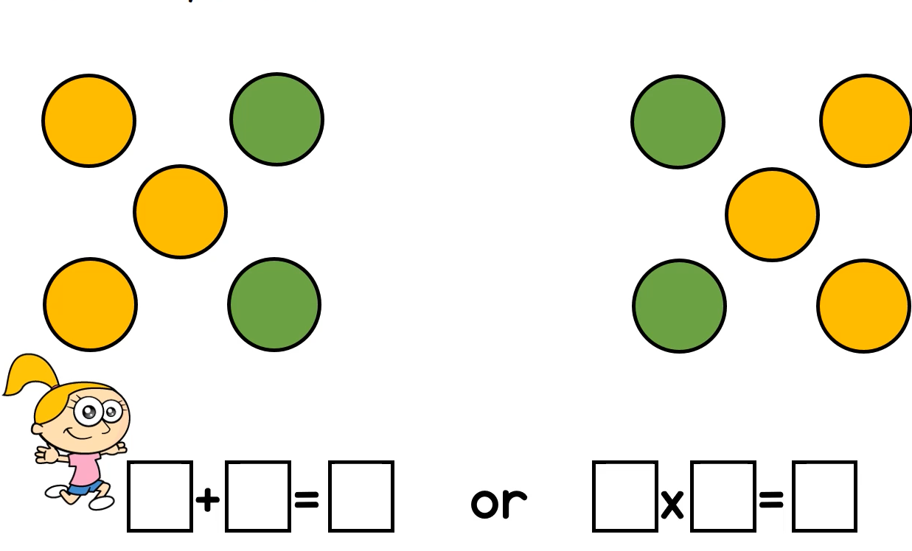
I see two things.
An addition
And a multiplication
5 5 10
2 5 10
5 add 5 equals 10
2 lots of 5 equals 10

Slide 4
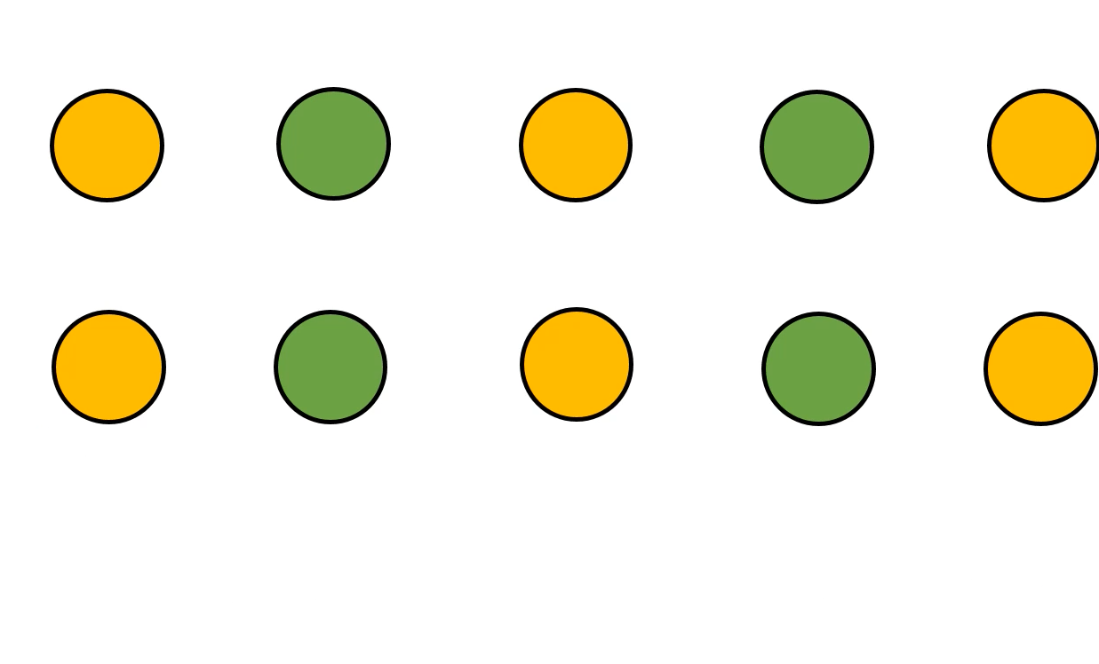
Eva has moved her circles around.. What can you see now?

Slide 5
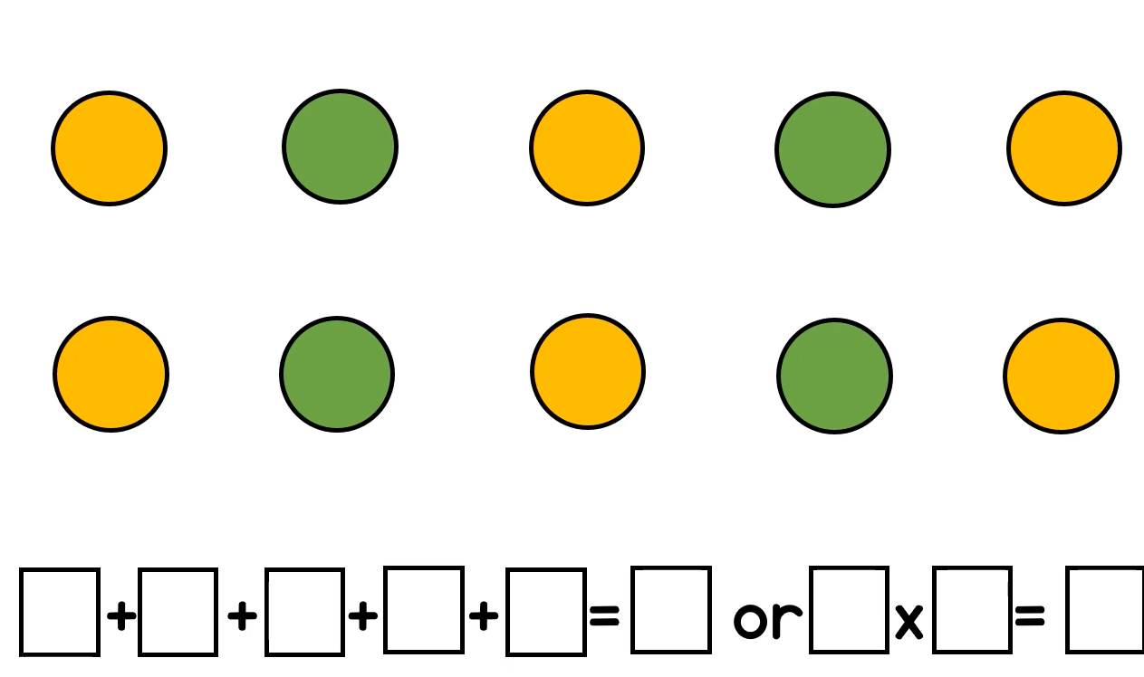
2 2 2 2 2 10
5 2 10
This time.. We have 5 lots of 2

Slide 6
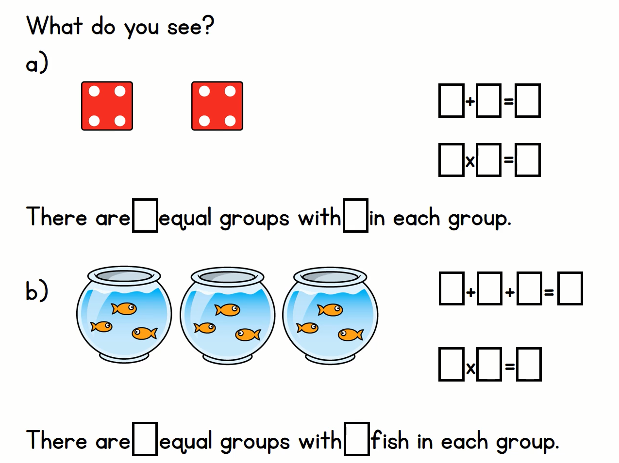
Have a look at these
images. What do you see?
Try to write the
addition and
multiplication
sentences for each
Image.

Slide 7
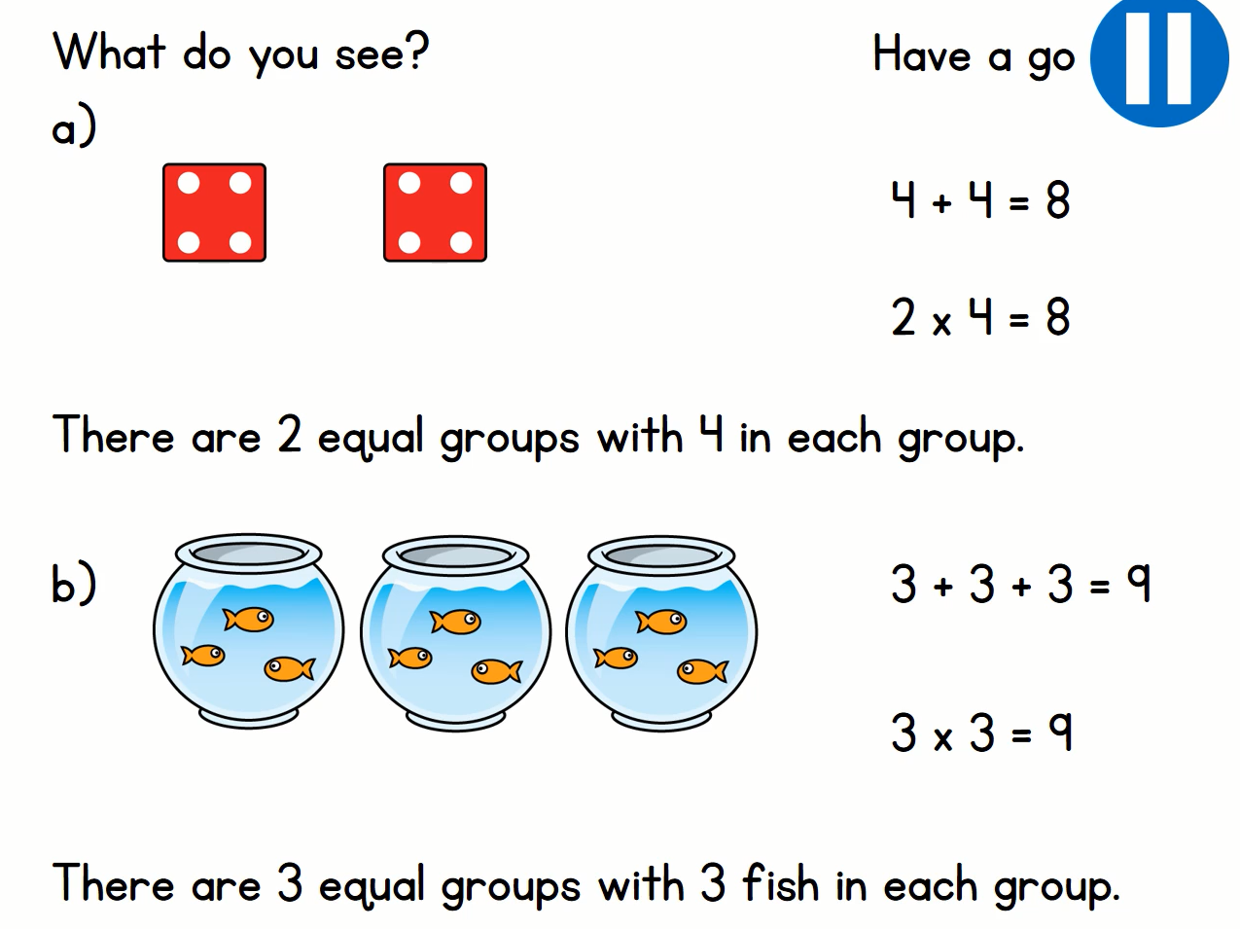

Slide 8
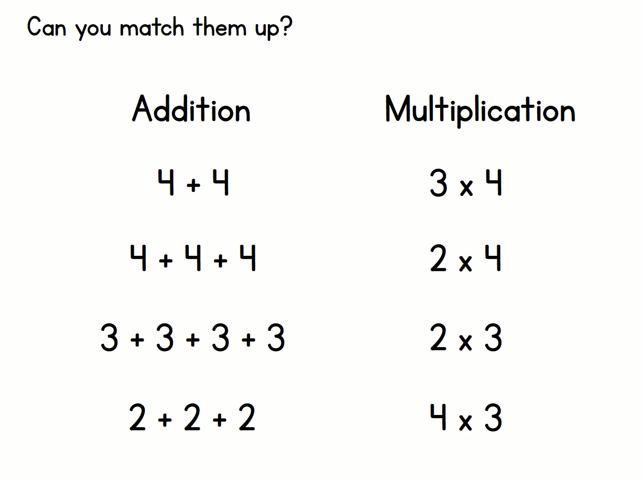

Slide 9
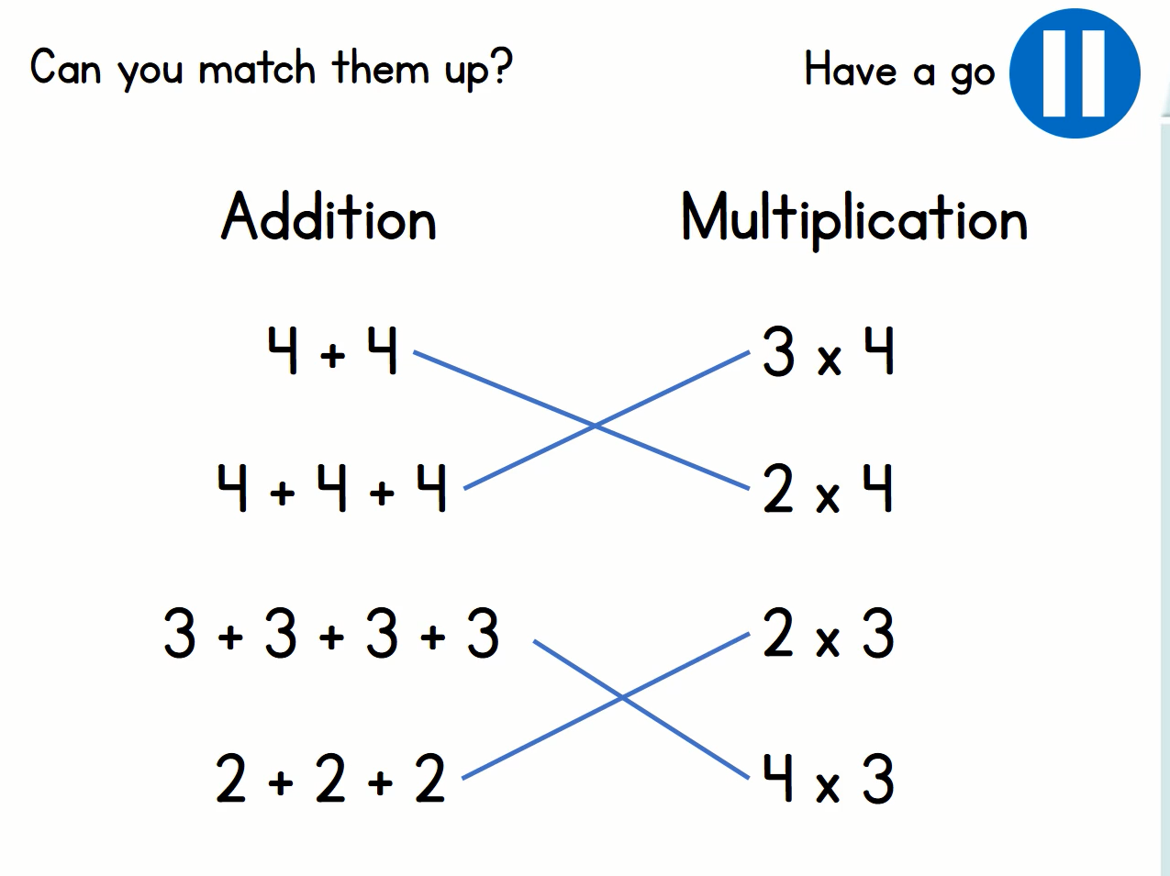

Slide 10
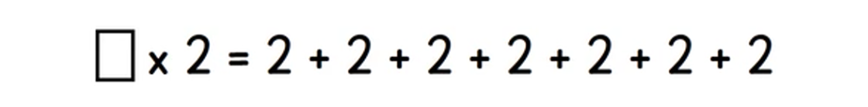
I have a puzzle this time….
7
My equals sign is in the middle.
If we use the words ‘is the same as’ instead of equals, my question sounds like this….
Something lots of 2 is the same as….
This means I need to balance it out, one side needs to show the same as the other.
I’m going to count how many twos are being added together after the ‘is the same as’ symbol.
There are 7 twos.
There are 7 lots of two.
7 x 2

Slide 11
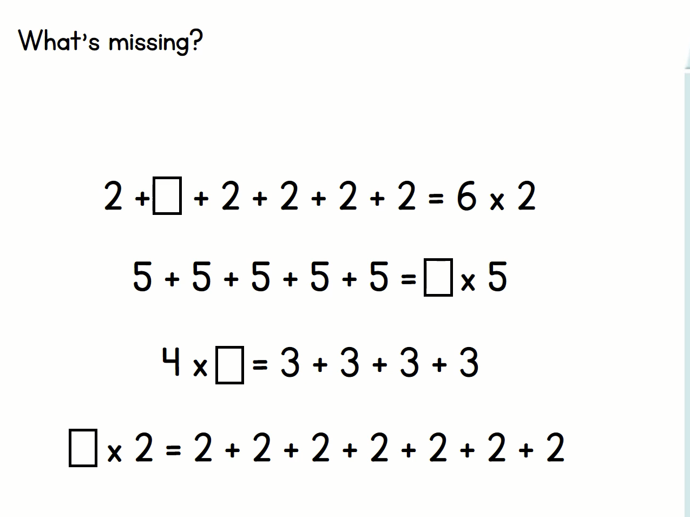
Try these puzzles using the same idea.

Slide 12
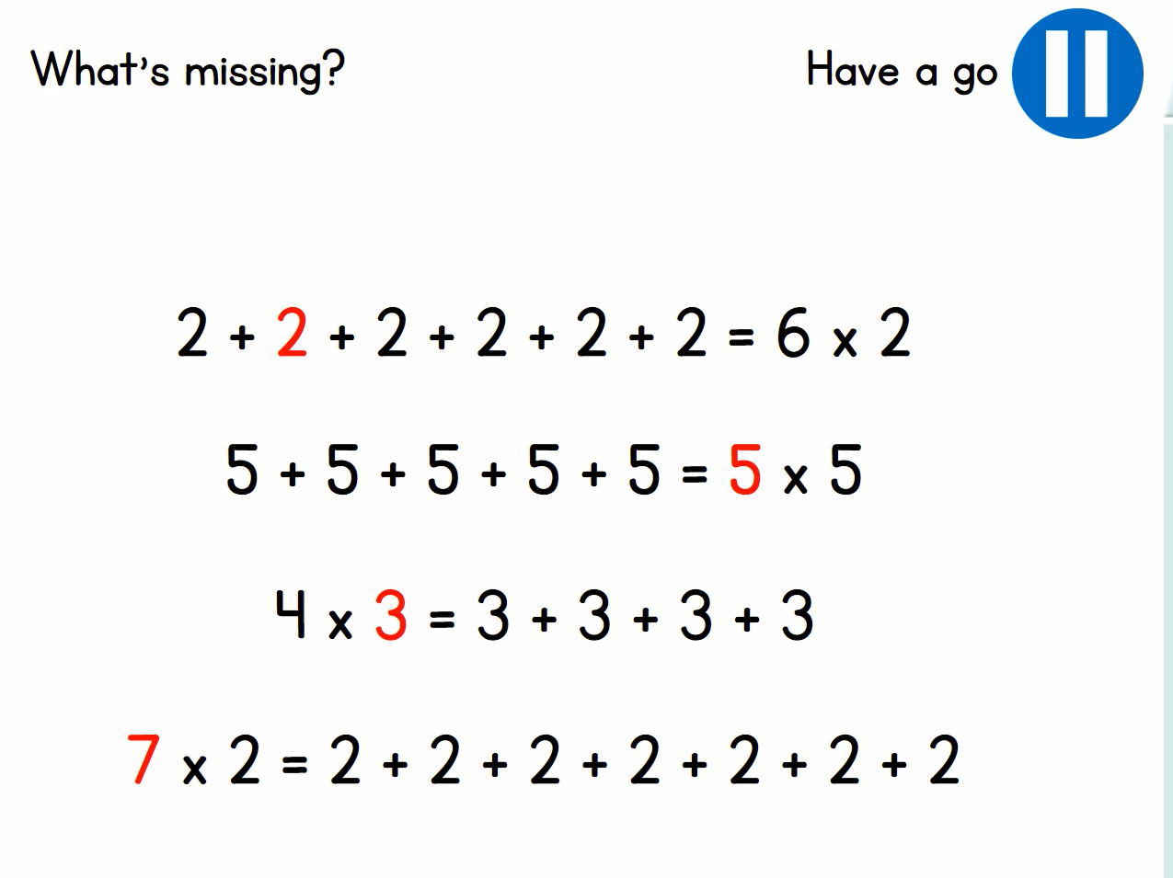

Slide 13
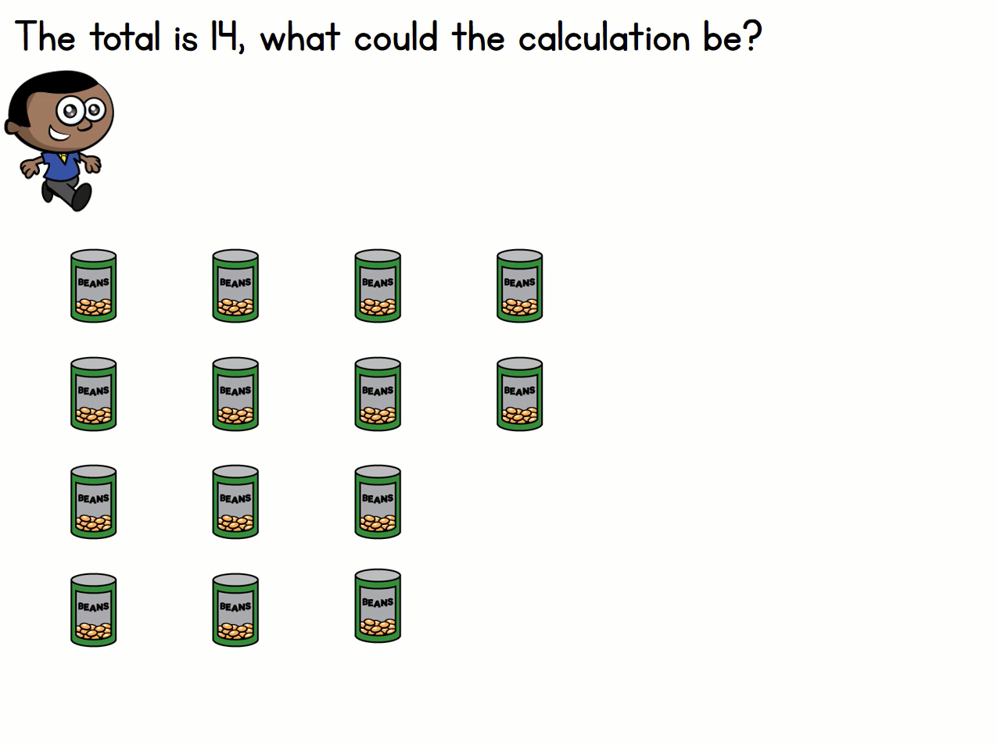
Mo has been helping to put these cans away. There are 14 cans.
Mo is trying to think what addition and multiplication sentences he could make.

Slide 14
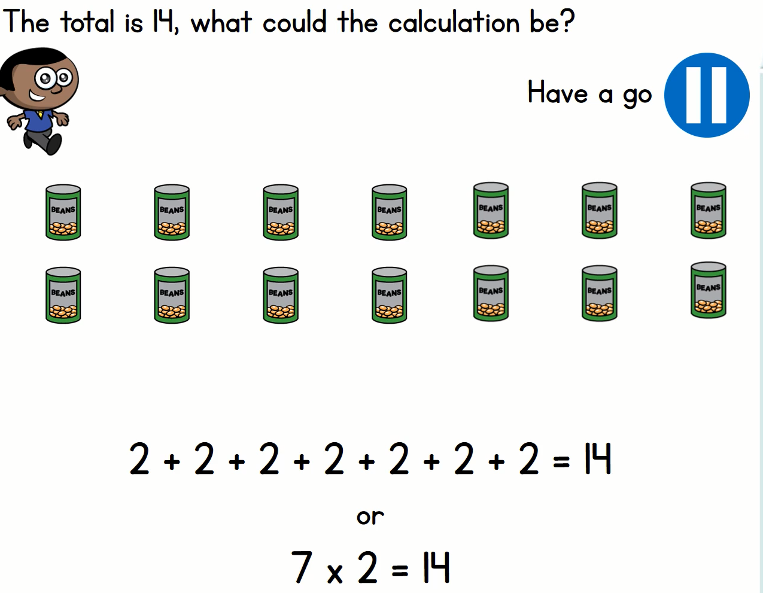
Mo rearranged the cans like this to help him work it out
Now he can easily make his sentences.

