Slide 1
Year 2– Multiplication and division
Session 6 – grouping.

Slide 2
Yesterday, we learnt to divide by sharing. Today, we are going to learn a new way to divide using grouping, putting things into groups.

Slide 3
How many bunches can I make with 3 daffodils in each?

Slide 4
I need to group to make bunches my daffodils.
I need 3 in each group.
I made 4 bunches of 3.
12 ÷ 3 = 4

Slide 5
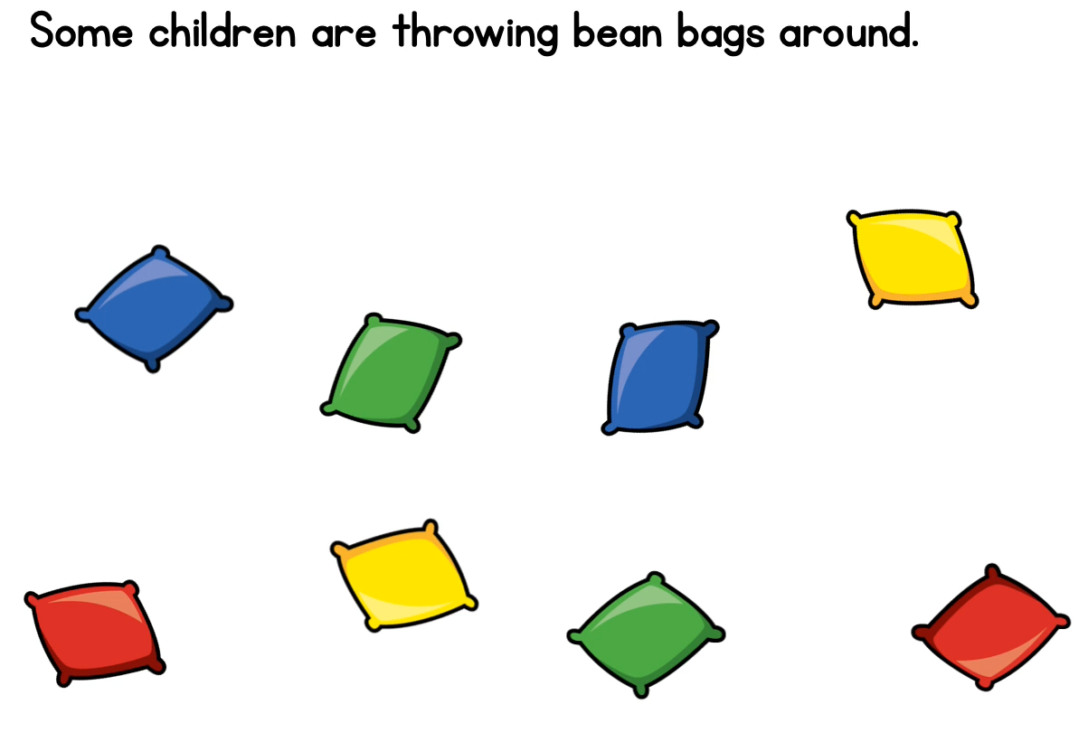
They have 8 bean bags.
To play their next game, each child needs 2 bean bags. How many children can play?
I need to put the beanbags into groups of 2.

Slide 6
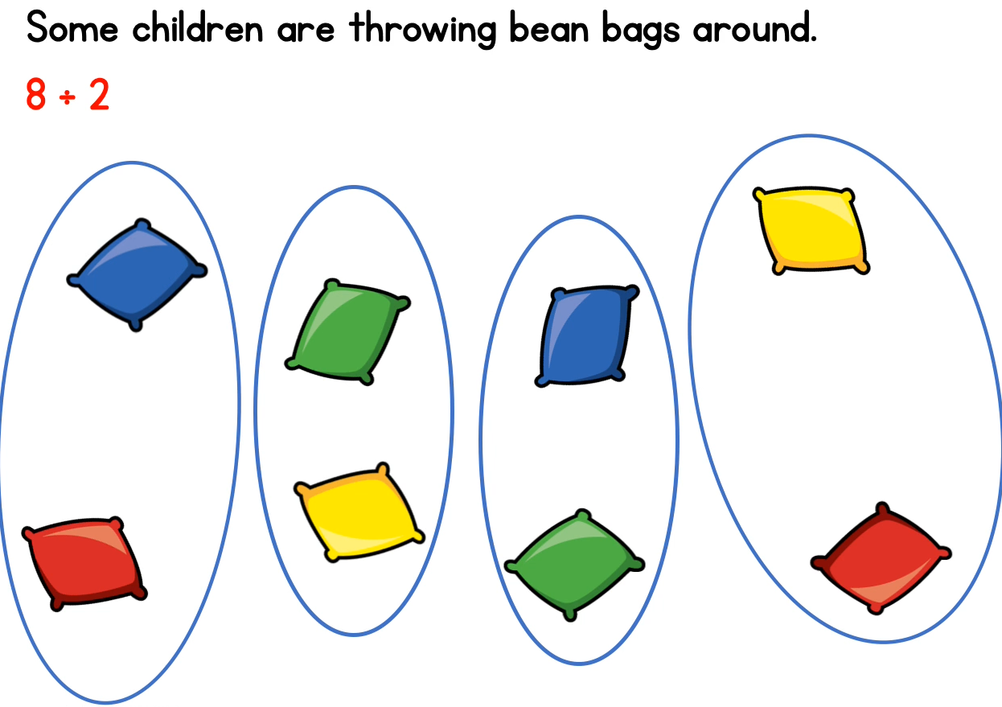
8 beanbags grouped into 2’s = 4 groups.
4 children can play the game.
8 ÷ 2 = 4

Slide 7
Dora is playing with these cards. Each person needs 4 cards.
12 cards grouped into 4
4

Slide 11
We can see that Alex is jumping in 2s today.

Slide 13
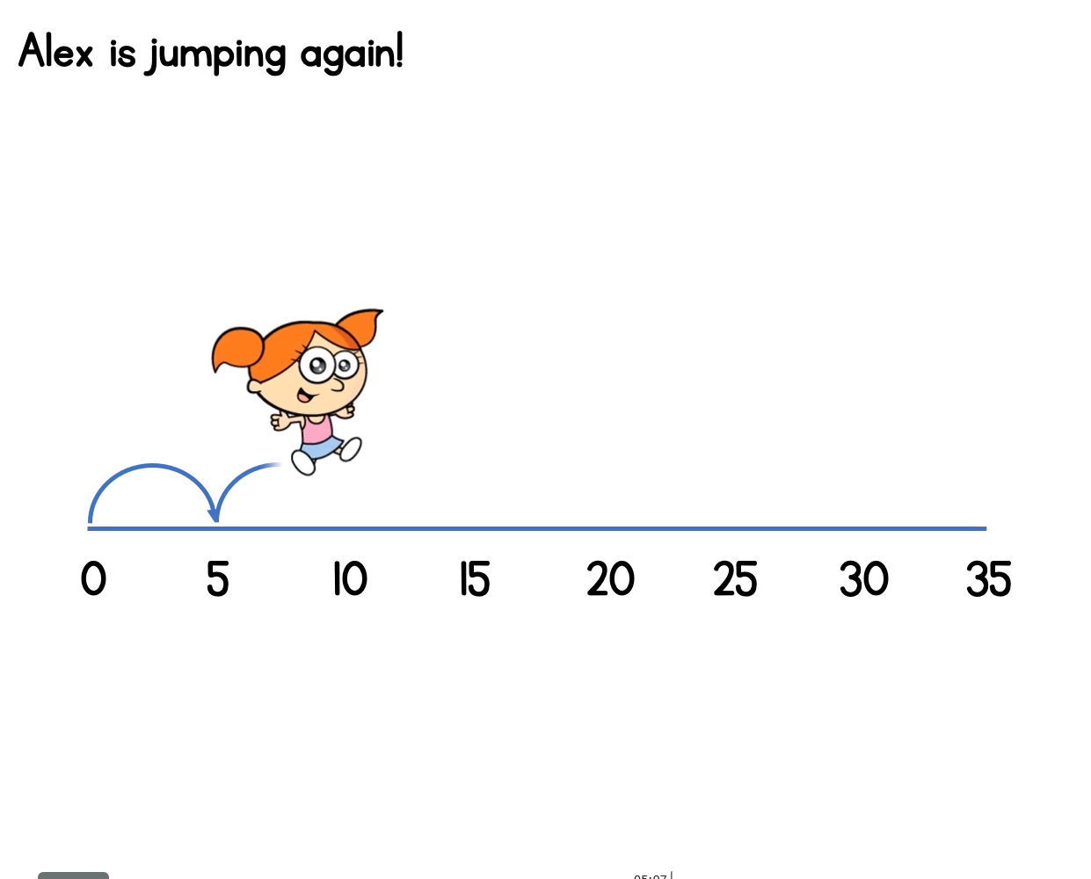
This time, Alex is jumping in 5s.

Slide 14
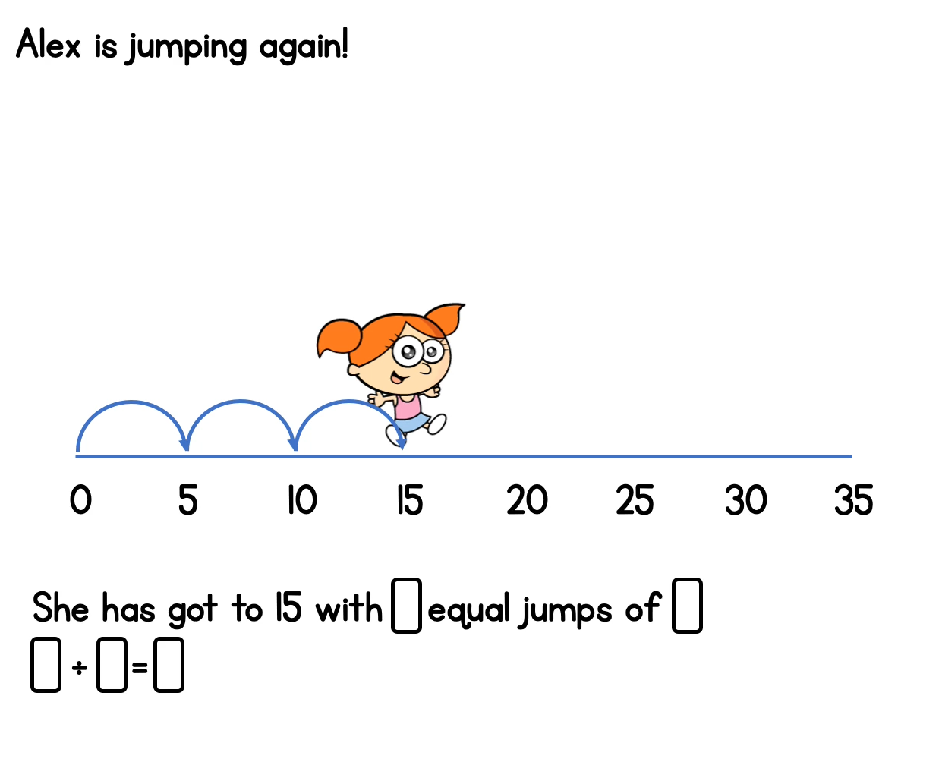
3
5
15
5
3

Slide 15
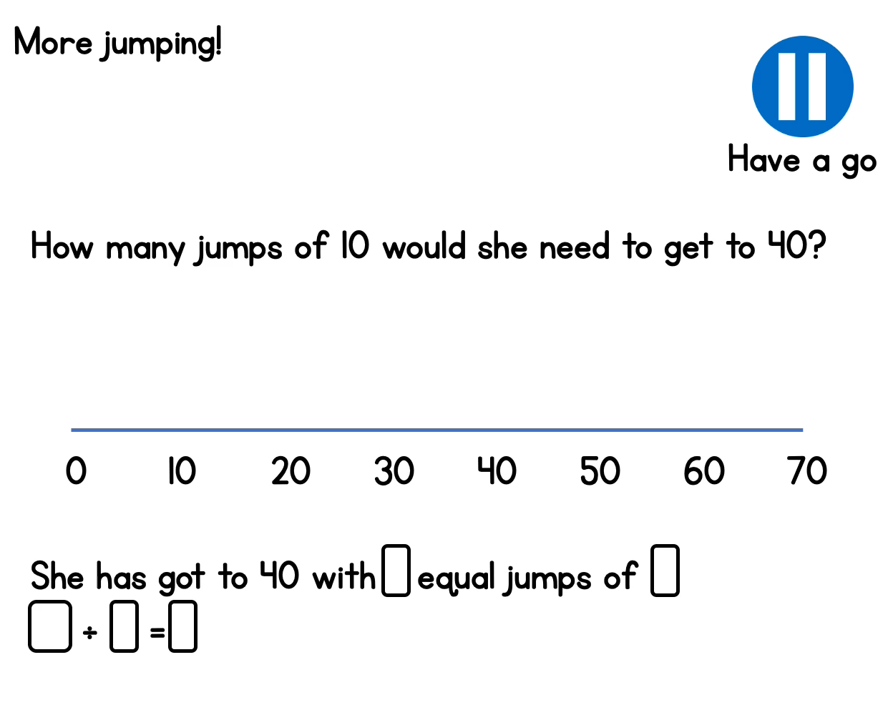

Slide 17
10 ÷ 2 =
The second number tells me how many I need in each group.
The first number tells me how many objects we have altogether
When we are grouping, this symbol (divide) means grouped into.

Slide 18
10 ÷ 2 =
5
5 groups
10 objects
grouped into
2s =

