Slide 1
Thursday 25th June 2020
Notes:
© Copyright Showeet.com – Free PowerPoint Templates. Photo credits: Pixabay (CC0 Public DomainFree for commercial use No attribution required)

Slide 2
Today we are going to read the final chapter of George’s Marvellous Medicine.
Goodbye Grandma
As always if you would prefer to listen to the video please find it at https://www.youtube.com/watch?v=al-QK5MGgOA
Chapter 15 starts at 12 mins and 20 secs.

Slide 3
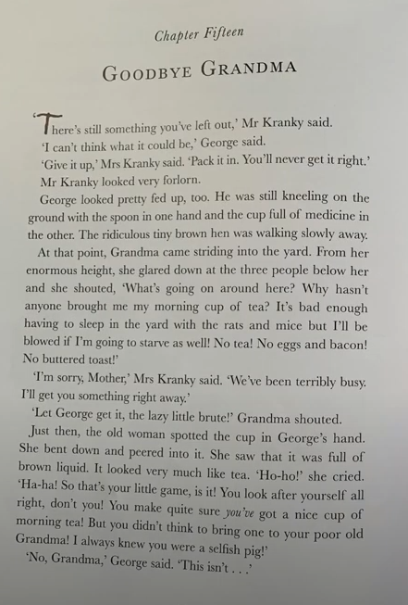
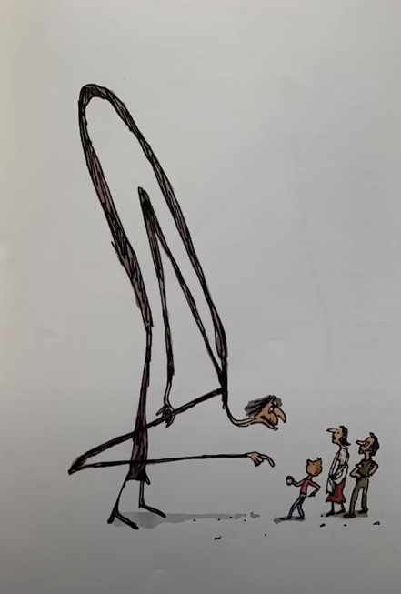

Slide 4
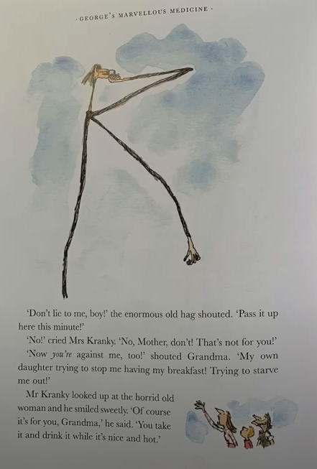
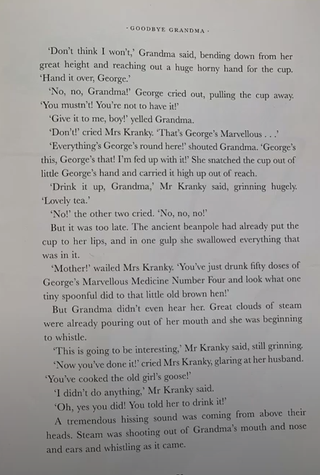

Slide 5
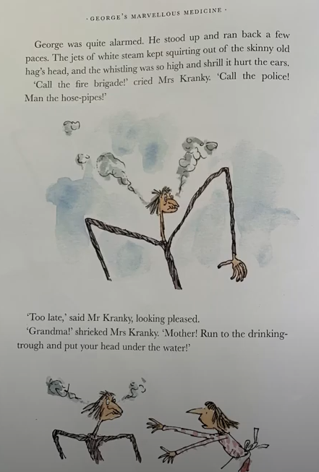
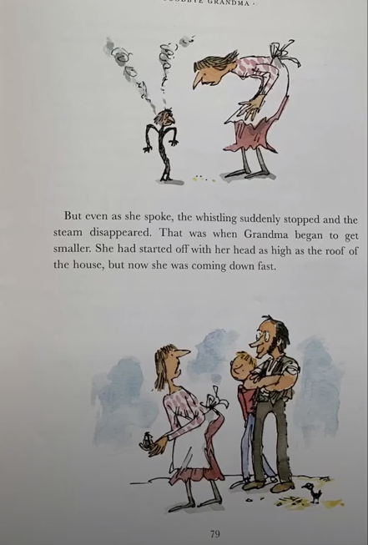

Slide 6
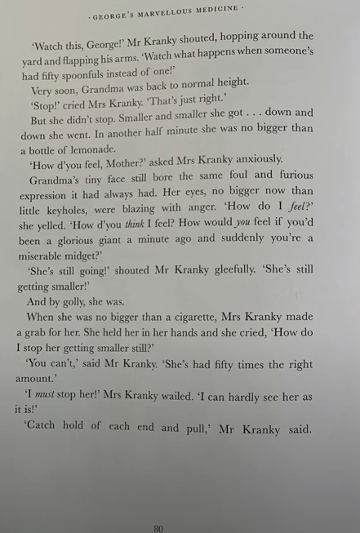
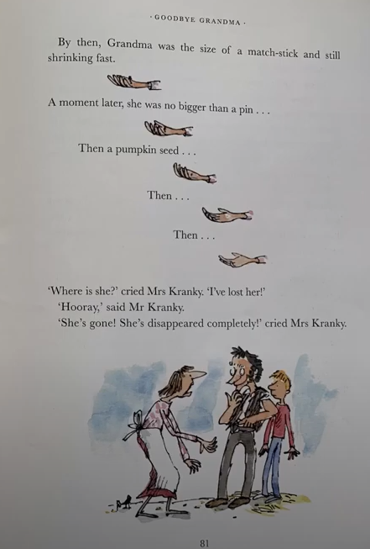

Slide 7
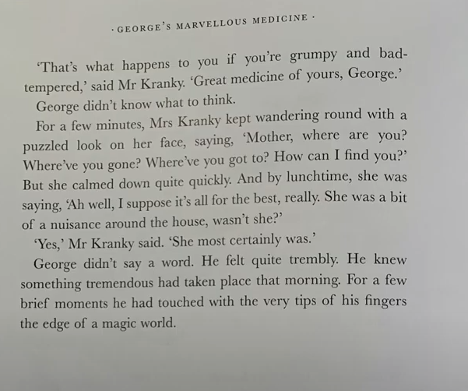
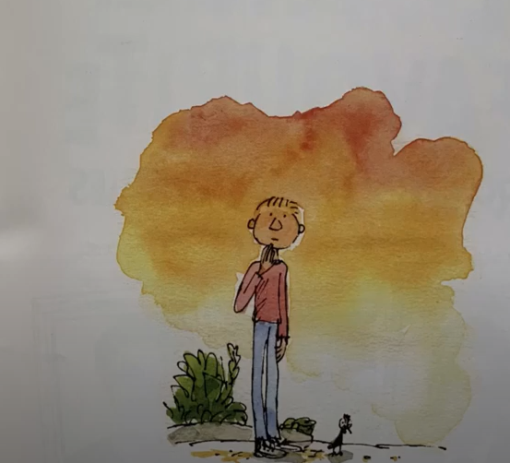

Slide 8
I’d like you to review ‘George’s Marvellous Medicine’ today for our work.
You can use the template provided or you can set it out in your own way.
I’d like you to think about:
What happens in the book.
Your opinion of the book.
Your favourite part of the book
Who else you think might like it.

