Slide 1
Wednesday 22nd April 2020
English – Writing skills/Grammar
Notes:
© Copyright Showeet.com – Free PowerPoint Templates. Photo credits: Pixabay (CC0 Public DomainFree for commercial use No attribution required)

Slide 2
Let’s warm our brains up with a quick grammar quiz.
What is a verb?
A verb is a doing word. It is the name of something you can do.
Examples: run swim sing

Slide 3
Let’s warm our brains up with a quick grammar quiz.
What is an adverb?
An adverb describes how you do something.
Examples: slowly happily cheekily

Slide 4
Let’s warm our brains up with a quick grammar quiz.
What is a noun?
A noun is the name of a person, a place or an object.
Examples: Ben table London

Slide 5
Let’s warm our brains up with a quick grammar quiz.
What is an adjective?
An adjective is a describing word.
Examples: big, shiny, colourful

Slide 6
Today, we are focusing on a skill that helps us to use description in our writing.
Today we are learning about expanded noun phrases.
Notes:
© Copyright Showeet.com – Free PowerPoint Templates

Slide 7
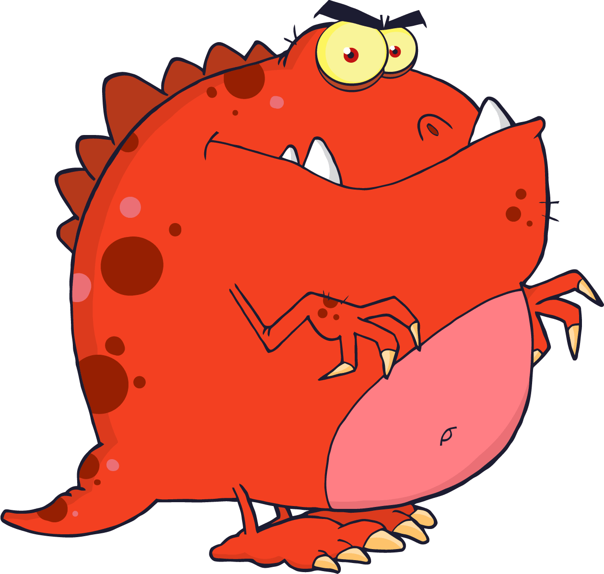
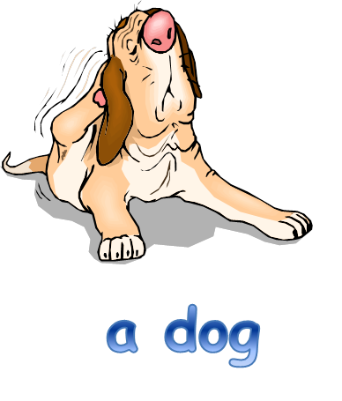
Noun phrases
Using words to describe and specify

Slide 8
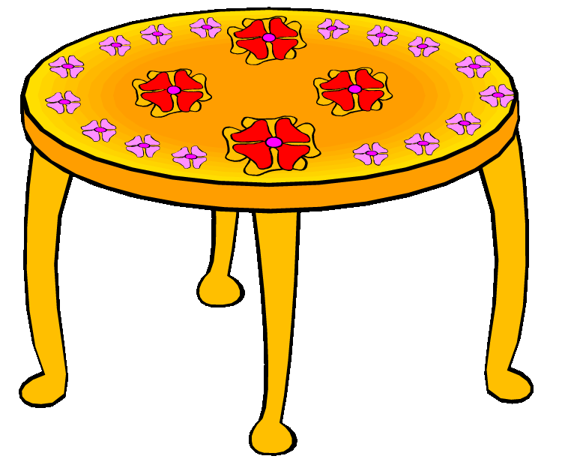
Noun phrase
A noun phrase is a group of two or more words that contains a noun but no verb to tell us what the noun is doing or feeling.
a table
the flowers

Slide 9
Expanded noun phrase
An expanded noun phrase is a noun phrase with extra details added.
Adjectives can be added to add more information:
a patterned table
the red flowers

Slide 10
Look at the pictures on the following pages and see if you can think of ways to expand the noun phrase by adding adjectives.

Slide 11
a tree
A tall tree

Slide 12
The kind lady
the lady

Slide 13
You can even add two adjectives to make the expanded noun phrase longer.
If you do this you must separate the two adjectives with a comma.
Like this….
I am a funny, red monster.

Slide 14
A stunning, yellow butterfly
a butterfly

Slide 15
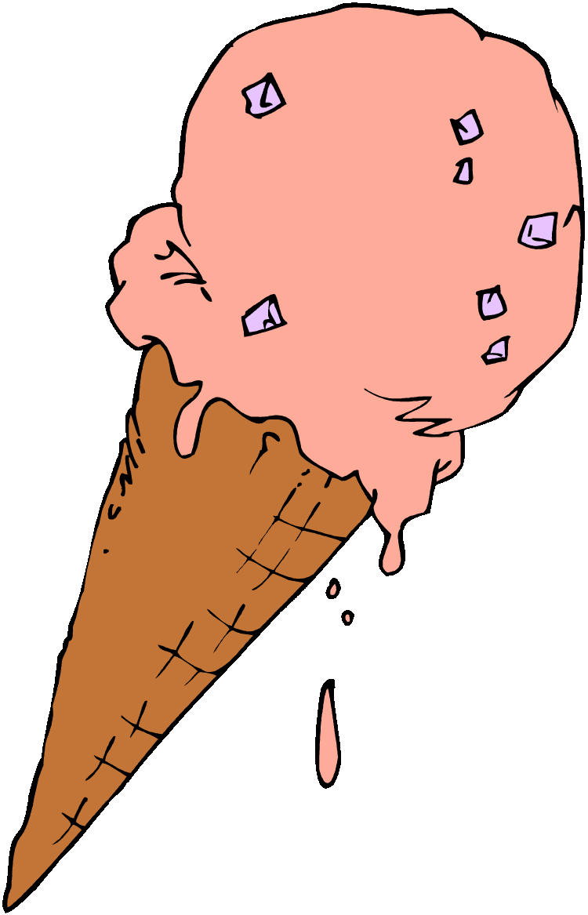
The cold, delicious ice cream
the ice cream

Slide 16
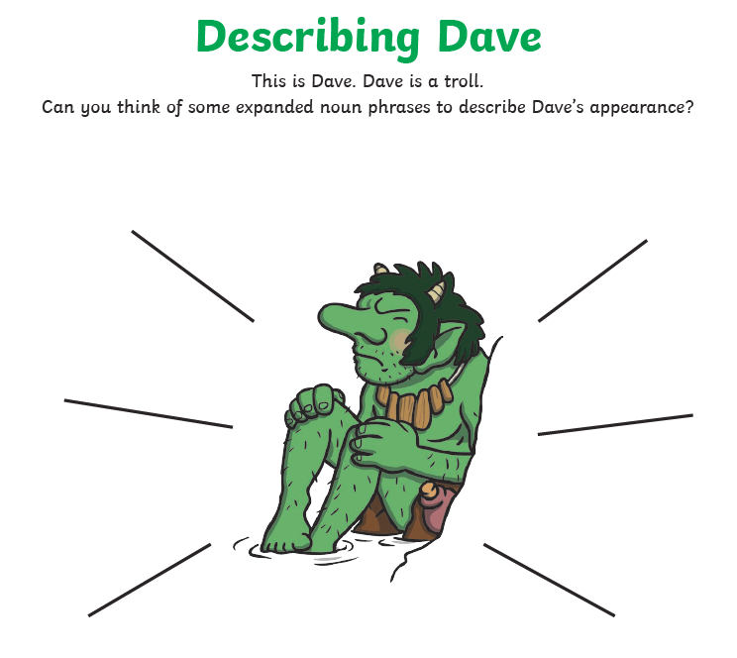
legs
clothes
teeth
breath

Slide 17
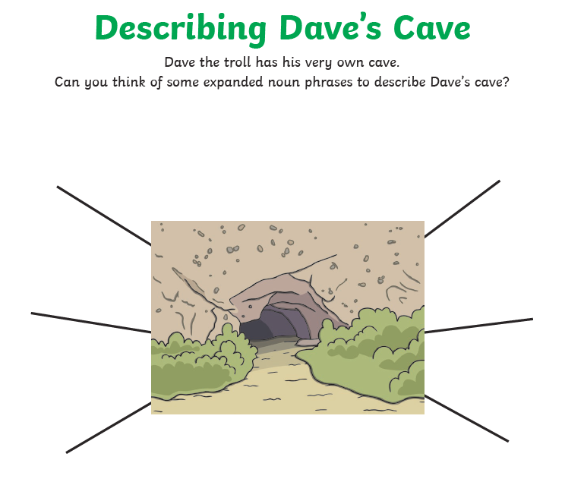
bushes
rocks
cave
mountain

Slide 18
Now, let’s use our noun phrase ideas to write 2 short paragraphs about Dave and his cave.
Paragraph 1 – Describe Dave
Paragraph 2 – Describe where he lives.
My example is on the next page.
Can you spot my expanded noun phrases?

Slide 19
Dave is a strange, mysterious creature. He is a cave troll. Like all cave trolls, Dave is a grumpy, unfriendly being. He has scaly, green skin and vicious, yellow teeth.
Dave lives in a small, dark cave underneath a tall, craggy mountain. Outside Dave’s cave there are lots of bushes with sharp, spikey thorns to keep away unwanted visitors.

Slide 20
Now, it is your turn!
Use your expanded noun phrases to write 2 paragraphs about Dave and his cave.
You could write this in your green homework book.
Self assessment
When you have finished, go back and underline all the expanded noun phrases you have used to see how successful you have been!
You could use green a pretend to mark your work like a teacher ☺

