Slide 1
^{Thursday 20th May 2020}
English - Spelling
Notes:
© Copyright Showeet.com – Free PowerPoint Templates. Photo credits: Pixabay (CC0 Public DomainFree for commercial use No attribution required)

Slide 2
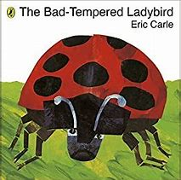
Yesterday, we learnt that The Bad-Tempered Ladybird is a Character Flaw story.
What happens in a Character Flaw Story?

Slide 3
Character Flaw
Opening | Introduce the Main Character and the situation.
Build | Character flaw is revealed
Problem | The flaw leads the Main Character into trouble
Resolution | Main Character learns a lesson and changes their ways
Ending | All is well for the future because of the change

Slide 4
You planned your own Character Flaw story. Today, we are going to write our stories using our plans to help us. My plan looked like this..
Questions to help you.
Opening | Introduce the Main Character and the situation. | The Rude Rabbit hops into the field full of carrots.
Build up | Character flaw is revealed | The friendly rabbit offers share the carrots but The Rude Rabbit wants them all because he is greedy and says he is going to fight the friendly rabbit.
Problem | The flaw leads the Main Character into trouble | The Rude rabbit hops off to find bigger animals to fight. He finds a dog, a pony and a bull. The bull flings the rabbit into the air with his horns and the rabbit lands with a thud in the carrot field.
Resolution | Main Character learns a lesson and changes their ways | The Rude Rabbit is feeling very sorry for himself. The friendly rabbit is kind and offers The Rude Rabbit some of the carrots. He says thank you and they share.
Ending | All is well for the future because of the change | The two rabbits dig a new burrow to share in the corner of the field.
Where do we first meet our character?
What is wrong with the character? How do we find out?
How does their flaw cause them a problem?
How have they changed?
How do we know the world is alright again?

Slide 5
Before we start, what Year 2 writing skills should we try and include?
What do we know about stories?
Stories need a good opening line.
We need to use interesting adjectives to describe.
We need to use conjunctions to make our sentences longer.
We need to use a range of sentence types.
We need to use the correct punctuation.
We need to think carefully about our spelling.
Be careful when character talk. Remember to split up the speech with a little action.

Slide 6
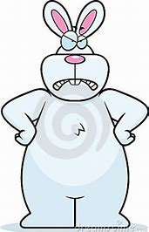
My turn….I’ve added some notes so that you can what I have done.
The Rude Rabbit
An interesting story opener.
Back in the days when animals could speak, there was
a field bursting with underground, orange surprises.
At 6 o’clock, the sun came up over the beautiful carrot field. A friendly rabbit hopped in from the left but at the same time a rude rabbit popped in from the right.
“Good morning! Would you like a carrot?” asked the friendly rabbit.
“Clear off! These carrots are mine! All mine!” screeched the rude rabbit “unless you want to fight me for them?”
The friendly rabbit looked the rude rabbit straight in his beady, mean eyes and said “If you insist”.
The rude rabbit looked a little unsure. “Oh you’re to small to fight”.
A different way to describe carrots!
Opening
conjunction
Build up
Question with a ?
Command
Added action to split up the speech.

Slide 7
“Then why don’t you go and fight someone bigger?” replied the friendly rabbit.
“I will!” growled the rude rabbit and he bounced out of sight.
At 9 o’clock the rude rabbit jumped into a dog. “Hey you! Want to fight?” he shouted.
The dog showed his sharp teeth and growled in a low, grumbly voice “ If you insist”.
“Oh, you’re not big enough!” squeaked the rude
Rabbit and he hopped off.
At 12 o’clock he sprang into a fine, white horse. “Hey you! Want to fight?” he spat.
The horse drew up onto his back legs and bucked around. His sharp, hooves ready to kick. “If you insist” he whinnied.
“Oh, you’re not big enough!” said the rude
Rabbit and he hopped off.
New line when someone new speaks.
Instead of saying he went
Described what the dog has that might scare the rabbit a little bit
Using different words for how my character moves.
Making my horse look ready to fight.

Slide 8
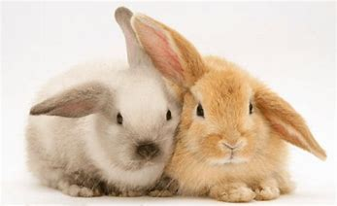
At 3 o’clock he gambolled straight into a huge, angry bull . “Hey you! Want to fight?” he screeched.
The bull charged at the rude rabbit at full speed and he lowered his long, sharp, dangerous horns. He gave the rabbit such a BIFF that he travelled over forests and over rivers and landed back in the luscious carrot field.
“Hello, you’re back” smiled the friendly rabbit. “You look sad, would you like a carrot?”.
“Yes please” sobbed the rude rabbit feeling very sorry for himself. “ I’m very sorry”.
Once they had finished a delicious feast of carrots, the two rabbits worked together to make a deep burrow that they could share. When the moon came out, they snuggled up together and went to sleep. What a busy day they’d had!
Problem
I’ve used capitals for effect like in the story.
Resolution
Ending
Exclamation sentence

Slide 9
Now, it is your turn to write your Character Flaw stories!
Tips to help us get excited about writing!
Try writing your story in little pieces. Go off, have a little break and come back to it.
If you don’t want to write using a pencil and paper, try typing your story up on a computer or a tablet.
If you want some feedback on your story, you can always send it me.

